Slide 1
Irvine royal Academy YOUTH FORUM

Slide 2
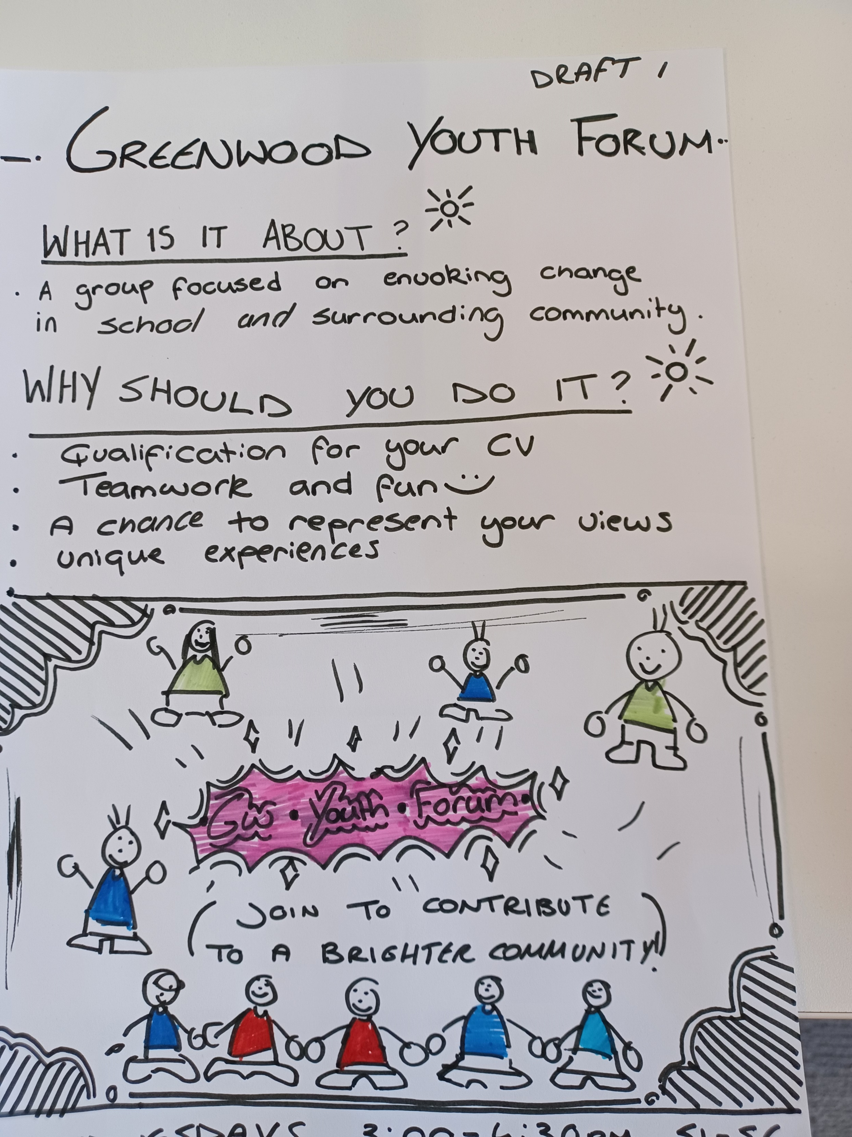
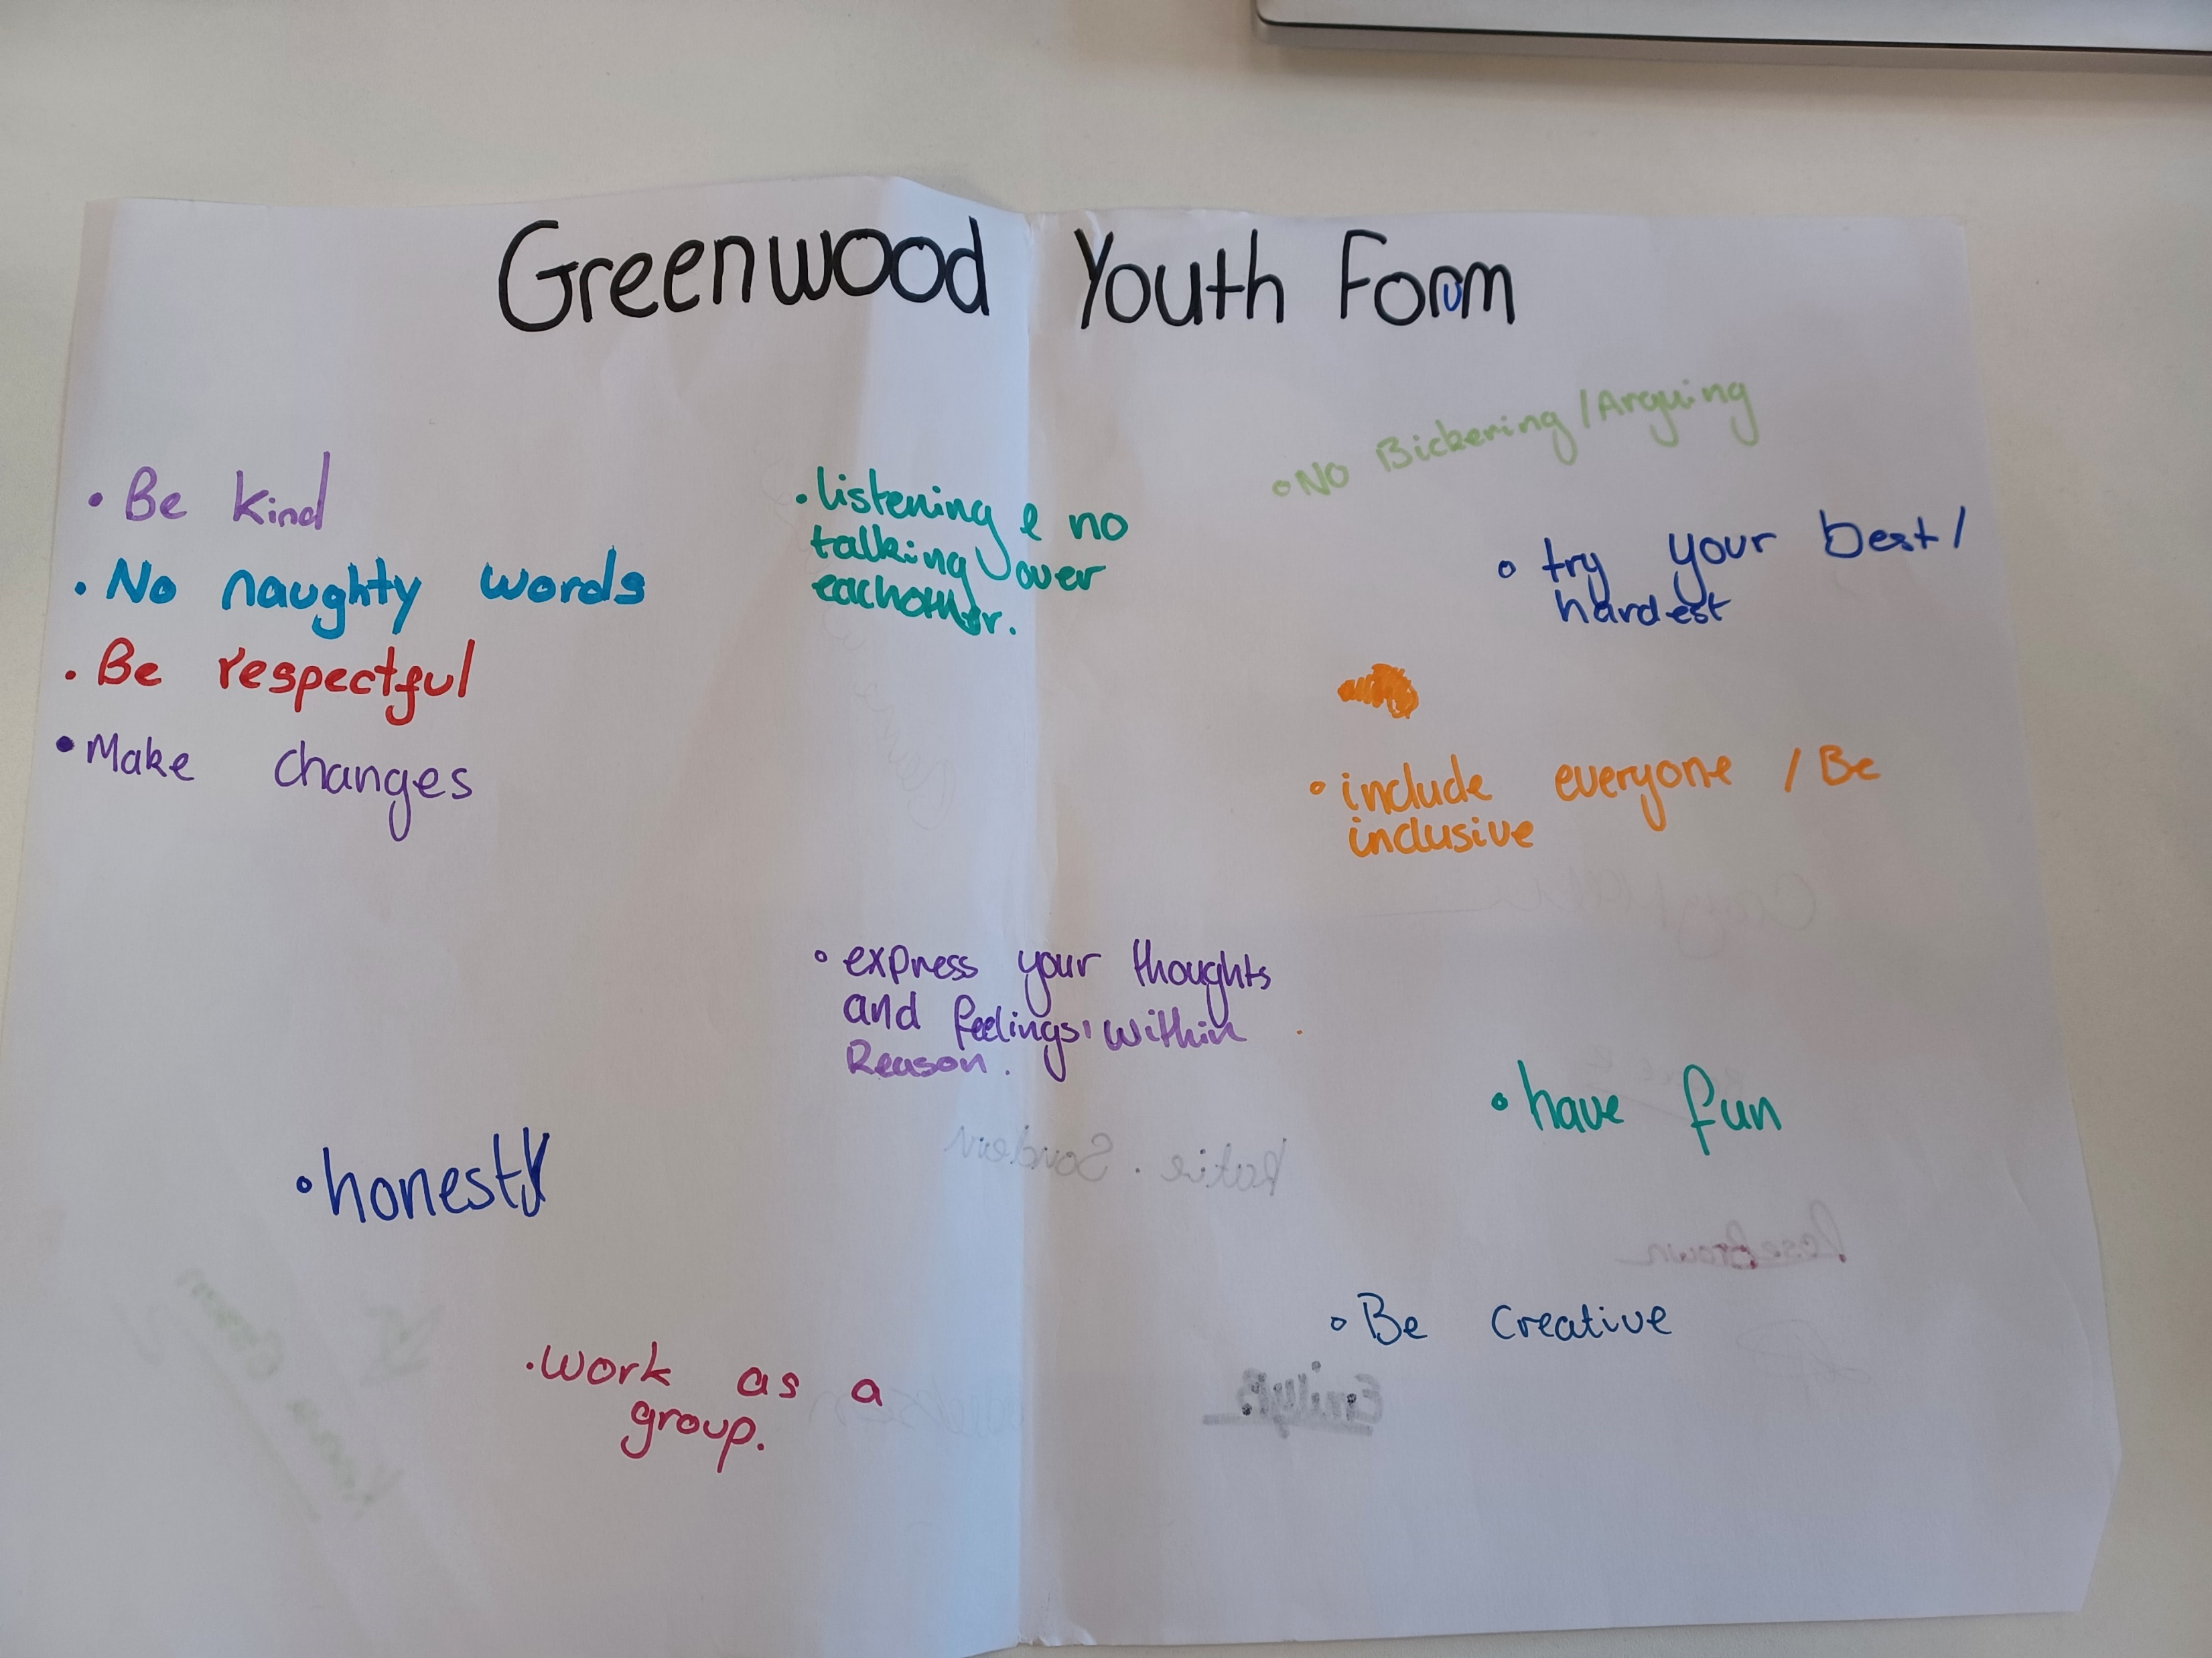
what is a youth forum?
A Youth Forum is an organised gathering of young people that come together to engage in various activities, discussions and projects within their community, This gives young people the chance to put ideas and opinions into their local area.

Slide 3
Why should I join the youth forum?
Social interaction and Networking
Youth Groups provide a platform for young people to meet and interact with others in their age group, This can lead to the development of lasting friendships.
Personal growth and confidence building
Engaging in group activities and taking on responsibilities within the group can boost self-esteem and confidence, This can be particularly beneficial for shy individuals.
CV building
Participation in a youth group can be a positive addition to a CV or college/ University/ Job application. It demonstrates a commitment to community involvement and personal development.
And lots more…

Slide 4
Here are some examples of different things that you as a young person can get involved in as part of a youth forum.
Community clean-up days
Street Art and Murals
Community Garden Projects
Public Forums and debates
Skill- Building workshops
Community surveys and research Projects
Educational workshops
Awareness campaigns
By joining the Irvine Royal Youth Forum it is an opportunity for you to put your ideas forward to make changes to your community and start up new projects that you and your peers can work on together to make a change on matters that mean most to you.

Slide 5
What does this mean for me?
As a member of the Youth Forum you will be expected to:
Attend all meetings where possible and if not give apologies.
Participate in the meetings.
Be open and honest at all times.
Respect other members opinions.
Represent the views of young people.
Represent the group at other council committee meetings where necessary.
If you have any other questions or are interested in joining please get in touch and contact Elaine Walker at elainewalker@north-ayrshire.gov.uk

