Slide 1
CAD Questions

Slide 3
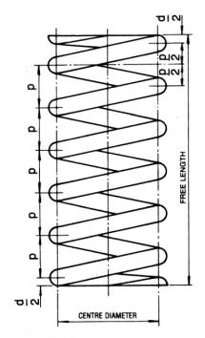
O6
20
20
20
20
20
50

Slide 4
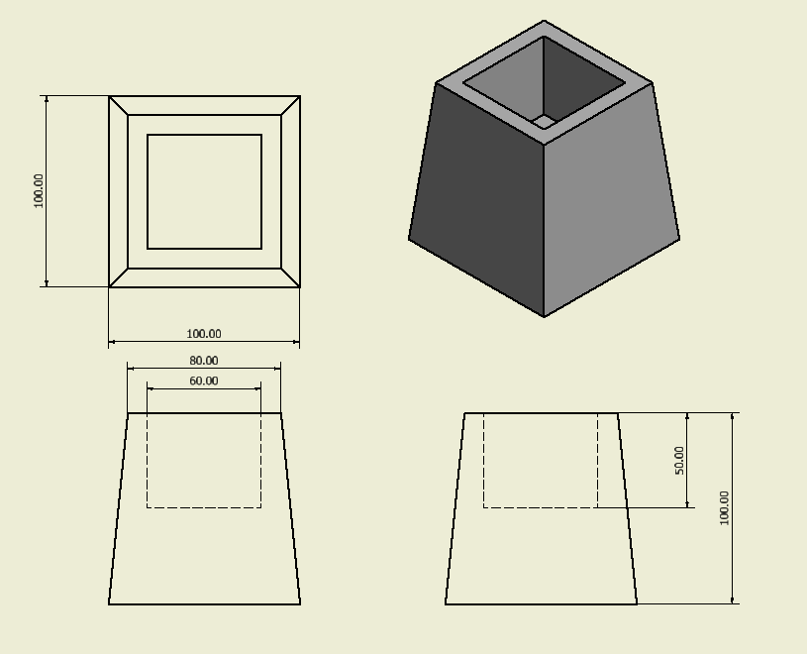

Slide 5
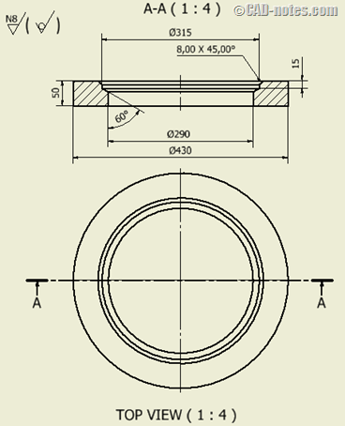
15
50
PLAN
PCD O380
O30
A
A
ELEVATION

Slide 6
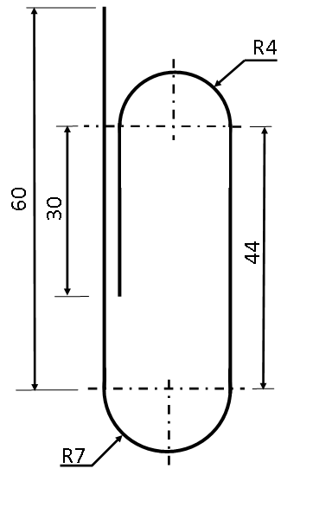

PAPER CLIP DIAMETER 2mm
R6
ELEVATION OF CENTRE LINE OF PAPER CLIP

Slide 7
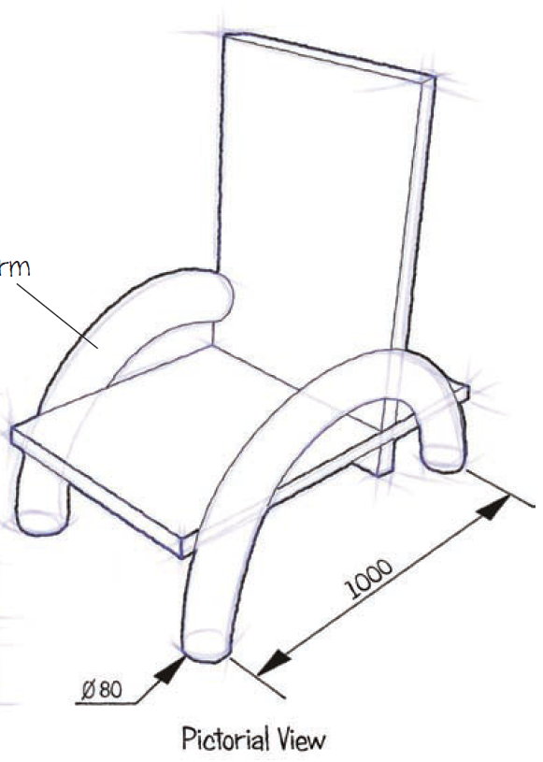
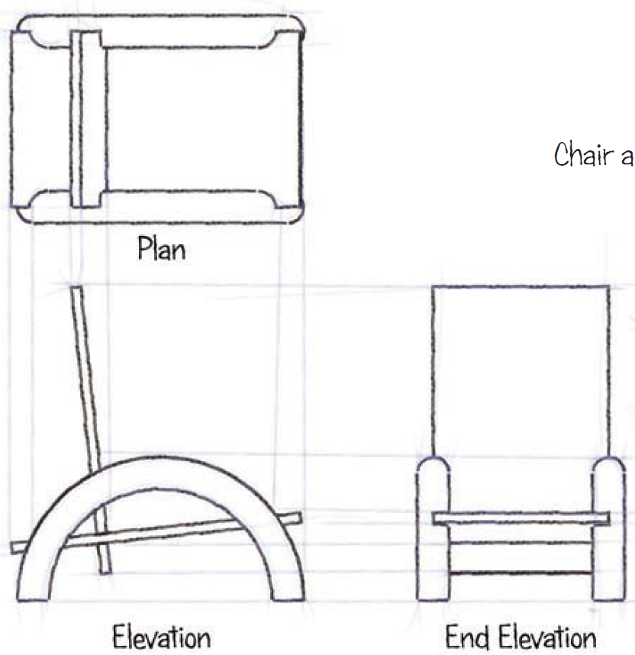

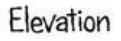
Explain how to draw one arm of the chair using CAD.
The arm of the chair follows a half oval shape,
do not show the cut outs for the chair seat to fit into.
600
1000

Slide 8
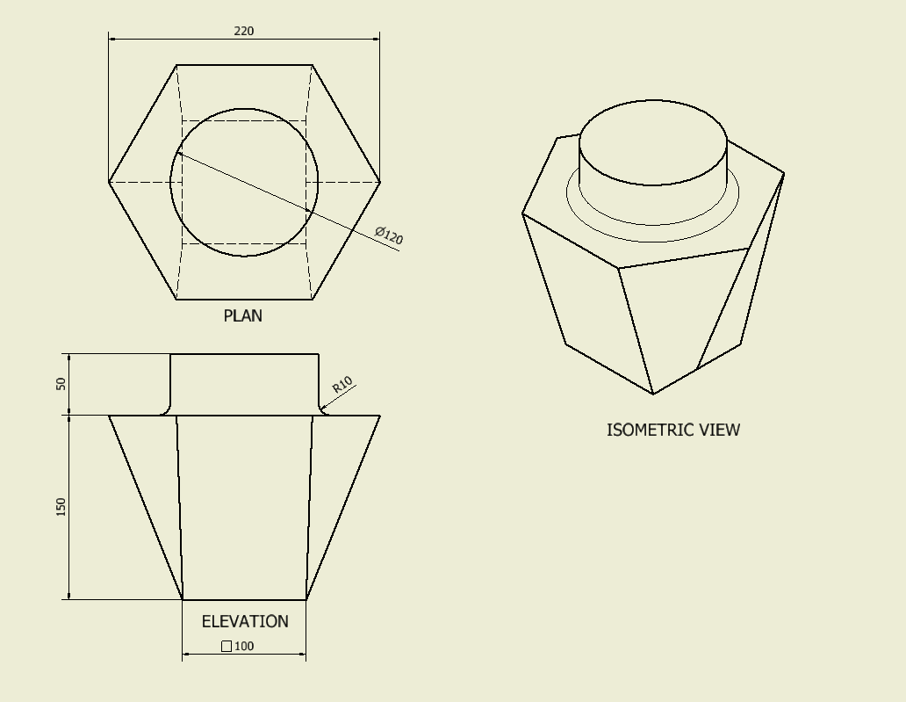
A/C
BASE IS OPEN TO CHANGE BULB
Explain how to draw the light shade using CAD.
The light shade is hollow with a thickness of 5mm and
the base of the shade is open to allow the light bulb
to be replaced.

