Slide 1
TOLERANCES
Advanced Higher Graphic Communication

Slide 2
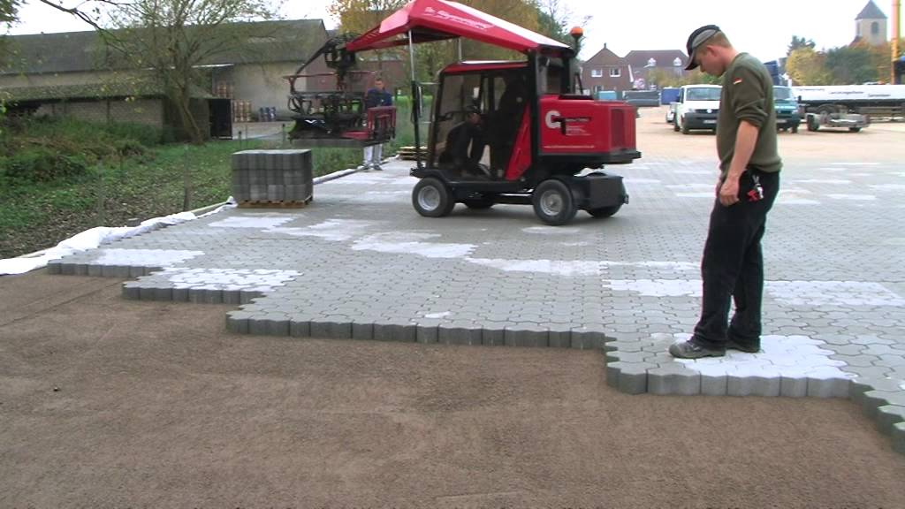
In manufacturing, tolerances in dimensions are very important.
If items are not made to a certain tolerance, then the pieces may not fit together.
Depending on the precision required for the object will affect how precise the tolerance needs to be.

Slide 3
A 20mm drill is used to make a hole in a piece of wood.
A 20mm round piece of dowel is to be inserted in the hole – will it fit?
The answer depends on tolerances.
The drill is nominally 20mm. If it is measured very precisely, it could be 20.08mm in size. Alternatively, it might be slightly smaller in size, eg 19.97mm. The latter may be due to wear and tear, the former due to the drill heating and expanding.
The stick is also nominally 20mm in size. If it was slightly smaller, it may fit in the hole. Wood can expand and shrink due to heat and moisture content, so some days it may fit, on others it might not.

Slide 4
To ensure components fit together, tolerances in their sizes are used.
Some industries, eg Space, Micro Engineering, will need very precise tolerances. Others, eg. Fence-building, may not.
In SQA exams, you will not only need to be aware of tolerances, but also be able to calculate sizes. (especially the latter!)

Slide 5
What is the Maximum and Minimum size indicated by the following dimension?
300±0.5
Answer=
300 + 0.5 = 300.5
300 – 0.5 = 299.5

Slide 6
What is the Maximum and Minimum size indicated by the following dimension?
275±0.25
Answer=
275 + 0.25 = 275.25
275 – 0.25 = 274.75

Slide 7
What is the Maximum and Minimum size indicated by A?
175±0.25
75±0.25
A
Answer=
175 + 0.25 + 75 + 0.25 = 250.5
175 – 0.25 + 75 – 0.25 = 249.5

Slide 8
Sometimes Tolerances can be irregular, i.e. they don’t have the same positive and negative values.
These are indicated thus:
125
What is the maximum and minimum size shown above?
+0.1
-0.2
Answer=
125 + 0.1 = 125.1
125 – 0.2 = 124.8

Slide 9
According to British Standards, the following dimensioning method is preferred for indicating sizes with tolerances:
275.25
274.75
NOTE:
This method doesn’t allow many exam questions, so it is not common in question papers!

Slide 10
Tolerances can also be applied to Angular dimensions (i.e. angles in degrees) or Surface Texture indicators.
Surface finishes are indicated on CAD drawings by the following symbol:
This is referred to as the machining symbol.
Numbers next to it indicate the quality of finish required, eg, how smooth it is ground.
1.6
0.4

Slide 11
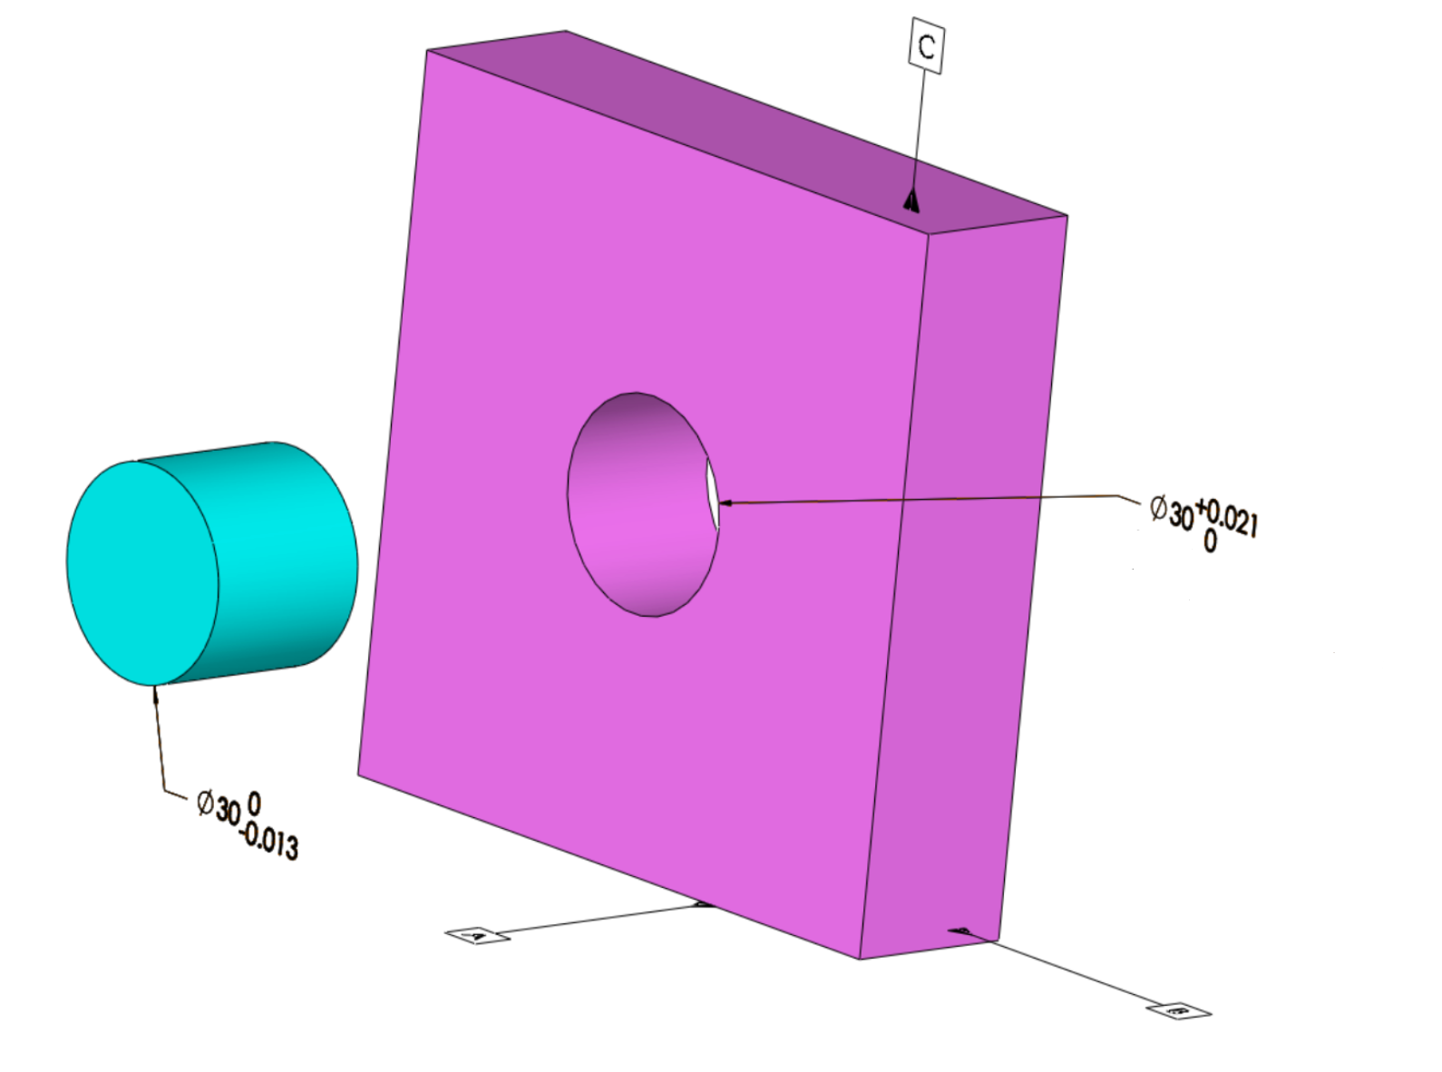
What is the largest tolerance when fitting the two items together?
What is the smallest tolerance?

