Slide 1
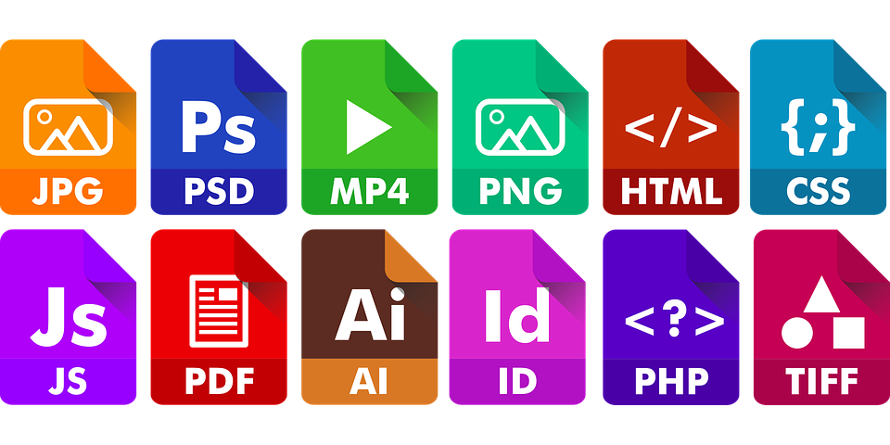
FILE formats
Irvine Royal Academy
Advanced Higher
Graphic Communication

Slide 2
HTML
Hyper Text Mark-up Language
Websites
Coding

Slide 3
PSD
Photoshop Document
Only used by Adobe Photoshop
Photography
Image creation
Raster
Large file type
Can flatten image
Layers
Pse – Photoshop Elements

Slide 4
AI
Adobe Illustrator
Only used by Adobe Illustrator
Can convert files into Vector
Image creation
Large file size

Slide 5
IDW
Inventor Drawing
Only used by Inventor
CAD drawings, made from Inventor Models and Assemblies

Slide 6
EPS
Encapsulated Photo Script
Used to be most popular filetype for print
Can contain either Vector or Bitmap images
Best for logos and illustrations

Slide 7
JPG or JPEG
Joint Photographic Experts Group
Photographs
Raster
Universal
Lossy compression
Loses quality each time it is used

Slide 8
PNG
Portable Network Graphics
Illustrations
Transparent background – shown by grey checkerboard
Expected to replace GIF files

Slide 9
Tiff or TIF
Tagged Image File Format
High Quality
Large file size
Saves alpha channel to allow transparency
Highest quality for photography

Slide 10
PDF
Portable Document Format
Can be opened with Adobe Acrobat
Difficult to edit
Used for printing
Acrobat is supplied as free download

Slide 11
GIF
Graphic Interchange Format
Images
Lossless
Can also include animations

