Slide 1
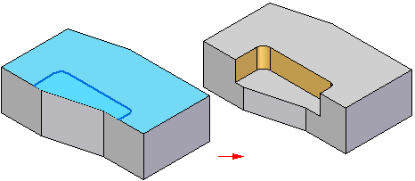
SQA Questions
Advanced Higher Graphic Communication
(SQA Exemplar Paper)

Slide 2
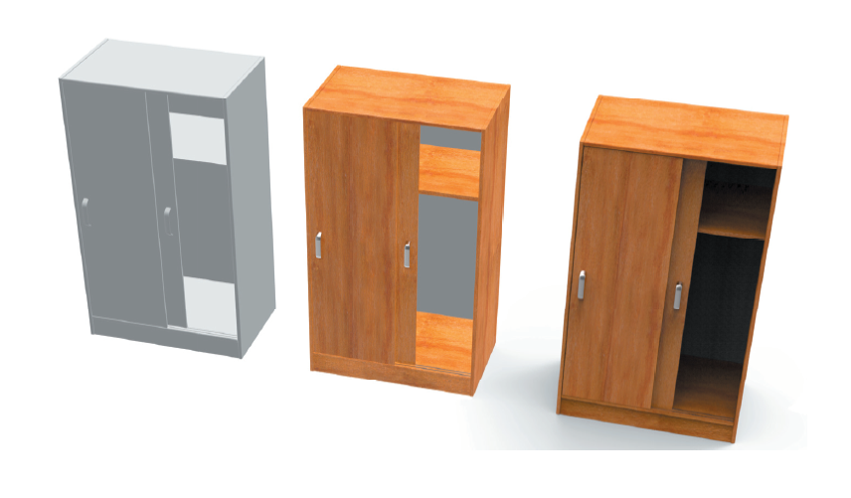
1. The stages in the creation of a realistic CAD illustration are shown above.
Three different techniques have been applied — one at each stage.
Explain the use of the different techniques applied at each stage. 6 marks

Slide 3
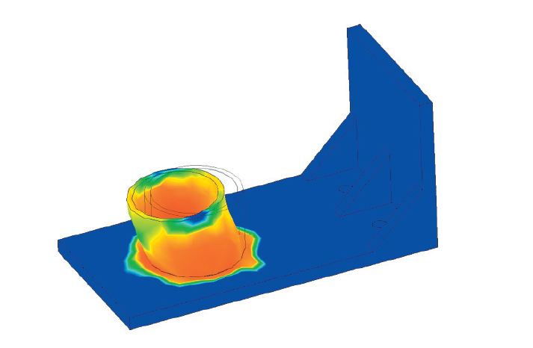
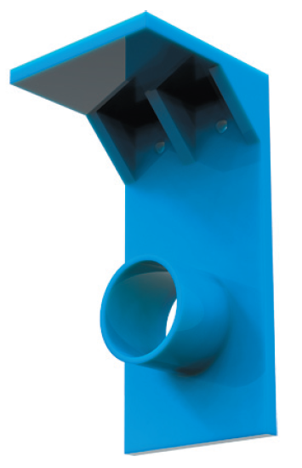
A wardrobe clothes rail bracket is to be manufactured.
A CAD technician is employed to produce a 3D CAD model of the bracket, to
enable testing prior to manufacture. The CAD technician created the 3D CAD model shown above left.
The bracket is required to hold a maximum specific load. An appropriate digital testing method has been applied to the 3D CAD model, before submitting the file for manufacture.
The simulated graphic result from the digital test is shown above right:
2. State the digital testing method applied to the 3D CAD model. 1
3. Describe four characteristics of this digital testing method. 4

Slide 4
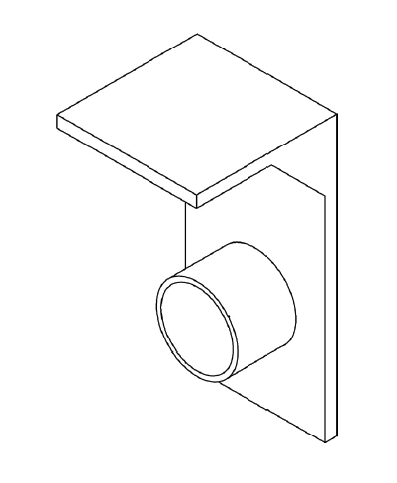
4. The digital testing method has revealed that the boss feature would fail under the required load.
Name the feature that could be applied to the boss to reinforce the component. 1
2. Sketch an improved bracket which would improve the load-bearing capacity of the bracket. You may not alter the dimensions of the boss. You may sketch upon the drawing below to support your answer. 2

