Slide 1
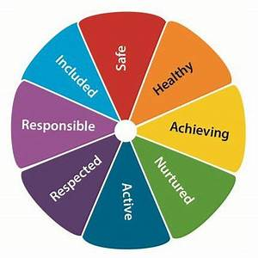
Standards and Qualities Report 2021

Slide 2
For the second consecutive school year, disruption to the continuity and delivery of learning and teaching was significant. That said, we continued on our improvement journey and made great progress in a multiplicity of areas. We are proud of our school community and its capacity to show great resilience in times of significant challenge. We are one team working collaboratively in order to get it right for every young person who comes through our doors.
Session 21/22 is a chance for us to further improve in a number of key aspects and in turn, embrace new initiatives pertinent to the world in which we live. It is an exciting time to be at the school. There is drive, energy, passion and unwavering commitment from all stakeholders. We are gathering momentum through the implementation of new systems and structures which will, in time, serve to further raise the attainment and achievement of all.

Slide 3
As we reflect on last session, I would like to take this opportunity to once again thank my pupils, staff, parents and partners. I continue to be immensely proud of the opportunity to lead this school and have every confidence that we will continue to make the required improvements that we have set out to make. I have never known a collective staff to show such compassion, empathy and kindness as they have throughout the prolonged disruption and indeed since the return of face to face learning last session. We are a school who prioritises the importance of connection and thus we will continue to ensure that nurturing, inclusive, trauma responsive approaches are at the heart of our practice across all areas of the school.
Linzie Sloan – Head Teacher

Slide 4
Vision
As a school, we believe that there is always room for further improvement, we can always do better in order to ensure improved outcomes for all members of our school community.

Slide 5
Values
We try everyday to model and promote the values of respect, responsibility and ambition.

Slide 6
Aims
We aim to:
have structures in place to ensure that all young people are safeguarded
ensure teachers are able to teach as freely as possible within a flexible timetable and dynamic curriculum
lead by example to develop and support first class teaching and learning in every lesson
bring real life into the classroom, inspiring all to take the learning beyond the four walls
make learning challenging to meet the needs of all learners, ensuring that no one is left behind
promote a ‘can do’ approach to continuous school improvement
empower all learners to contribute fully to the life of the school and to exercise their responsibilities as global citizens.

Slide 7
Staffing
Despite the staffing impact of COVID 19 across the country, we were very fortunate in that our staff attendance levels remained high and periods of absence low. Our roll has continued to increase since August 20 and is currently sitting at 753 – that said, for session 2021/2022, our staffing compliment is 56.52. We have also been given an additional 1.5 staff in order to support the ‘recovery’ agenda.
What are you going to do now?
We have recently appointed 9 internal staff into PT1 Positions funded through the Pupil Equity Fund:
PT Learning and Teaching
PT Raising Attainment
PT DYW
PT Family learning
PT STEM
PT Outdoor Learning
PT Sustainability
PT Communications
PT Data Analyst
The introduction of the aforementioned positions will support our drive to improve outcomes for all and critically, support our quest to close the poverty related attainment gap.

Slide 8
Self-evaluation
What’s working well?
In March 2021, we were involved in an NAC review. The purpose of the review was to establish the impact and effectiveness of our remote and blended learning provision.
The review had a specific focus on the following areas:
Wellbeing, Equality and Inclusion
Safeguarding
Meeting Learners’ Needs
ASN Provision/Personalised Support
Learning and Teaching/Masterclasses
Tracking/Monitoring/Interventions
Childcare Hub
Health and Safety

Slide 9
Self-evaluation
The review concluded the following as captured by NAC:
Progress and Strengths
Quality of leadership provision and recognition of this by staff
Strategic approaches to leadership including high priority placed on communication e.g. DHT attending link DM’s & weekly SLT & HT/DHT meetings
Quality of hub provision articulated by staff members including identification of appropriate supports and evidenced with pupil feedback on questionnaire
AIW & Campus Officer in hub daily to support young people
ILP continued on a weekly basis to support young people & families and included agency partnership working
Level of IT provision including the internal online IT support desk
Positive next steps indicate teachers evaluating provision and acting efficiently to benefit the wellbeing of the young people e.g. young people’s use of IT to contact PTs Support/Guidance for support (many pupils finding it a safer & easier way to make contact).
Use of baselines to recognise strengths & identify gaps in terms of provision of learning & teaching
Quality of highly effective online learning & teaching document – set out high expectations to meet needs of all young people
Informed nature of identified next steps e.g. strategic approach to feedback
Pupil Voice strongly heard e.g. in focus groups in Social Subjects & RME faculty. This informed strategies to increase engagement. Similarly, Creative Arts adapted provision and used smaller tasks based on pupil feedback.

Slide 10
Self-evaluation
Focus on skills development as an important factor in learning provision
Equity of provision a key consideration across the school - measures implemented to address this
Clear & thoroughly deliberated evaluation of Leadership & Integrated Support
Flexible approach to accommodate family circumstances appreciated by parents
Quality of Professional discussions e.g. the definition of pupil engagement, patterns identified & themes to take forward as face-to-face learning fully resumes
TMI Policy sets out clear expectations and responsibilities for all staff
GROW model is valuable process to aid learning discussions with young people
Use of EEF strategies – interventions are refined as a result of data
Focus on impact of digital literacy as we progress
Key leader focusing on health & safety for all
Learning provision for young people out with traditional school time e.g. night school, Easter holidays. Again, importance of pupil voice was clear

Slide 11
Overall
“In terms of strategic themes, leadership across the school is strong. There were clear strategic messages around the significance of open and honest evaluation, evidence to inform next steps and a consistent approach to ensure pupils were cared for and encouraged to achieve their potential”.
NAC Senior MANAGER – 31.3.21

Slide 12
Attainment and Achievement
2020 – Presentations
= 839
2021 – Presentations
=855
Level | No of presentations | A-C Number | % of Awards | A-D Number | % of Awards
AH | 25 | 24 | 96% | 25 | 100%
H | 219 | 147 | 67.12% | 195 | 89.04%
N5 | 596 | 390 | 65.44% | 513 | 86.07%
Level | No of presentations | A-C Number | % of Awards | A-D Number | % of Awards
AH | 15 | 11 | 73.33% | 13 | 86.67%
H | 311 | 259 | 83.28% | 289 | 92.93%
N5 | 529 | 374 | 70.70% | 456 | 86.20%
Year Group | Level | Presentations | A-D Number | % of Awards
S4 | N5 | 435 | 396 | 91.03%
S5 | N5 | 123 | 89 | 72.36%
S5 | Higher | 140 | 125 | 89.29%
S6 | N5 | 38 | 28 | 73.68%
S6 | H | 78 | 69 | 88.46%
S6 | AH | 25 | 25 | 100%
Year Group | Level | Presentations | A-D Number | % of Awards
S4 | N5 | 382 | 338 | 88.48%
S5 | N5 | 101 | 78 | 77.23%
S5 | Higher | 219 | 202 | 92.24%
S6 | N5 | 46 | 40 | 86.96%
S6 | H | 92 | 87 | 94.57%
S6 | AH | 15 | 13 | 86.67%

Slide 13
Attainment and Achievement
The prioritisation of high level personal support is a critical factor in raising attainment and achievement. Our systems and structures within an support context have been revised in order to better meet pupil need whilst in turn ensuring the fulfilment of statutory requirements.
Last session, the Support Team put in place 349 Alternative Assessment Arrangements (AAA) - this is an increase of 194 from the previous session – the introduction of Departmental Ambassadors is a critical factor in ensuring that all young people, across all subjects, get the arrangements suited to their individual needs.
Our in-house TRT intense reading programme has had a significant impact on the reading ages of our young people across all stages of learning – on average, those involved, have improved their reading aged by 2.5 years.

Slide 14
Attainment and Achievement
Continued refinement of our tracking, monitoring and interventions system is a critical component of our 2021/2022 maintenance agenda. We are committed to improving on the attainment from last session and thus our interventions spreadsheets have been further streamlined by our Data Analyst in order to ensure ease of access and enhanced levels of impact.
Early and effective intervention to support attainment and achievement is key and thus in order to ensure that all young people are given the best chance to succeed, we will issue tracking reports at the following times:
Senior Phase:
5/10/21
30/11/21
22/2/22
BGE:
25/10/21
14/3/22
We have continued to review and expand upon our curriculum offering in order to ensure that it better meets the needs of all learners – this year, our offering includes: bike maintenance, nail bar, barista, lab skills, practical electronics, music technology to name but a few skills based courses that we have introduced.

Slide 15
Positive Destinations
It gives me great pleasure to share that our positive destination data continues to go from strength to strength.
We were the only school in North Ayrshire to show an improvement in our data last session – 96.1% of our pupils went on to a positive destination – the NAC average was 92.4% and the National Average was 93.4%. We will look to build upon this even further and continue to aim to have 100% of our young people leaving us to go into a positive and sustained destination.
We remain eternally grateful for all the work carried our by our in-house SDS team – their support of our young people and their strong partnership working with our Integrated Support team continues to pay dividends.
Last session, 26 young people applied to University through the UCAS process, this year we have 36 applicants. This example serves to elucidate the enhanced aspirations of our young people – they are now developing the confidence in their own ability and are showing the kind of ambition that they should be.

Slide 16
Learning and Teaching
Last session we updated our learning and teaching guidelines to include digital learning due to the increased use of Google classroom/Microsoft Teams – this year we are working towards achieving our ‘Digital Schools Award’.
Staff engagement in professional learning last session was exceptional – the appetite to learn and improve pedagogy on the digital platform was second to none. Never has there been a time where collaboration and the sharing of good practice been higher.
Professional Learning engagement via virtual local and national inputs and our learning and teaching Google Classroom continues to gather momentum – an in-house CLPL programme has been created for staff to participate in. In addition, we will be working in close partnership with the Professional Learning Academy this session - a particular focus will be on literacy and numeracy.

Slide 17
Health and Wellbeing
Our House Team around the child meetings continued on a weekly basis - weekly updates were and still are issued to all staff.
Our support of pupils who required enhanced contact during remote learning was of a high standard. Members of the Integrated Support team used mobiles and email to check in with identified young people at regular intervals. PTs Pastoral facilitated weekly wellbeing check-ins with all pupils.
Pupils who were part of our Inclusive Learning Programme (ILP) continued to attend school throughout the period of remote learning – the need was significant and thus the daily contact allowed us to ensure that said pupils were safe and well – this was the priority.
During the delivery of our Childcare Hubs, we introduced wellbeing walks – we have continued to build wellbeing walks into our curriculum in order to promote the importance of positive mental, emotional and physical health.
We continue to be committed towards developing an ethos and culture with positive relationships at the core. Our existing ‘Promoting Positive Relationships’ policy continues to evolve - stakeholders have a key role in any adaptations made.
Our breakfast provision has been tweaked in recent months – pupils now collect a snack and a drink from their entrance points in the morning – members of SLT are on hand to supervise and to meet and greet the young people.

Slide 18
Health and Wellbeing
‘Wellbeing Wednesday’ was introduced on the back of staff and pupil consultation. Members of our Health and Wellbeing Faculty delivered weekly fitness inserts for staff and pupils were set weekly challenges – our social media profile to promote said activities was high.
Our ‘Royal Resources’ initiative has served to support a number of families over the last year. Through on-going support from our Parent Council and local supermarkets, we have been able to provide uniform, toiletries and home washing products for those most in need.
Weekly wellbeing check-ins were timetabled during all PSHE classes.
Our in-house engagement trackers was colour coded to indicate where there was a wellbeing need.
On our return from remote learning, our ‘Choc and Talk’ inserts ensured that we had a sound understanding of how all pupils were feeling – this allowed us to thereafter put effective support interventions in place.
Our Sports Leaders played an integral role in the school last session – where able, they delivered extra-curricular clubs, supported Primary Challenge Days and facilitated at Primary Sports Days and events.
Staff wellbeing has always been at the forefront of our thinking – we were able to gage this through our staff wellbeing survey –our ‘Staff Buddy’ initiative and ‘Hug in a Mug’ insert was well received. Staff successes and achievements continue to be recognised through the HT Excellence system and our HT weekly staff bulletin.

Slide 19
Inclusion
We are fully committed to inclusion in all forms – this includes digital inclusion. Last session, we ensured that all learners at all stages of the learning journey had access to IT.
Pupil attendance continues to be a main priority within the school, the last year has shown improvement in this area for the second year in a row:
Exclusion is the last resort for all young people – our reflection and reset arrangements support our aim of ensuring that all profiles of learners remain a part of our school community.
Historically, Irvine Royal Academy’s exclusion data has been significantly higher than the North Ayrshire average and indeed the National average – for the second year running, we were significantly below the North Ayrshire and National average. We are committed to focusing our efforts on alternatives to exclusion – our integrated approach towards supporting young people sits at the heart of this.
1/8/2019 – 3/9/2019 | 87.72%
1/8/2020 – 3/9/2020 | 90.06%
1/8/2021 – 3/9/2021 | 91.88%

Slide 20
Leadership
Last year, our Senior Pupil Leadership Team continued to drive forward school improvement, despite the challenges they faced. They led a number of charities events and their ‘Day of Kindness’ was a great success. They played in integral role in the delivery of the breakfast provision made a significant impact on our internal and external school community. They were visible in their respective roles and made a fantastic contribution to the development of a positive ethos and culture.
We have elected our new 2021/2022 Senior Pupil Leadership Team and they have formulated a clear Improvement Plan for this term which will sit alongside our School Improvement Plan. In addition, we have also introduced and Extended Pupil Leadership Team this session – said members have responsibility for driving key areas: Transition, Mental Health, Sport, ASN…
The expansion of the staff Extended Leadership Team through the introduction of PEF has served to further develop capacity at all levels – the additional members are key to driving forward our strategic plan for this academic session.

Slide 21
Professional Learning
Our staff show a real commitment to professional learning through engagement in Coaching, Mentoring and Facilitation.
We have a number of staff who are undertaking Masters qualifications.
Last session, we worked collaboratively with the Professional Learning Academy and we have signed up to a number of learning events this session.
Last session, we scheduled facilitated inputs with North Ayrshire Council’s Leadership Team for both our SLT and our PTs Guidance – inputs of this nature will be introduced into other Faculty areas.
We have developed our own “in-house” CLPL twilight sessions again this session.

Slide 22
Integrated Support
Our Integrated Model of Support continues to go from strength to strength.
The various support services based in the school work collaboratively to ensure that all young people get the right help at the right time – this is inclusive of our Nurture, Barnardo’s, ILP, MCR, Area Inclusion and Attainment and Inclusion provision.
The move to a House system has proven to be effective - the weekly ‘House Team’ sharing of information to all staff has had a significant impact – lines of communication are open and thus young people are effectively supported.

Slide 23
Partnerships
We have always been well known for having positive partnerships with stakeholders – we have an open door policy and are receptive to feedback to ensure further improvement. We expanded this even further last session and engaged in regular Irvine Royal Cluster partnership meetings. As it stands, nearly 25 internal and external partners support the wellbeing of our young people across the Irvine Royal Cluster. We have worked hard to produce standard paperwork to ensure a consistency of approach and created a service directory in order to raise awareness of potential interventions.
Engaging families in Family Learning activities continues to be a main priority. For the second consecutive session, we have Laura Landon and Mr Muirhead continues in the role of PT Family Learning. Last session, our focus was on: Mental Health, decision making, subject tasters (digital support). The evaluation data showed that 100% of those families who engaged felt that the interventions had a positive impact on the key areas addressed.
Parents in Partnership will continue to feature highly on our agenda this year. In turn, term one will see a focus on literacy and numeracy and term two will prioritise STEM work.
We are grateful to the excellent work undertaken by our Parent Council again last session – their commitment to fundraising and grant applications helped the school to give out free school uniform items and significantly reduce the cost of the school day for some families. We look forward to the continuation of a positive partnership with our Parent Council as its membership continues to grow – a special thanks to our new Chair, Lynsey Leckie, who takes over from Sally Anne Robertson.

Slide 24
Transitions
Our transition provision did not happen the way we had hoped last session(it was obviously out with our control) – this meant that many of our S1s did not get the support that they should have as part of an effective transition programme – we did however have them up in their school bubbles, where we could. That said, we have ensured high levels of support in term one of this session – enhanced transition nurture provision is one such example .
This session we will prioritise transitions at all levels and ensure key information is shared at all stages. We have already shared the transition and enhanced transition programme schedules with the Primaries and will be hosting a P7 Open Event at the end of this month.
Enhanced partnership working with Ayrshire College will ensure that pupil needs are more effectively met at the point of transition from school and into a positive destination – this will include intervention and support from our Nurture staff, where appropriate.

Slide 25
Around the departments…
ILP – All young people in the ILP last session achieved a minimum of 5 qualifications.
Sphere – Development of the Key Adult programme to ensure enhanced levels of support, where required.
Health and Wellbeing – Huge increase in the use of digital technology, within the class and at home – leading to improved learning and teaching experience. Social media presence throughout the year to share pupil success was significant.
Pupil Support – Expansion of curricular offering to include: JASS groups and Duke of Edinburgh.
Social Studies and RME – Increased number of ’A’ grades and increased number of presentations in most subject areas.
Maths, Numeracy and Computing – Expansion of curricular offering to include: NPA in Computer Games Development and Applications of Maths.

Slide 26
Around the departments…
Creative Arts – Course plans have been updated for all subjects and levels within the Faculty – this has allowed for greater streamlining of tracking processes. 100% of pupils presented achieved N5 - Advanced Higher ‘A-C’ awards.
Science – Expansion of curricular offering to include Laboratory Science and Practical Electronics. Pupil voice is at the of course planning and delivery.
English, Literacy and Languages – The relative value compared with other subject continues to raise attainment across the school. 97.9% A-C pass rate at N5, 93.4% A-C pass rate at Higher and a 100% A-C pass rate at Advanced Higher.
Technical Education – Almost all pupils in the Senior Phase showing progression. Three years of improvement in Higher Design and Manufacture – increasing number of N5 ‘A’ passes Graphic Communication over the past three years.

Slide 27
Highlights
‘Great British Bake Off’
‘Easter Cake Challenge’
‘Chef of the Week’
‘Five Star Friday’
‘TRT ‘intervention
Social Butterflies
‘Action on Sectarianism’
‘Lessons from Auschwitz’ participation
‘Royal Readers’ initiative
Wellbeing Wednesday – live fitness sessions
House Badge Competition

Slide 28
Highlights
‘Live Literature’ events
Virtual Christmas Concert
Successful Participatory Budget bids
ABRSM Theory exams
Royal Recognition Awards
Rotary Competition: Young Photographer/Young Artist/Young Musician/Young Writer
RSA Schools Art Award
LSM Musical Theatre Exams
‘Raven’ Magazine
‘Fork in the Road’ podcast
Scotland Day – to celebrate the National Football Team getting to the Euro Finals…
‘Wear a Hat’ Day

Slide 29
Priorities 2021/2022

Slide 30
Maintenance Agenda 2021/2022
Attendance
Attainment and Achievement
Family Learning/Engagement
Transitions/Positive Destinations
Curriculum expansion including IDL
Pace of learning/Starters/LIs/Plenaries/Differentiation/Planning
Feedback
Moderation including BGE and Senior Phase
Evidence gathering at all levels
PPR
Tracking, Monitoring and Interventions
Integration of Support provision
Staged Intervention
Wellbeing Planning
Staff and Pupil Wellbeing
ASN Provision including AAA
Pupil Voice
Whole School Staff/Pupil Leadership

Slide 31
Self Evaluation Ratings
Quality Indicator 1.3 – Leadership of Change – 4/5
Developing a shared vision, values and aims, strategic planning for continuous improvement, implementing improvement and change
Quality Indicator 2.3 – Learning, Teaching and Assessment – 4/5
Learning and engagement, quality of teaching, effective use of assessment, planning, tracking and monitoring
Quality Indicator 3.1 – Wellbeing, Equality and Inclusion – 4/5
Wellbeing, fulfilment of statutory duties, inclusion and equality
Quality Indicator 3.2 – Attainment and Achievement – 3/5
Attainment in Literacy and Numeracy, Attainment over time, overall quality of learners’
achievement, equity for all learners

Slide 32
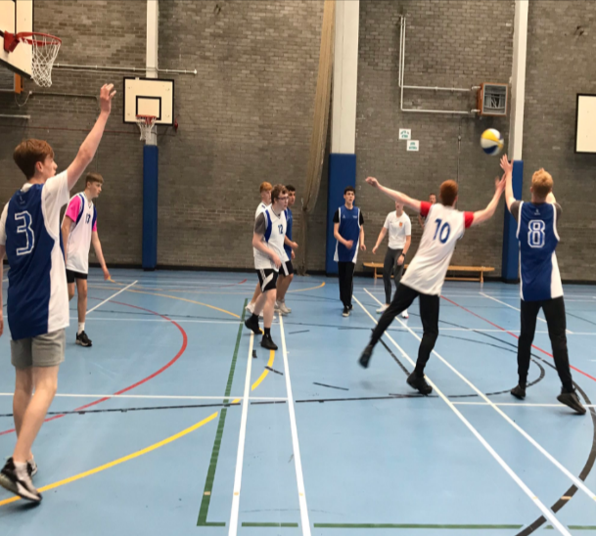
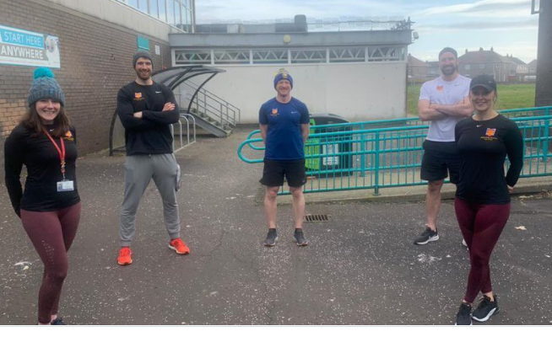
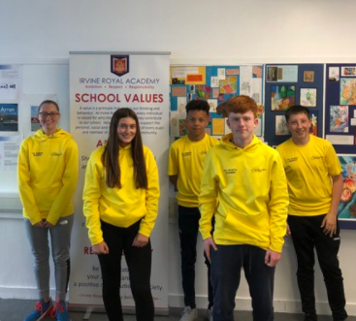
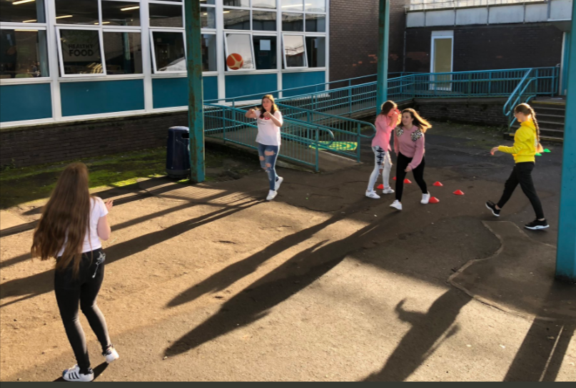
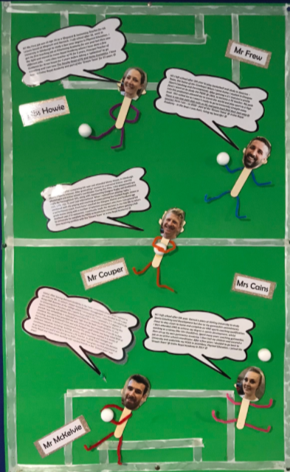
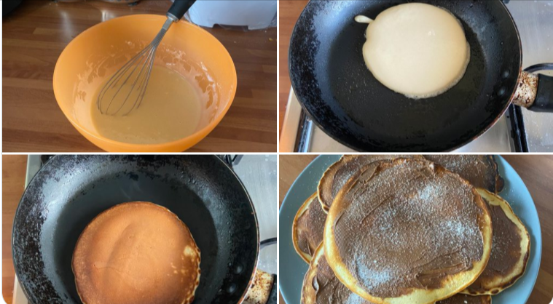
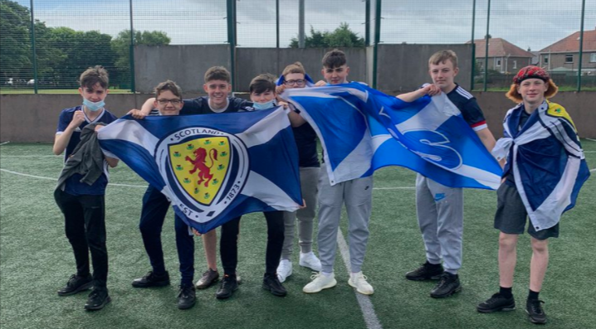
Photo Gallery

Slide 33
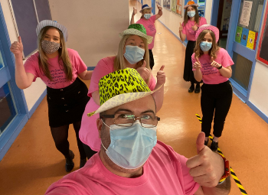
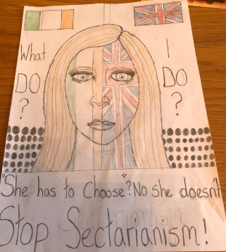
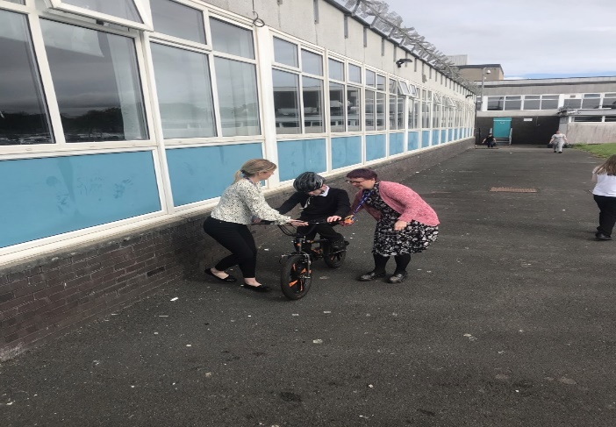
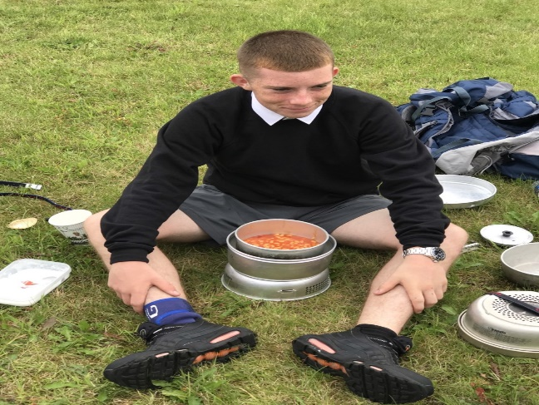
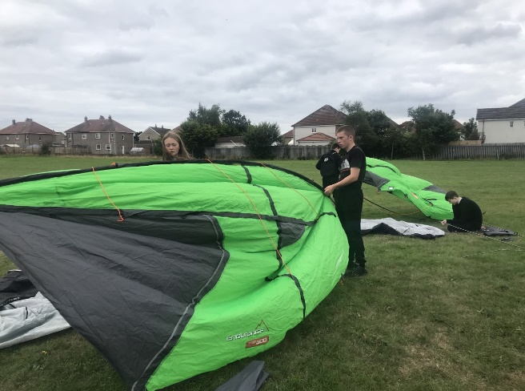
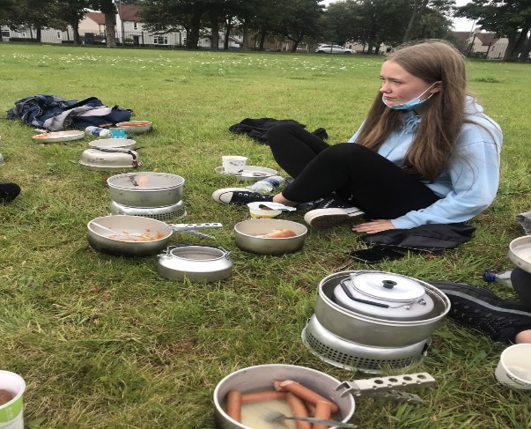
Photo Gallery

Slide 34
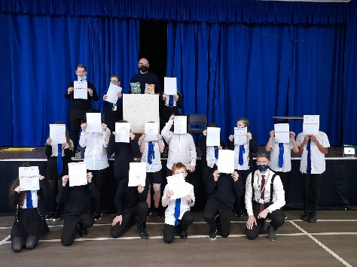
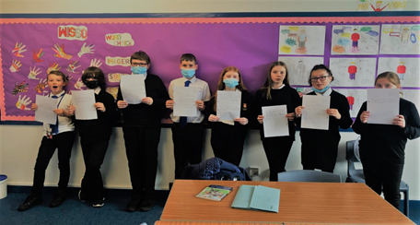
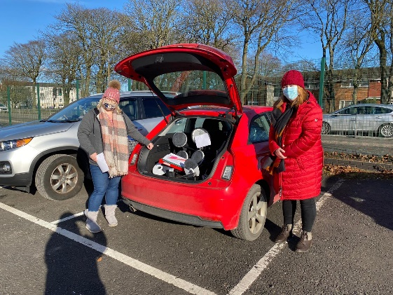
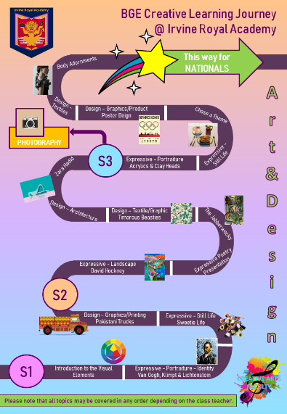
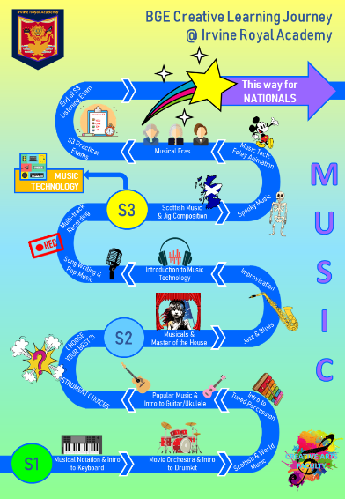
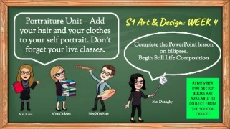
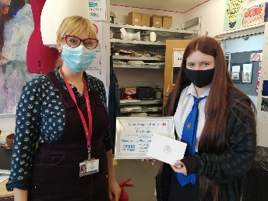
Photo Gallery

