Slide 1


Protecting and Safeguarding North Ayrshire’s Children
August 2022 – June 2023
Notes:
The pupil census in 2021 gives North Ayrshire’s primary school roll as 9,642 and secondary school roll as 8,080 pupils, and there are 200 pupils attending ASN schools. Of the pupils on the school rolls, 5,864 (31%) have an Additional Support Need.
28.8% of North Ayrshire population are significantly above the Scottish average for deprivation.

Slide 2



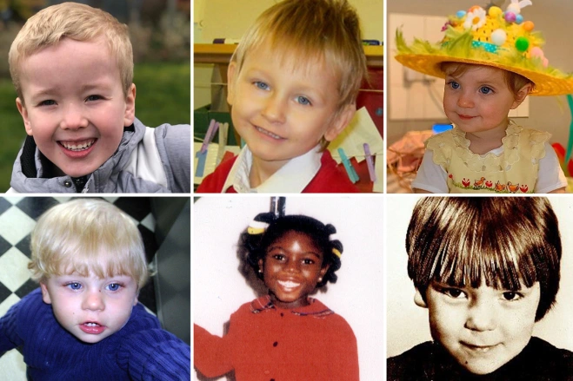
Notes:
Many families will be under extra stress during the current period of austerity and increased poverty and there are real concerns that vulnerable children may be at even higher risk.
All North Ayrshire staff have an essential role to play a part to keep our children safe from harm. It’s more important than ever that we all keep our eyes and ears open.
If you see or hear something that doesn’t sound right, take action. If you’re at all concerned about a child’s welfare, do something – doing nothing is not an option. Everyone can help keep children safe.
What do we do?
If you are concerned about the immediate safety of a child or young person, please contact:
01294 310300 (Monday to Thursday 9.00am to 4:45pm and Friday 9.00am to 4:30pm)
Out of hours service on 0800 328 7758
If the child is in immediate danger contact the police by telephoning 101 or in an emergency 999
Worried about a child?
DOING NOTHING IS NOT AN OPTION
YOU MUST FOLLOW North Ayrshire Council Child Protection GUIDANCE that is to follow:
Talk to your establishment CP Co-ordinator or Childcare Hub Manager/Supervisor if you have concerns.
A few cases from the past
Maria Colwell's death sparked a national outcry
Tragically, she couldn't be saved and was declared dead on January 7, 1973. Maria's death became a watershed moment for child safety in the UK- triggering major changes to how the authorities tackle child abuse. It emerged in her final 15 months, neighbours and teachers had repeatedly shared their concerns at Marie's wellbeing to social services. At the time of her death, she was under the supervision of the local authority in Brighton, who had visited her home on more than 50 separate occasions.
Victoria Climbié was tied up and made to sleep in a bathtub. She was tied up for 24 hours a day and forced to sleep in a bin liner filled with her own excrement in a bath tub after the severity of her injuries rendered her incontinent. Victoria was also branded "Satan", burned with cigarettes and a hot tap, made to eat food like a dog and hit with bike chains, hammers, coat hangers and shoes.
Concerns were first raised in July 1999 when her babysitter's daughter suspected she was suffering from non-accidental injuries. She was taken to hospital but a doctor accepted Kouao's lies that Victoria was scratching at scabies sores. Medics did alert child protection authorities as a precaution but social workers cancelled a home visit. Eventually, Kouao stopped taking Victoria to hospital and instead turned to churches for her injuries - claiming the youngster had "demons" inside her. During this time, she called Haringey social services and said Manning had been sexually abusing Victoria before withdrawing the claim the next day. Social workers visited the home three times but after getting no answer, wrongly assumed Kouao had moved to France. They closed the case on February 25, 2000 - the day Victoria died. The girl was rushed to hospital suffering from hypothermia, weighing just three stone and 10 pounds and suffering 128 injuries. She died soon after and Manning and Kouao were caged for life after being convicted of murder. A public inquiry became the first in Britain to use special wide-ranging powers to look at everything from the role of social services to police child protection arrangements. It found there 12 occasions when the system could have intervened and potentially saved Victoria's life.
Baby P
Arguably one of the notorious child abuse deaths, Peter Connelly died in London aged just 17 months old after suffering more than 50 injuries. During an eight-month campaign of cruelty, he was seen 60 times by healthcare professionals and social workers.
Daniel Pelka – top middle picture
On March 3, 2012, four-year-old Daniel died after being severely battered by his mum Magdalena Łuczak and her partner Mariusz Krężołek. The pair had starved and tortured the little boy at their Coventry home - with his weight plummeting to just 1st 9lbs at the time of his death. Daniel had also suffered 22 different injuries - including ten to his head - and a fatal brain injury. It later emerged the youngster was locked in a room and forbidden to use the toilet by his captors. Daniel was also force-fed salt and made to perform squats as punishments. Łuczak claimed she was forbidden from feeding her son by Krężołek, who had tried to drown Daniel in a bath of cold water. A review into his death found police had been called 26 times to the family home following domestic violence and alcohol abuse incidents. Social workers easily accepted Łuczak's excuses for his injuries and a probe launched after Daniel broke his arm was closed in June 2011. Teachers began noticing the seriously underweight boy was stealing fruit from other pupils and eating food which had been thrown in the bin. A school nurse also noticed lumps on his head and finger marks around his throat and he had stopped interacting with fellow pupils. His weight by this point had dropped to under 2 stone and he had been force-fed salt by his evil captors. In his final hours, Daniel was left to die alone in a filthy box room after being bludgeoned.
Poppi Worthington died aged just 13 months. A sickening catalogue of abuse suffered by Poppi in her short life included horrific internal injuries, a broken leg, "significant" bleeding "caused by penetration and bruises to her throat. In January 2018, a coroner ruled that she was sexually assaulted before suffocating on a double bed. The tot's DNA was found on her dad's genitals, but a flawed police investigation failed to place him under arrest for eight months. Poppi's heartbroken mum wept as she revealed she heard her daughter scream out on the night of her death. Moments later, Worthington ran down the stairs with the lifeless tot in his arms after she suffered "significant" bleeding.
Arthur Labinjo-Hughes
Tragic Arthur, six, was tortured to death by his dad Thomas Hughes and stepmum Emma Tustin after months of horrific abuse. He was segregated for 14 hours a day and forced to sleep on the floor in a brutal struggle that matched the “medical definition of child torture”. Arthur was also poisoned with so much salt he was too weak to even put up a fight against his torturers' horrific abuse. On June 16 2020, Tustin repeatedly smashed the youngster's head against a hard surface causing him to collapse. He died in hospital the next day from a "head trauma inflicted on him by an adult" consistent with being "vigorously shaken and his head banged repeatedly against a hard surface". Arthur's frail and skeletal body was covered with 130 bruises and he suffered 93 different areas of injury - including on his head, arms, legs, feet and torso. Chillingly, Arthur's final months on earth were captured in harrowing audio clips and recordings made by Tustin and Hughes. Arthur could be heard wailing in one 23-second recording "no one loves me" and "no one is going to feed me". Shockingly, the couple's months of abuse slipped under the net after Hughes and Tustin used lockdown to pull the wool over the eyes of the authorities.
Key to not letting it happen is to follow procedure.

Slide 3
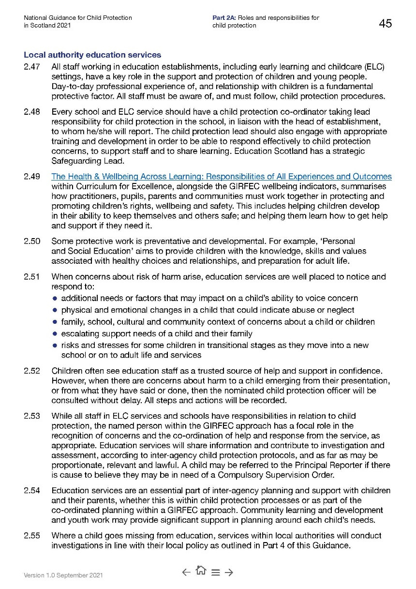
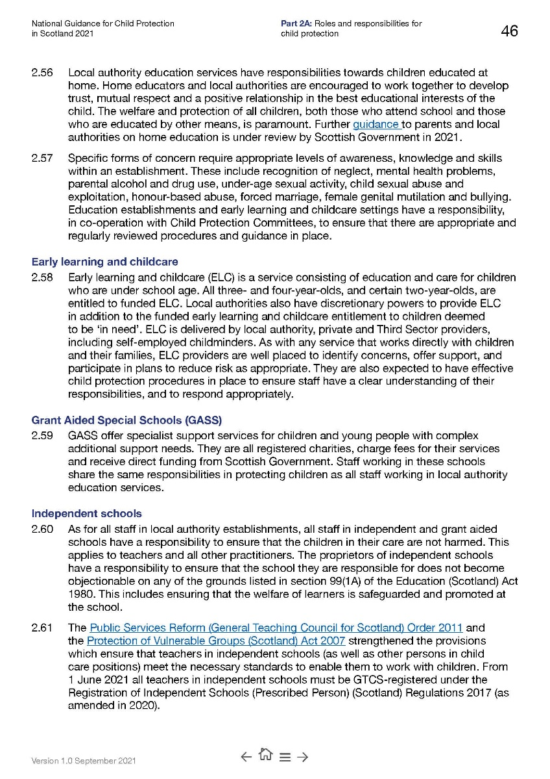
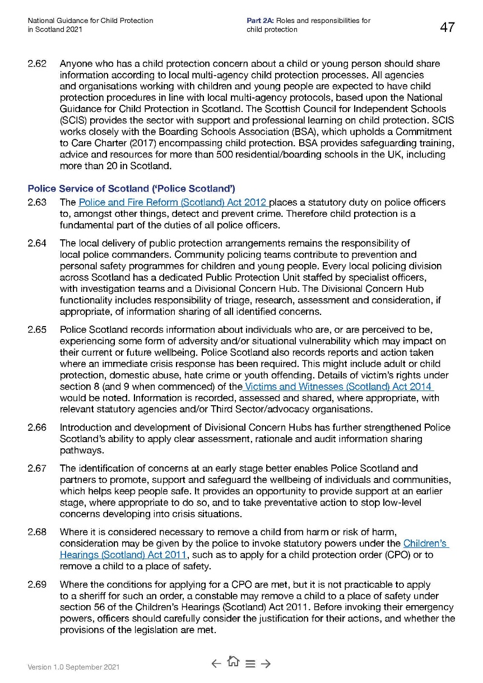
Role of CP Co-ordinator – National Guidance 2021
Notes:
The National requirements of a CP Co-ordinator:
https://www.gov.scot/publications/national-guidance-child-protection-scotland-2021/documents/ - Page 45-47

Slide 4

Child Protection Data- Headlines
Notes:
At 10 June 2022, there were 97 children on the CP Register.
The majority on the CP register live in the Irvine (44%) and Three Towns (32%).
Kilwinning is also home to 11% of the families on the register.
Garnock (4%)
North Coast (2%)
Arran (less than 2%)
Out of area (2%)
The highest number of children on the CP register is located within the Irvine locality (44%)

Slide 5

Child’s Rights
Each child has a right to be treated as an individual.
We want to recognise, respect and promote children’s rights. These include rights to be treated fairly, to be heard and to be as healthy as possible.
Notes:
Every child who can form a view on matters affecting them has the right to express those views if they so wish. Those views should be given due weight in accordance with a child’s age and maturity. Any intervention by a public authority in the life of a child must be properly justified.
Connections between safety and rights are further illustrated in ‘The Promise.’
Children must be heard in decision-making that affects them. Children feel safe when the relationships which they need are recognised, nurtured , supported and sustained.
The UNCRC (Article 23) protects the rights of disabled children and the UN Convention on the Rights of Persons with Disabilities, ratified by the UK Government in 2009, states that in order for disabled children to be able to realise the rights mentioned above, they need to be provided with disability and age-appropriate assistance.
If a child has learning disabilities or needs additional support with communication, consideration must be given to the best way to involve the child.
The child’s experience, views and needs are central within child protection processes. Talking with and listening to children means attention not only to their words, but also to their experience, needs, wishes and feelings. Listening includes attention to non-verbal communication, and to physical and behavioural responses to their care and environment. Understanding communication involves consideration of the timing and context of expressed words and feelings.
Children should be involved in decision-making in ways that are attuned to the needs and understanding of each child.

Slide 6

Protecting and Safeguarding
Everyone’s Responsibility
National Guidance
Minimising Risk/Early Years
Getting it right for every child
Responding & Reporting Disclosure/CP Concerns
What is Significant Harm?
Key Contacts
Identification of Concerns
Appendix 3 and Appendix 4 – Written Notification of Concern (WNoC)
Click this on topic slides to return to this
main menu
All buttons marked with a must be completed by all staff/volunteers on the first day of term or their first day in the establishment via a in-person presentation and on each in-service day
Notes:
This PowerPoint will be used for the August 2022 refresh for all staff, including child minders, out of school staff, janitorial and catering staff and volunteers. The completion of the slides linked to the 9 initial buttons is compulsory for all staff on the first day of the school term (August in-service). A copy should be placed in the school’s shared drive/staff Child Protection & Safeguarding noticeboard, as well as being utilised as a resource to supplement training/ information sessions completed throughout the academic year and for new staff, volunteers and partners working within the establishment.
Click on the boxes to navigate your way through the presentation.
This PowerPoint is best used by clicking on the boxes/buttons on this and the next page to navigate content. Each box/button will take you to the relevant page within the PowerPoint and sometimes provide additional links to a website for further information.
The intention with this year’s Child Protection and Safeguarding presentation is to update and consolidate content from the last few years and to emphasise that our Child Protection procedures are robust, the responsibility of all and that our procedures apply regardless of the nature of the concern.

Slide 7
Protecting and Safeguarding
Suicide Prevention and Response
Abuse/Neglect
Child Sexual Abuse/Child Sexual Exploitation
Anti-Bullying
Children with Disabilities
TICC/Domestic Abuse
Mental Health and Wellbeing
Online Safety
Poverty
Click this on topic slides to return to this sub menu
Priority should be given to these Child Protection issues
Notes:
This PowerPoint will be used for the August 2022 refresh for all staff, including child minders, out of school staff, janitorial and catering staff and volunteers. The completion of the slides linked to the 9 initial buttons is compulsory for all staff on the first day of the school term (August in-service). A copy should be placed in the school’s shared drive/staff Child Protection & Safeguarding noticeboard, as well as being utilised as a resource to supplement training/ information sessions completed throughout the academic year and for new staff, volunteers and partners working within the establishment.
Click on the boxes to navigate your way through the presentation.
This PowerPoint is best used by clicking on the boxes/buttons on this and the next page to navigate content. Each box/button will take you to the relevant page within the PowerPoint and sometimes provide additional links to a website for further information.
The intention with this year’s Child Protection and Safeguarding presentation is to update and consolidate content from the last few years and to emphasise that our Child Protection procedures are robust, the responsibility of all and that our procedures apply regardless of the nature of the concern.

Slide 8
Protecting and Safeguarding
Adult Support & Protection
FGM
Honour Based Abuse and Forced Marriage
CPC Training
Radicalisation and Extremism
Child Trafficking
Care Experienced (Looked After Children)
Useful Documents & Websites
Children Missing from Education
The remainder of buttons should be completed during the academic session as directed by the Head of Establishment or CP Co-ordinator
Click this on topic slides to return to this sub menu
Notes:
All staff should complete all sections of the presentation during an academic session and it is the responsibility of the Head of Establishment/CP Co-ordinator to direct staff in August as to how this is to be completed. Staff records should be maintained by the CP Co-ordinator to record all staff have completed the presentation content by 27 May 2022. Establishment and individual staff record templates will be made available for CP Co-ordinators on the Child Protection and Safeguarding tile on Glow. (Located within the GIRFEC tile.)

Slide 9

Safeguarding and Protecting is Everyone’s Responsibility
All staff working in and supporting Education must:
Be aware of arrangements for protecting children and adults
Be alert to children’s needs
Be clear about their own role in relation to safeguarding
Know who the Child Protection Co-ordinator is – J Gilchrist
Know if CP Co-ordinator/Head of Establishment/member of Senior Management Team is not available where to locate the emergency contact phone tree (Staff Child Protection & Safeguarding Noticeboard)
Know within Secondary schools who the ASIST (Applied Suicide Intervention Skills Training) trained member of staff is
See Communities and Education Directorate, Standard Circular L3: Protecting and Safeguarding North Ayrshire’s Children and establishment Child Protection Noticeboard

Slide 10
Safeguarding and Protecting is Everyone’s Responsibility
Education staff can contact:
Philip Gosnay, Senior Manager for Child Protection – 07798 577355
Local Service Access Offices (see Slide 78)
01294 310300 (Monday to Thursday 9.00am to 4:45pm and Friday 9.00am to 4:30pm – office hours)
Out of hours service – 0800 328 7758
If the child is in immediate danger contact the police by telephoning 101 or in an emergency 999
The health visitor is not a CP coordinator for Education establishments
See Communities and Education Directorate, Standard Circular L3: Protecting and Safeguarding North Ayrshire’s Children and establishment Child Protection Noticeboard

Slide 11


Safeguarding and Protecting is Everyone’s Responsibility
Teaching and Non Teaching Staff | Office Staff | Classroom Assistants | Educational Psychologists
Parents, Volunteers & Visitors | Childminders/ After-School Providers | Janitorial/Cleaning Staff | Catering Staff
Campus Police Officers | School Nurses | Drivers & Escorts | School Counsellors
Notes:
All are responsible for CP – all must follow procedures.
Duty is to report – if you have a concern, then that is enough to report to the CP Co-ordinator.

Slide 12
Identification of Concerns
Other agency
The child discloses
Attendance/
Exclusions
Observation
Presentation/
behaviours of child/parent/
carer
Expression of concern from parent/friend/
public
Patterns from chronology
Overheard
Identification of Concerns
Notes:
Keeping a chronology is vital – your notes help build this – it is vital that your report ASAP and provide notes with dates and times.
By examining a Chronology it is possible to link patterns of behaviour and incidence – this can add up to child protection – without a shared knowledge and communication children are put at further risk of harm.
Child protection refers to the processes involved, where there are concerns that a child may be at risk of harm. Child Protection Guidance provides overall direction for agencies and professional disciplines where there are concerns that a child may be at risk of harm.
Public authorities should promote the upbringing of children by their families, in so far as is consistent with safeguarding and promoting the child’s welfare.
Child Protection Procedures are initiated when Police, Social Work or Health professionals determine that a child may have been abused or may be at risk of significant harm.
Child protection involves:
immediate action, if necessary, to prevent significant harm to a child
inter-agency investigation about the occurrence or probability of abuse or neglect, or of a criminal offence against a child. Investigation extends to other children affected by the same apparent risks as the child who is the subject of a referral
assessment and action to address the interaction of behaviour, relationships and conditions that may, in combination, cause or accelerate risks
focus within assessment, planning and action upon each child’s experience, needs and feelings
collaboration between agencies and persistent efforts to work in partnership with parents in planning and action to prevent harm or reduce risk of harm
recognition and support for the strengths, relationships and skills within the child and their world in order to form a plan that reduces risk and builds resilience.

Slide 13

Responding to Disclosure/Allegations
Whoever receives the information from the child (or other person) should:
Let the child speak
Let them know you are listening carefully
Stay calm and not show disbelief or panic
Avoid expressing views on the matter
Take the allegation seriously, reassure the child and advise what you will do next.
Not guarantee confidentiality
Advise that they or the CP Co-ordinator will keep the child or young person informed
Advise they will remain available should the child wish to speak again. Ask how they feel and check if there is anything the child needs.
Report concerns immediately to Child Protection Co-ordinator or establishment Senior Management, or in their absence, Cluster Senior Manager, Head of Service or Philip Gosnay Senior Manager, Child Protection on 07798577355
Record what the child has said in their own words and follow advice of CP Co-ordinator
Not discuss concern/disclosure with anyone other than Child Protection Co-ordinator or Senior Management Team
Do not question the child further – this is the responsibility of agencies trained to carry out investigative interviews of children. Questions inappropriately phrased could be thought to be suggestive and then lead to evidence being held as inadmissible in possible future criminal proceedings.
NEVER Carry out an investigation or gather any photographic evidence into the allegation – this is not your role
Notes:
Whoever receives the information from the child (or other person) should:
Let the child speak- tell me how you feel – tell me what happened. You are here to help them
Let them know you are listening carefully
Stay calm and not show disbelief or panic
Avoid expressing views on the matter
Take the allegation seriously, reassure the child and advise what you will do next.
Not guarantee confidentiality
Advise that they or the CP Co-ordinator will keep the child or young person informed
Advise they will remain available should the child wish to speak again. Ask how they feel and check if there is anything the child needs.
Report concerns immediately to Child Protection Co-ordinator or establishment Senior Management, or in their absence, Cluster Senior Manager or Head of Service.
Philip Gosnay, Senior Manager, Child Protection – 07798577355
Record what the child has said in their own words and follow advice of your CP Co-ordinator
Do not discuss concern/disclosure with anyone other than Child Protection Co-ordinator or Senior Management Team
Do not question the child further – this is the responsibility of agencies trained to carry out investigative interviews of children. Questions inappropriately phrased could be thought to be suggestive and then lead to evidence being held as inadmissible in possible future criminal proceedings.
NEVER Carry out an investigation or gather any photographic evidence into the allegation – this is not your role… Let Social work deal with it – although others can be a source of advice – the first port of call for a CP is Social Work. They take action and this is logged in the WNoC. This comes into HQ and further info made be sought after the WNOC is received.

Slide 14
Reporting Disclosure/CP Concerns
All instances of disclosure/CP or safeguarding concerns should be reported to the establishment's Child Protection Co-ordinator without delay.
If the Child Protection Co-ordinator or Head Teacher/Head of Centre is not available, seek advice from a Senior Manager or the Head of Service (Education) as a matter of urgency. Please refer to the Phone Tree within this presentation and on the establishment CP noticeboard.
The welfare of the child and young person is paramount
Notes:
The disclosure/allegation of abuse or concern should be reported to the establishment’s Child Protection Coordinator without delay.
In all instances of disclosure, the Child Protection Co-ordinator should:
Follow the guidance contained in Appendix 1 – Flow Chart for Child Protection and Safeguarding Procedures.
Open a confidential Child Protection and Safeguarding 7-Part File.
Record the timing of the reported concerns from the staff member.
Listen carefully to the child, identify and respond to the child’s immediate needs as sensitively as possible.
Seek the child’s views and check how they are feeling. Always record what they say in their own words and record in section 7 of the child’s Child Protection and Safeguarding 7-Part File.
Make a decision as to whether the child is in need of protection.
If child is in need of protection, follow guidance in Appendix 3 – Checklist – Telephone Notification of Concern to Social Services and submit Appendix 4 – Written Notification of Concern form following guidance noted on Appendices 3 and 4
Copy all Child Protection Written Notification of Concerns to Caroline Amos (Head of Service), Philip Gosnay (Senior Manager) and Angela Feeney.
All Safeguarding/Welfare Written Notification of Concern forms should be forwarded to Philip Gosnay (Senior Manager) and Angela Feeney and followed up by the Child Protection Co-ordinator.
Where the Head of the Establishment is not the Child Protection Co-ordinator, the Head of Establishment should be copied into all communication, relating to the Child Protection/Safeguarding Notification of Concerns.
Ensure the child is advised of any action taken and provide the child with information about other sources of support eg Childline, Social Services, NSPCC as appropriate.
Support the staff member who raised the concerns by sensitive debriefing and ensuring they are kept informed of decisions made and actions taken as appropriate. A follow up check in should also be arranged in consultation with the staff member, and if necessary, information in relation to accessing supports such as Occupational Health provided.
Ensure information is recorded and stored securely in the confidential Child Protection and Safeguarding 7-Part File and reference is made to the submission of Appendix 4 – Child Protection Written Notification of Concern (WNoC) as a significant event within Pastoral Notes/AYRshare (where the record exists).
Add date and type of notification to Appendix 5a – Child Protection Written Notification of Concern Record – which should be located inside front cover of Child Protection and Safeguarding 7-Part File.
Do not upload the Written Notification of Concern form to the pupil’s wellbeing application or AYRshare record, store securely in Child Protection and Safeguarding 7-Part File.

Slide 15

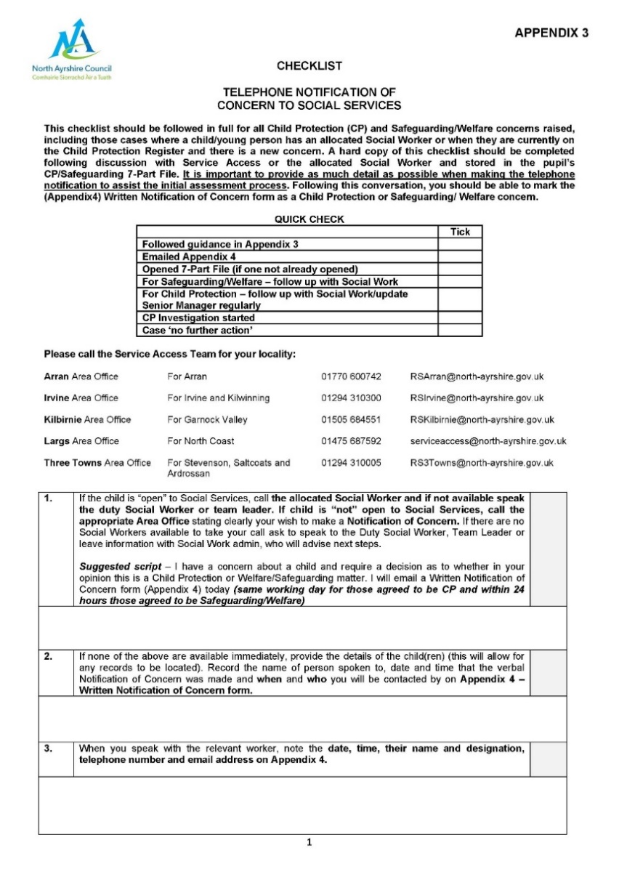
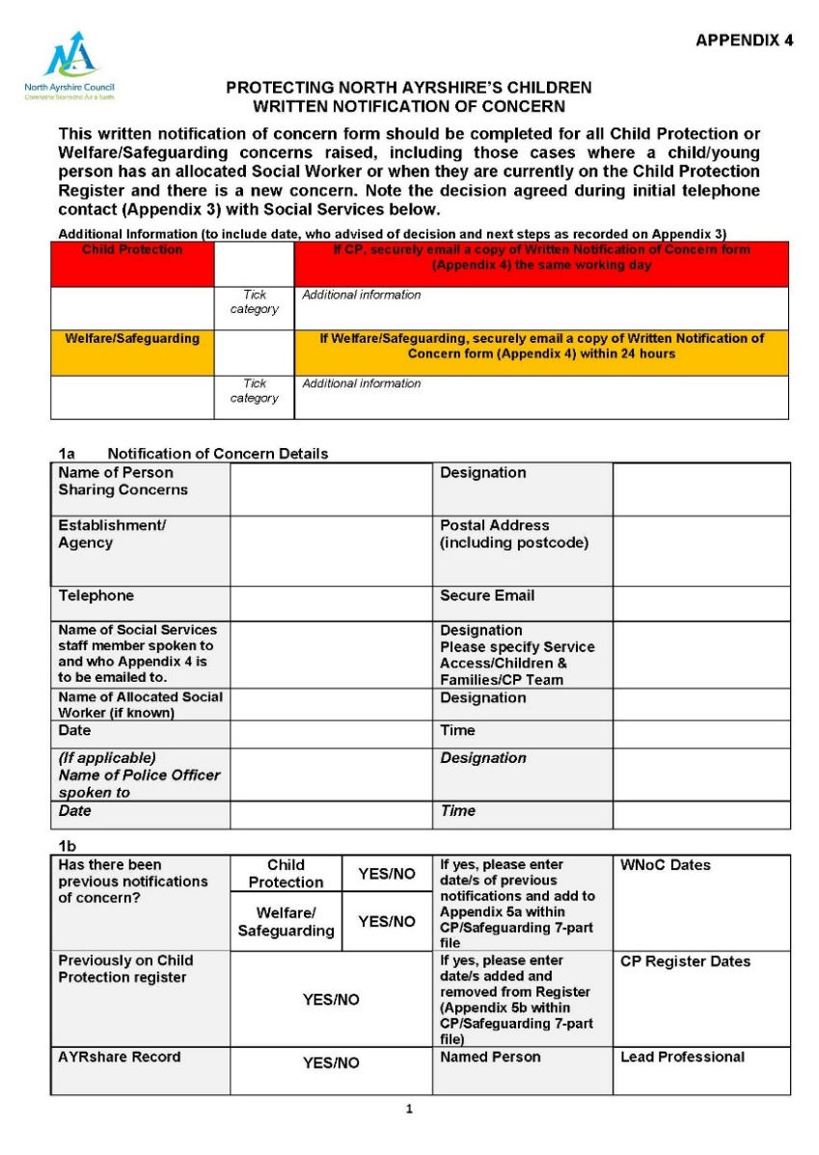

L3 – Appendix 3 and Appendix 4
Notes:
Appendix 3 is a systematic step walk through and is there to ensure all steps are taken in accordance with policy. It is designed to help the thought process given that CP is traumatic not only for the child but also for the CP Co-ordinator – when trauma occurs it is often our higher order thought processes that are affected. Have it on your wall/desk, computer desktop or your phone…for ease of access.
Appendix 4 – this is the Written Notification of Concern – there has been a tendency to perhaps go straight to this but Appendix 3 is equally important.
If child is in need of protection, follow guidance in Appendix 3 – Checklist – Telephone Notification of Concern to Social Services and submit Appendix 4 – Written Notification of Concern form following guidance noted on Appendices 3 and 4
Copy all Child Protection Written Notification of Concerns to Caroline Amos (Head of Service), Philip Gosnay (Senior Manager) and Angela Feeney.
All Safeguarding/Welfare Written Notification of Concern forms should be forwarded to Philip Gosnay (Senior Manager) and Angela Feeney and followed up by the Child Protection Co-ordinator.
The completed Checklist – Telephone Notification of Concern to Social Services (Appendix 3) and Written Notification of Concern form (Appendix 4) should be stored in the child’s Child Protection 7-Part File within the Child Protection Co-ordinators notes section and not be uploaded to AYRshare or SEEMiS.

Slide 16
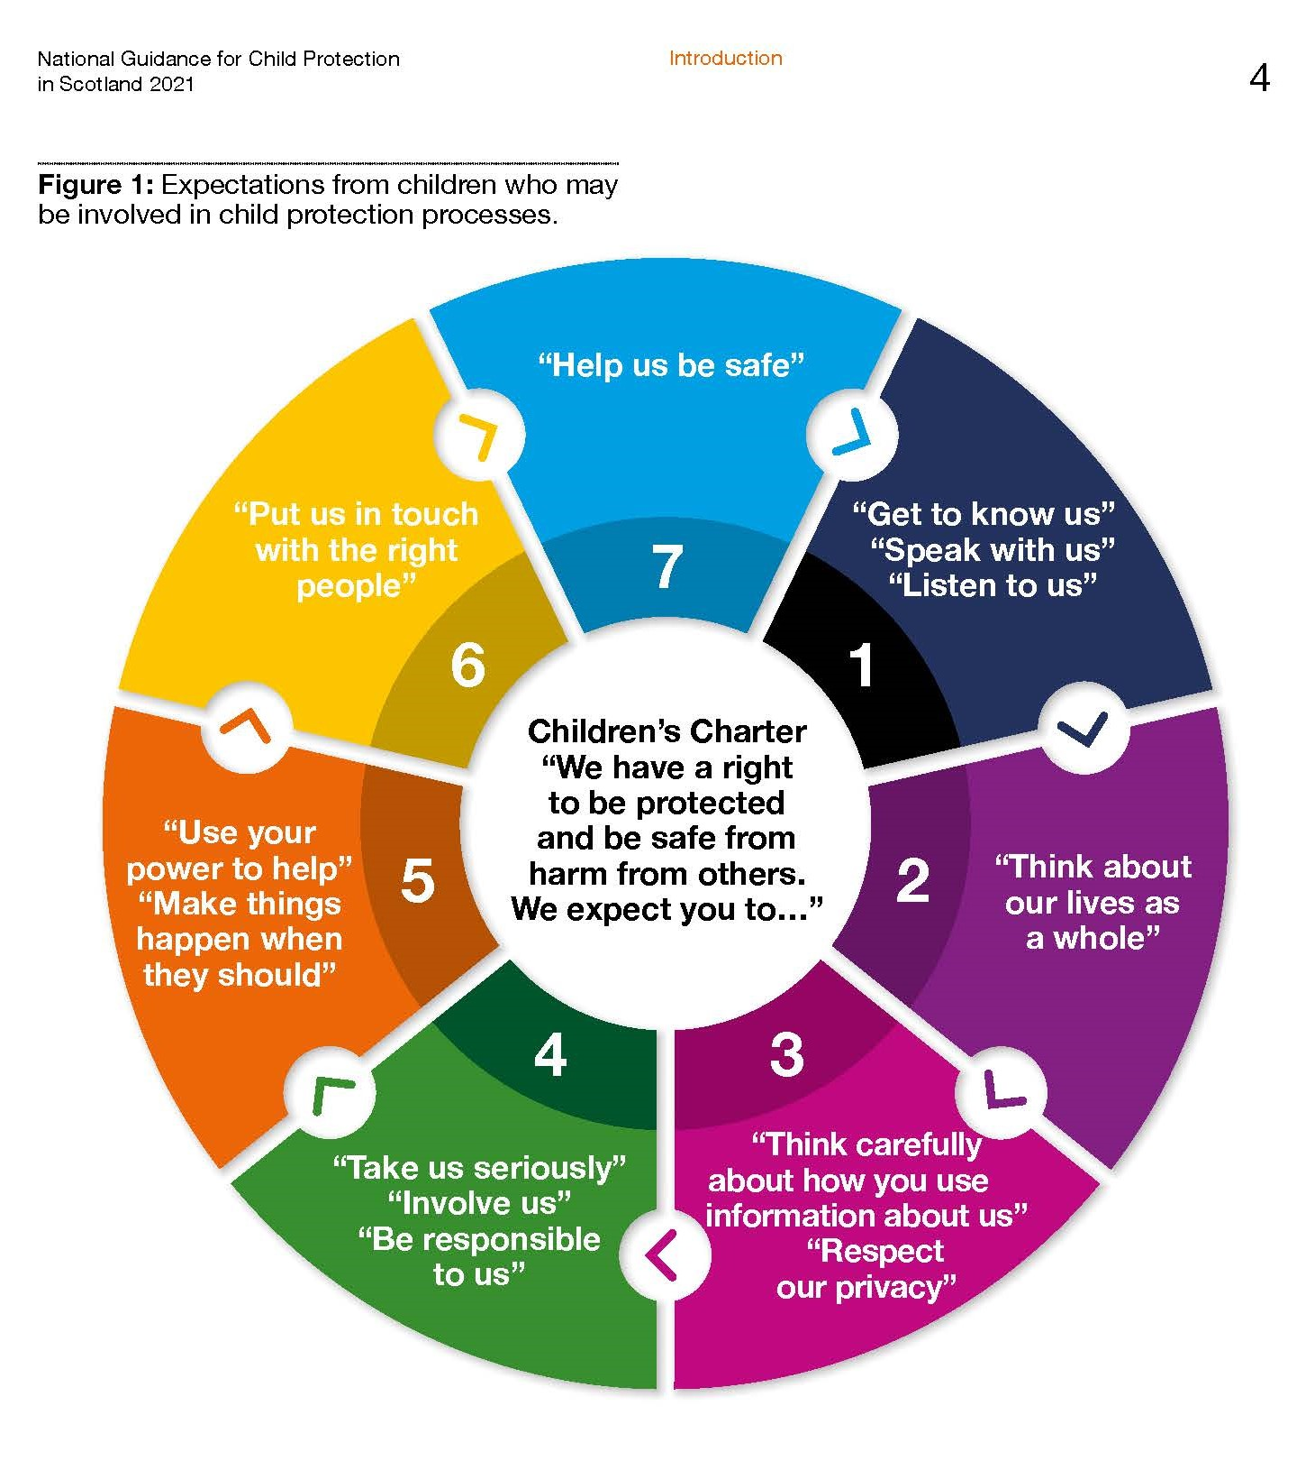
What children and
young people need from us
Notes:
https://www.gov.scot/publications/national-guidance-child-protection-scotland-2021/documents/ - Page 4 (or 12 of 276)

Slide 17

Immediate Concerns - Suicidal Ideation
If you believe the child or young person may be having suicidal thoughts or has a plan to complete suicide:
Contact the Child Protection Co-ordinator or if not available a member of the Senior Management team, who will liaise with the ASIST (Applied Suicide Intervention Skills Training) trained member of staff (secondary schools) and take advice from CAMHS (Child and Adolescent Mental Health Services).
In line with current training, the Child Protection Co-ordinator or the ASIST trained member of staff will ask the young person if they have a plan to complete suicide and to support the young person and help disable a plan, if one is place.
Notes:
Suicide Prevention Response Toolkit:
To get to the GIRFEC in North Ayrshire Tile for this document
Log into Glow - https://www.rmunify.com/
Click on the 'temple' shaped icon on left hand side of screen
GIRFEC in North Ayrshire Tile is on the third row – click on this
Find 'Safeguarding and Child Protection (GIRFEC bird) - tile number 1 on top row - click on this
First column 'Suicide and Prevention Response’

Slide 18
Immediate Concerns - Suicidal Ideation
The Child Protection Co-ordinator will confirm with the person the child disclosed to and the child, how that person will remain in the process and where possible how they can continue to support the child or young person.
Standard Child Protection and Safeguarding processes will be followed in line with Standard Circular L3.
Please refer to flow chart on your staff noticeboard
At all times, the safety and wellbeing of the young person will remain the priority.
Notes:
Suicide Prevention Response Toolkit:
To get to the GIRFEC in North Ayrshire Tile for this document
Log into Glow - https://www.rmunify.com/
Click on the 'temple' shaped icon on left hand side of screen
GIRFEC in North Ayrshire Tile is on the third row – click on this
Find 'Safeguarding and Child Protection (GIRFEC bird) - tile number 1 on top row - click on this
First column 'Suicide and Prevention Response’

Slide 19
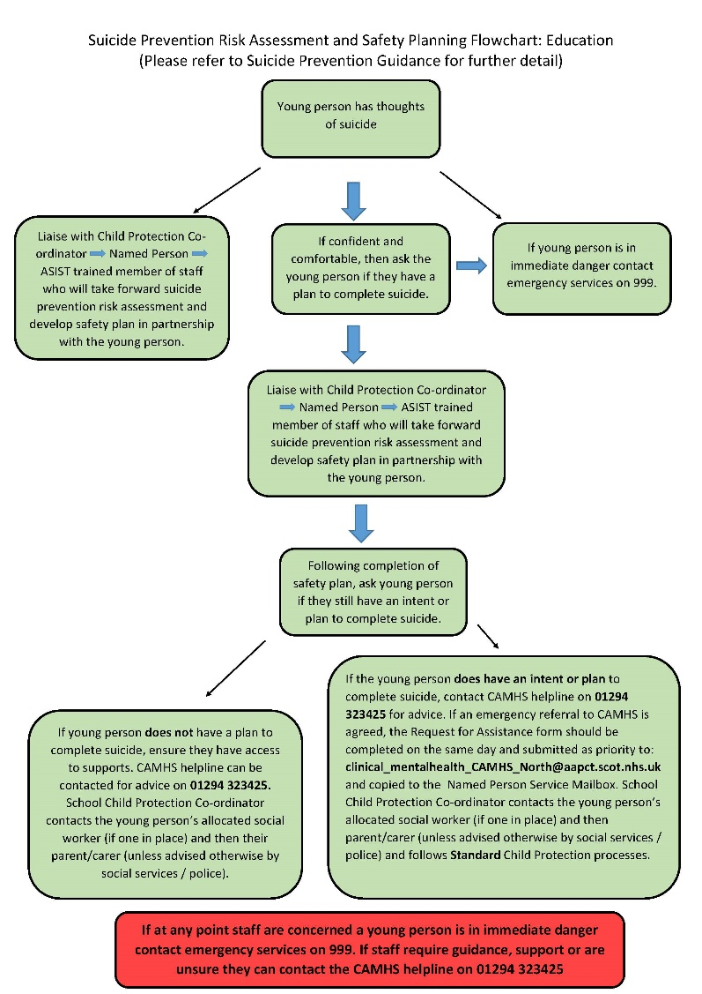
Suicide Prevention Safety Planning and Risk Assessment Flowchart
Whilst any concerns relating to Suicide Prevention should be reported to the Child Protection Co-ordinator and Head of Establishment immediately and the agreed CP processes followed, if the member of staff who the child or young person discloses to feels confident and comfortable, they should ask the child or young person if they have a plan to complete suicide. Following this the member of staff should refer to the CP Co-ordinator as above who will work with young person, partners, to assess risk and create a safety plan.
If at any point the staff member is concerned a child or young person is in imminent danger, contact Emergency Services on 999
Notes:
Suicide Prevention and Supports
To ensure everyone understands the processes around supporting young people who present with suicide ideation and/or a plan to complete suicide, a short life working group developed a flow chart which should be displayed on the establishments CP & Safeguarding noticeboard. This was issued to CP Co-ordinators in August 2019.
Suicide Prevention Response Toolkit:
To get to the GIRFEC in North Ayrshire Tile for this document
Log into Glow - https://www.rmunify.com/
Click on the 'temple' shaped icon on left hand side of screen
GIRFEC in North Ayrshire Tile is on the third row – click on this
Find 'Safeguarding and Child Protection (GIRFEC bird) - tile number 1 on top row - click on this
First column 'Suicide and Prevention Response’

Slide 20

Suicide Prevention – Conversation Guidance
North Ayrshire Council has revised their processes for informing the Named Person following a child or young person’s attendance at Emergency Department with suicidal intent or attempt. The Named Person Service will notify education establishments in the event of an attendance and the child or young person will have the opportunity to meet with a member of staff from Service Access and CAMHS.
Conversation Guidance has been produced to assist education staff to support pupils. This can be accessed through the Suicide Prevention Tab on the Glow blog.
Notes:
Suicide Prevention
https://blogs.glowscotland.org.uk/na/mhwbnac/suicide-prevention/staff-information-and-guidance/
Suicide Prevention Response Toolkit:
To get to the GIRFEC in North Ayrshire Tile for this document
Log into Glow - https://www.rmunify.com/
Click on the 'temple' shaped icon on left hand side of screen
GIRFEC in North Ayrshire Tile is on the third row – click on this
Find 'Safeguarding and Child Protection (GIRFEC bird) - tile number 1 on top row - click on this
First column 'Suicide and Prevention Response’

Slide 21
Suicide Prevention – Self Harm
Self Harm refers to self-poisoning or self-injury, irrespective of the apparent purpose of the act. Self-harm is generally a way of coping with overwhelming emotional distress.
If there are concerns that abuse or neglect are associated with self-harm, Child Protection processes should be followed.
If a child or young person discloses self-harm or you suspect self-harm, then your school nurse or the local Penumbra self-harm service can provide support.
North Ayrshire Self Harm Project – Penumbra – http://www.penumbra.org.uk/service-locations/west-area-services/ayrshire/self-harm-services/
Notes:
Suicide Prevention and Supports
To ensure everyone understands the processes around supporting young people who present with suicide ideation and/or a plan to complete suicide, a short life working group developed a flow chart which should be displayed on the establishments CP & Safeguarding noticeboard. This was issued to CP Co-ordinators in August 2019.
Suicide Prevention Response Toolkit:
To get to the GIRFEC in North Ayrshire Tile for this document
Log into Glow - https://www.rmunify.com/
Click on the 'temple' shaped icon on left hand side of screen
GIRFEC in North Ayrshire Tile is on the third row – click on this
Find 'Safeguarding and Child Protection (GIRFEC bird) - tile number 1 on top row - click on this
First column 'Suicide and Prevention Response’

Slide 22
Youth Suicide Prevention Taskforce
The Young People’s Suicide Taskforce is a multi-agency group, including education, who meet monthly, they focus on suicide prevention activities, bereavement support and actions in the event of a youth suicide.
Please click on the link below for a short, narrated presentation on the work of the group - here
Alternatively it can be found in the Suicide Prevention tab on the MHWB glow Education Staff Glow blog
Notes:
Suicide Prevention and Supports
To ensure everyone understands the processes around supporting young people who present with suicide ideation and/or a plan to complete suicide, a short life working group developed a flow chart which should be displayed on the establishments CP & Safeguarding noticeboard. This was issued to CP Co-ordinators in August 2019.
Suicide Prevention Response Toolkit:
To get to the GIRFEC in North Ayrshire Tile for this document
Log into Glow - https://www.rmunify.com/
Click on the 'temple' shaped icon on left hand side of screen
GIRFEC in North Ayrshire Tile is on the third row – click on this
Find 'Safeguarding and Child Protection (GIRFEC bird) - tile number 1 on top row - click on this
First column 'Suicide and Prevention Response’
Glow Blog
https://blogs.glowscotland.org.uk/na/mhwbnac/suicide-prevention/staff-information-and-guidance/

Slide 23
Mental Health and Wellbeing
All staff should be aware the impact societal factors can have on children and young people’s mental health and wellbeing. These include but are not limited to:
Poverty
Poor parental/family wellbeing
Geographical/social isolation
Self and familial use of drugs and alcohol
Gender based Violence
Child protection procedures can increase anxiety in children and young people therefore support and approach are crucial
Where adults are vulnerable, consideration should be given to making a referral to the Adult Protection Team - see Slide 54 – for guidance
Notes:
Suicide Prevention and Supports
To ensure everyone understands the processes around supporting young people who present with suicide ideation and/or a plan to complete suicide, a short life working group developed a flow chart which should be displayed on the establishments CP & Safeguarding noticeboard. This was issued to CP Co-ordinators in August 2019.
Suicide Prevention Response Toolkit:
To get to the GIRFEC in North Ayrshire Tile for this document
Log into Glow - https://www.rmunify.com/
Click on the 'temple' shaped icon on left hand side of screen
GIRFEC in North Ayrshire Tile is on the third row – click on this
Find 'Safeguarding and Child Protection (GIRFEC bird) - tile number 1 on top row - click on this
First column 'Suicide and Prevention Response’
Glow Blog
https://blogs.glowscotland.org.uk/na/mhwbnac/suicide-prevention/staff-information-and-guidance/

Slide 24
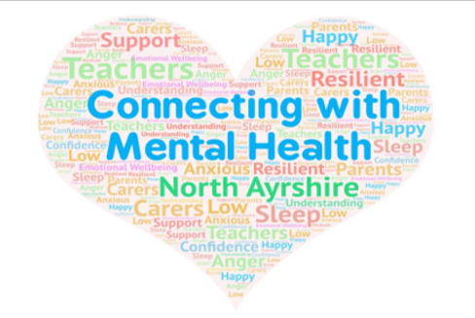
Mental Health and Wellbeing
Children and young people experiencing mental health problems
Children can experience a range of mental health illnesses but most will recover from this and experience good wellbeing. When required, service and support is vital; local training and policy should raise awareness about such issues.
Contributory factors to poor mental health include neglect; domestic abuse; substance misuse; bereavement; bullying; discrimination; poverty; caring responsibilities etc.
Children and young people experiencing poor mental health may be a risk to themselves and others. Support and intervention are key in preventing this.
Notes:
Suicide Prevention and Supports
To ensure everyone understands the processes around supporting young people who present with suicide ideation and/or a plan to complete suicide, a short life working group developed a flow chart which should be displayed on the establishments CP & Safeguarding noticeboard. This was issued to CP Co-ordinators in August 2019.
Suicide Prevention Response Toolkit:
To get to the GIRFEC in North Ayrshire Tile for this document
Log into Glow - https://www.rmunify.com/
Click on the 'temple' shaped icon on left hand side of screen
GIRFEC in North Ayrshire Tile is on the third row – click on this
Find 'Safeguarding and Child Protection (GIRFEC bird) - tile number 1 on top row - click on this
First column 'Suicide and Prevention Response’
Connecting with Mental Health https://glowscotland.sharepoint.com/:p:/r/sites/NorthAyrshireCouncil/StaffArea/ConnectingWithMentalHealth/_layouts/15/Doc.aspx?sourcedoc=%7B4719761E-99F7-4E05-BC32-7BA1BFE7AD7E%7D&file=SV%20Taskforce%20Short%20presentation%20%20SOUND.pptx&action=edit&mobileredirect=true

Slide 25
Mental Health and Wellbeing
Children and young people experiencing mental health problems
GIRFEC approach should be utilised in supporting mental wellbeing; services made available when required and those with a duty of care should be able to signpost to support.
CP practitioners should be trauma informed and intervene at the earliest opportunity. Collaboration and a multi-agency approach should take place when a child is at significant risk of harm.
Impact of transitions should be considered: school; Care Experienced; criminal justice processes; LGBTQ+; phases of recovery.
Those who experience childhood trauma may parent children early and experience poor mental health in adulthood.
Unaccompanied asylum seeking children may be at risk of poor mental health.
Third sector and community support is critical.
Notes:
North Ayrshire’s Education Staff can be accessed by all staff through their Glow account https://blogs.glowscotland.org.uk/na/mhwbnac/ there is a wealth of information available.
All staff are encouraged to sign up and complete the Children and Young People’s
Mental Health and Wellbeing - A Professional Learning Resource For All School Staff –
https://www.cypmh.co.uk

Slide 26


National Guidance for Child Protection 2021
Child protection’ means protecting a child from child abuse or neglect. Abuse or neglect need not have taken place; it is sufficient for a risk assessment to have identified a likelihood or risk of significant harm from abuse or neglect in order for the family to receive support from services to prevent abuse or neglect.
Child protection is closely linked to the risk of ‘significant harm’. ‘Significant Harm’ is a complex matter and subject to professional judgement based on a multi-agency assessment of the circumstances of the child and their family. Where there are concerns about harm, abuse or neglect, these must be shared with the relevant agencies so that they can decide together whether the harm is, or is likely to be, significant.
Standard processes (L3) should be followed for all CP and Welfare/ Safeguarding concerns.
Click on the image for link to document
Notes:
The guidance recognises that physical and emotional safety provides a foundation for wellbeing and healthy development. There are collective responsibilities to work together to prevent harm from abuse or neglect from pre-birth onwards, including safe transitions of vulnerable young people towards adult life and services.
The most effective protection of children involves early support within the family, before urgent action is needed and purposeful use of compulsory measures are necessary. If children do require placement away from home, real protection involves attuned, nurture trauma-informed and sufficiently sustained support towards re‑unification of sustaining of the family , or towards an alternative secure home base when this is not possible.

Slide 27
National Guidance for Child Protection 2021
Procedures and guidance cannot in themselves protect children; a competent, skilled and confident workforce, together with a vigilant public, can.
Child protection is a complex system requiring the interaction of services, the public, children and families.
For the system to work effectively, it is essential that everyone understands the contribution they can make and how those contributions work together to provide the best outcomes for children.
Everyone working with children needs to appreciate the important role they can play, by remaining vigilant and providing robust support for child protection and safeguarding.

Slide 28
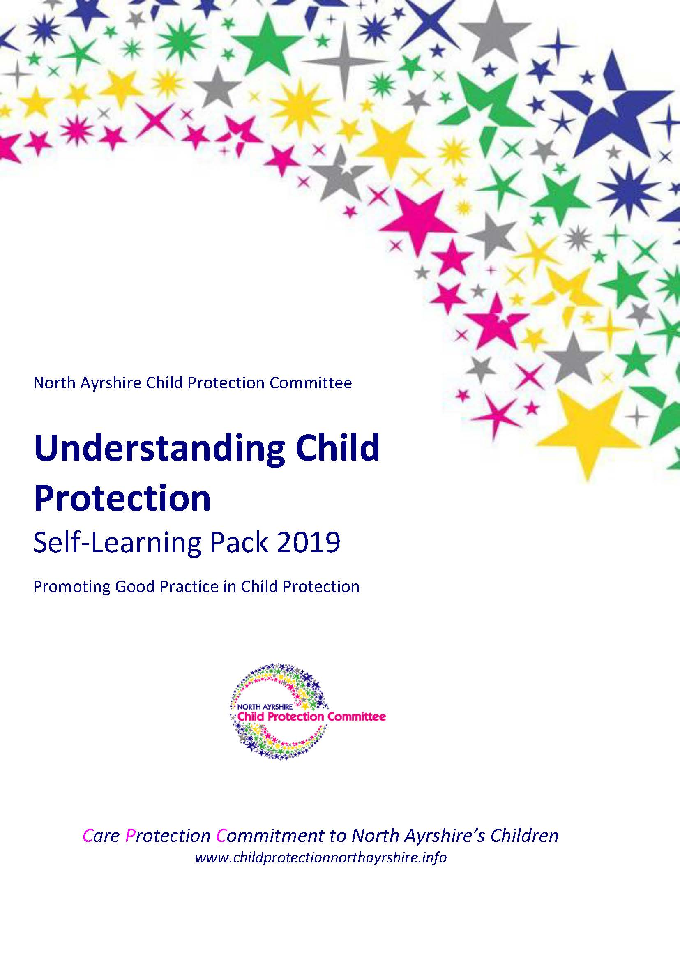
What is Significant Harm in Child Protection?
Significant harm can result from a specific incident, a series of incidents or an accumulation of concerns or events over a period of time that interrupt, change or damage a child's physical and psychological development.
It is essential that when considering the presence or likelihood of significant harm that the impact (or potential impact) on the child takes priority.
Key professionals will take a number of things into account when exercising their professional judgement.
There is no absolute criteria for judging what constitutes significant harm, talking to other agencies and sharing/gathering information will be a priority.
Notes:
Self Learning Pack 2019 – http://childprotectionnorthayrshire.info/cpc/training/ – link in this page

Slide 29
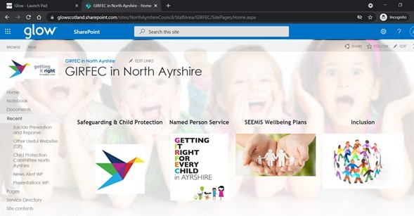
Getting it right for every child in North Ayrshire
The Getting it right for every child in North Ayrshire Glow tile contains separate areas for Safeguarding and Child Protection, Named Person Service and Wellbeing Assessment and Plans and provides links to GIRFEC North Ayrshire and GIRFEC Pan Ayrshire websites
All staff should complete the GIRFEC module on the Pan Ayrshire website –http://girfec-ayrshire.co.uk/training/
Notes:
The Getting it right for every child (GIRFEC) policy and practice model is a practical expression of the Scottish Government’s commitment to implementation of the United Nation’s Convention on Rights of the Child (UNCRC) now receiving Royal Ascent into Scot’s Domestic Law. Rights must now be recognised in law – article 12 is particularly important – CYP must be involved in decisions that affect them. Policy is being updated by Scottish Government. Children’s rights are a theme running through all the Children’s Services Improvement Plan for North Ayrshire and are a key priority for development.
The Getting it right for every child (GIRFEC) approach promotes and supports multi-agency planning to be provided in the way which best safeguards, supports and promotes the wellbeing of children, and ensures that any action to meet needs is taken at the earliest appropriate time to prevent acute needs arising.
To get to the GIRFEC in North Ayrshire Tile:
Log into Glow - https://www.rmunify.com/
Click on the 'temple' shaped icon on left hand side of screen
GIRFEC in North Ayrshire Tile is on the third row – click on this
Find 'Safeguarding and Child Protection (GIRFEC bird) - tile number 1 on top row - click on this

Slide 30

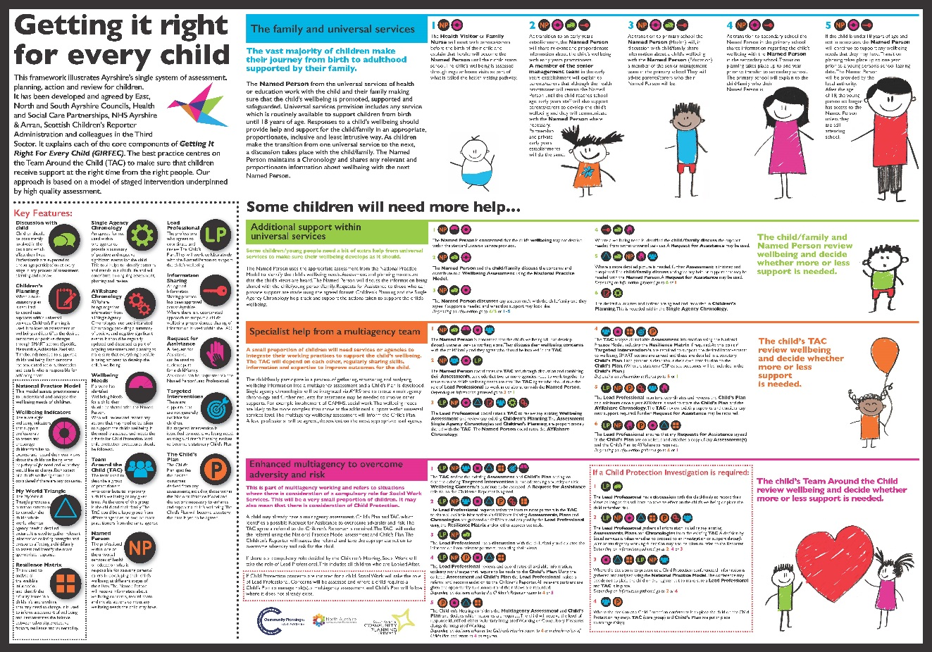
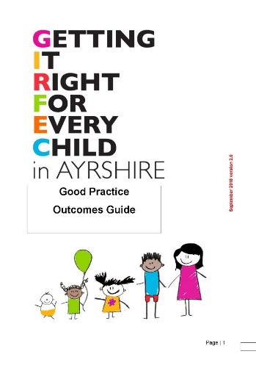
Wellbeing Concerns
Getting it right for every child Pathway
Named Person 0-5
Lead Professional
National Practice Model
Holistic Assessment of Need/Staged Intervention
Wellbeing Plan
Multi Agency Discussions (TAC)
Early & Effective Intervention
Chronologies – SEEMiS and AYRshare
Named Person
0-5 – Health Visitor/Family Nurse Practitioner
5-18 – Head Teacher/PT Pastoral Support
Notes:
Getting It Right for every Child provides us with the 8 Wellbeing indicators which allow the assessment of Wellbeing. Safeguarding should be viewed as part of a continuum from Wellbeing through to safeguarding and Welfare and finally Child Protection. Whilst it is hoped that most children will not require protection, early and effective support can promote safeguarding at any point along this continuum. The Pan Ayrshire infographic and supporting documents provide a framework to support children and young people with identified wellbeing needs.
All staff should complete the GIRFEC online module located on the Pan Ayrshire GIRFEC website.
Overarching Principles and Legislation
Every child and young person in Scotland is on a journey through life: experiencing rapid development and change as they make the transition from childhood through adolescence and into adulthood.
As they progress, some may have temporary difficulties, some may live with challenges that distract them on their journey and some may experience more complex issues. No matter where they live or whatever their needs, children and families should know where they can find help, what support might be available and whether that help is right for them.
We all want our children and young people to be fully supported as they grow and develop to be:
These eight wellbeing indicators, sometimes known as SHANARRI, will help all those that come into contact with children to identify areas of concern or vulnerability.
All services should ensure that they have a shared understanding of the eight well-being indicators.
Getting it right for every child means that all practitioners who come into contact with children and/or their parents and carers in the course of their work need to cooperate together to meet children and young people’s needs.
To assist practitioners to do this, a common set of principles and values has been developed which apply across all aspects of working with children and young people. Developed from knowledge, research and experience, they reflect the rights of children expressed in the ‘United Nations Convention on the Rights of the Child’ (1989) and build on the Scottish ‘Children’s Charter’ (2004). They are reflected in legislation, standards, procedures and professional expertise. The Principles and values can be found in the GIRFEC Guide below. Click on the image or follow the ‘url’ in the footnote.
Pan Ayrshire GIRFEC Website - http://girfec-ayrshire.co.uk/practitioners/practitioner-downloads/
The principles of Getting it Right for every child should be followed whenever any support is being given to any child or young person and everything should be done to ensure that we seek the views of those children and young people; their carers or parents; and that we share appropriate and proportionate information with the child’s named person and lead professional. The GIRFEC Practice model (Appendix 1) should be used to provide support at the right time; by the right person with the appropriate skills and resources. For more information please see the Pan Ayrshire Web site for further guidance documents.
The Children and Young People Act (Scotland) Act 2014, highlights the need for a ‘named person’ for every child, and a ‘Child’s Plan’ for every child that needs one.

Slide 31

Named Person Service
North Ayrshire Named Person Service has produced a Named Person Service – Service Directory for Named Persons and Lead Professionals. The aim of the Directory is to provide NP/LPs with guidance on a variety of services both local and national which can be accessed to support children, young people and families.
The Service Directory is available online at:
Glow/GIRFEC – www.rmunify.com/
(click on Named Person Service tile – you will find a link to the NPS Directory (middle of screen). Or you can request a copy by email namedpersonservice@north-ayrshire.gov.uk
Notes:
To get to the GIRFEC in North Ayrshire Tile for this document
Log into Glow - https://www.rmunify.com/
Click on the 'temple' shaped icon on left hand side of screen
GIRFEC in North Ayrshire Tile is on the third row – click on this
Click on Named Person Service tile – you will find a link to the NPS Directory (middle of screen)
Getting It Right for Vulnerable Children and Young People in North Ayrshire –https://glowscotland.sharepoint.com/sites/NorthAyrshireCouncil/StaffArea/GIRFEC/News%20Alert%20NPS/Vulnerable%20Children%20and%20Young%20People%20in%20North%20Ayrshire%20Aug%202018.pdf
Named Person Service (Page 11)

Slide 32

Vulnerable Children and Young People
EXAMPLES FROM INDEX
Section 1 – Primary Guidance
Children and young people who run away, or go missing
Children and young people who are trafficked in the UK
Children and young people who parents are in prison
Section 2 – Brief Guidance and Signposting
Children and young people who may be seeking or refuge or asylum
Children and young people who are affected by their own misuse of alcohol and/or drugs
Children and young people who are affected by parental drug and/or alcohol misuse
North Ayrshire Child Protection Committee’s Getting It Right for Vulnerable Children and Young People in North Ayrshire , should be made available to all staff via the Child Protection Co-ordinator and CP noticeboards.
Notes:
North Ayrshire Child Protection Committee’s Getting it right for Vulnerable children and young people in North Ayrshire Young Person’s Guidance 2018, provides detailed information and links on a number of areas relating to supports for vulnerable children and young people in North Ayrshire. A copy can be found on the GIRFEC North Ayrshire Glow page, within the Named Person Service tile.
https://glowscotland.sharepoint.com/sites/NorthAyrshireCouncil/StaffArea/GIRFEC/News%20Alert%20NPS/Vulnerable%20Children%20and%20Young%20People%20in%20North%20Ayrshire%20Aug%202018.pdf

Slide 33

Children with Disabilities
Staff should be alert to the range of possible Child Protection and Safeguarding issues and risks associated with this group of vulnerable children and young people.
Disabled children are children first and foremost and have an equal right to be safe.
Children with communication impairments, behavioural disorders, learning disabilities and sensory impairments may be additionally vulnerable to abuse and neglect.
Some disabled children require specific assistance and communication support so that they can share their experience and participate.
Incidence of abuse of disabled children is likely to be under reported.
Notes:
Disabled children is a broad term – may be applied to children with a broad range of physical, emotional, developmental, learning, communication and healthcare needs. The term is applicable when these needs have a substantial and long-term impact on the child’s ability to engage fully in day to day activities. These difficulties are not always assessed or diagnosed.
The experience of each child must be central. Their voice and feelings must be heard when decisions are being made about them. Some children require specific support so that they can share their experience and views and special care should be given to ensure attunement to their experience, and to ensure their wellbeing and safety
Some people may find it hard to believe that disabled people are at risk of abuse
Invisibility of abuse is more likely when children are afraid, isolated or do not understand what is happening, and also when those around are not responsive to their distress
A child’s dependency on support: communication, mobility, manual handling, intimate care, feeding and/or invasive health procedures:
A child’s understanding of abusive behaviour and ability to resist
Availability of sex education and support for understanding
A child’s experience of asserting choice
Availability of a trusted person within or outside the family
Availability of advocacy and communication
Fear of abusers, of rejection or blame
Additional vulnerability to online abuse
Attachment history, including significant losses, disruptions and trauma
Neglectful response to the child relating to parent or carer needs or cultural attitudes
Some disabled children may behave harmfully to others: limited understanding of boundaries/reduced self-control may partly explain this.
Training about the susceptibility of disabled children to abuse is essential in order to build awareness and confidence among staff. This includes staff such as bus drivers, care assistants, escorts and personal assistants. Some roles will require additional training eg those involved in child protection investigations should understand indicators of concern; consideration of a child’s wishes, feelings support and communication needs
Significant transitions can be periods of heightened vulnerability and need to be planned jointly with parents to ensure risks are reduced

Slide 34
Children with Disabilities
Interacting factors:
Barriers to effective protection can occur at any stage in support and child protection processes:
When nobody listens to the child and those who know the child best
If the child’s communications and reactions are not understood
When there is a lack of curiosity, competence and confidence in exploring reasons for distress or signs of maltreatment
When there is a lack of practitioner awareness of the impact of neglect
When there are delays or fragmentation in assessment and sharing of information, or the coordination and planning of assessment and support
Notes:
Getting It Right for Vulnerable Children and Young People in North Ayrshire – https://glowscotland.sharepoint.com/sites/NorthAyrshireCouncil/StaffArea/GIRFEC/News%20Alert%20NPS/Vulnerable%20Children%20and%20Young%20People%20in%20North%20Ayrshire%20Aug%202018.pdf
Children and young people who may be vulnerable as a result of their own or others disability (Page 53)

Slide 35


Care Experienced Children and Young People
The Promise
The care review heard that Scotland needs to change how it cares for children.
The Promise supports shifts in policy, practice and culture so Scotland can
#KeepThePromise to care experienced infants, children, young people, adults and their families - that every child grows up loved, safe and respected, able to realise their full potential
How can education contribute to improved outcomes for care experienced children and young people in North Ayrshire?
Increased vulnerability, for example:
Children and Young People looked after away from home may be vulnerable in relation to exploitation and online safety.
Care Experienced Children and young people report that at times they may feel unsafe and may be at risk of misusing drugs, alcohol and self harming
We know through research that most neglect and abuse occurs in the home
Staff should be alert to the range of possible Child Protection and Safeguarding issues and risks associated with this group of vulnerable children and young people.
Notes:
Getting It Right for Vulnerable Children and Young People in North Ayrshire – https://glowscotland.sharepoint.com/sites/NorthAyrshireCouncil/StaffArea/GIRFEC/News%20Alert%20NPS/Vulnerable%20Children%20and%20Young%20People%20in%20North%20Ayrshire%20Aug%202018.pdf
Children and young people who are ‘looked after’ or ‘looked after and accommodated’ by a local authority (Page 56)
As at 31 January 2021, there were 531 Children Looked After by North Ayrshire, of which 158 children were looked after at home and 373 away from home.
6 Corporate Parent Duties
Be alert to matters which, or which might, adversely affect the wellbeing of children and young people
Assess the needs of those children and young people for services and support
Promote the interests of those children and young people,
Provide those children and young people with opportunities to participate in activities designed to promote their wellbeing,
Take such action as it considers appropriate to help those children and young people-
- to access opportunities
- to make use of services, and access support, which it provides
Take such other action as it considers appropriate for the purposes of improving the way in which it exercises it’s functions in relation to those children and young people.
https://www.carereview.scot/pledge/

Slide 36
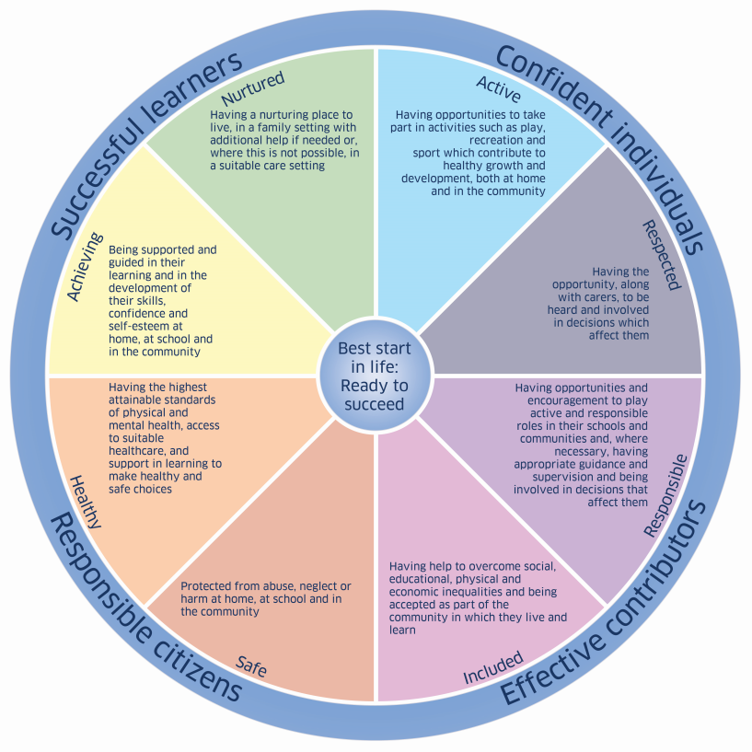
Minimising Risk
The National Practice Model and Wellbeing Indicators provide the broad framework for identifying a child or young person’s needs.
They do so under eight headings, which should form the basis for planning around the child:
Safe
Healthy
Achieving
Nurtured
Active
Respected
Responsible
Included
The My World Triangle and the Wellbeing Indicators serve as a starting point for considering what risks and vulnerabilities might be present in a child’s life.
Notes:
In order to safeguard children and young people it is essential that we collectively minimise risk wherever possible.
Getting It Right for Vulnerable Children and Young People in North Ayrshire
Assessing the Needs of Children and Young People (Page 8)/(Appendix 1 – Page 93)

Slide 37
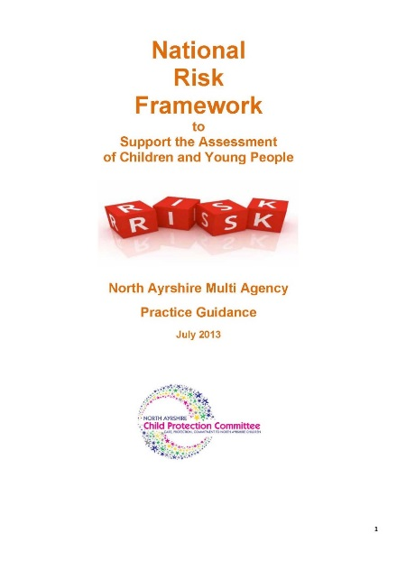
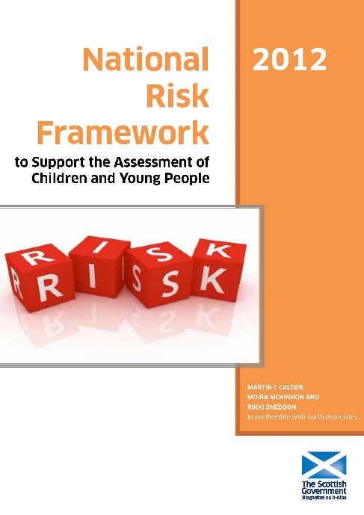
National Risk Framework
Assessment tools such as the National Risk Framework 2012 or North Ayrshire Practice Guidance 2013 should be used by Named Persons and CP Co-ordinators to help assess both risk and protective factors
The GIRFEC National Practice Model and Risk Assessment
The Getting it right for every child (GIRFEC) approach is the key thread running through policy and practice affecting children, young people and their families in Scotland. At its heart is the National Practice Model, which provides the foundation for identifying concerns, assessing needs and initial risks and making plans for children in ALL situations. It helpfully provides a shared language and a common understanding and approach for all practitioners across all services. This single system of planning for a child should be used in every case. All agencies, thus, need to use and contribute to the model in a way that reflects their core responsibilities; this includes all adult services.
To fully assess a child’s circumstances when a concern has been identified the National Practice Model combines a number of useful tools for practitioners addressing the needs of children and young people: the Well-being Wheel, My World Triangle and Resilience/Vulnerability Matrix. f
Notes:
Assessment of risk does not always need to be a formal process involving the completion of paperwork. CP Co-ordinators and staff within establishments will assess risk regularly.
It is however, essential that when this carried out in an informal basis or in response to an ongoing situation and concern, that the outcome of the assessment and any subsequent actions are recorded as significant events on Pastoral Notes and AYRshare as appropriate.
Getting It Right for Vulnerable Children and Young People in North Ayrshire
Assessing the Needs of Children and Young People (Page 8)

Slide 38
Minimising and Responding to Risk in Relation to Staff
If any member of staff receives information or hears an allegation of abuse or inappropriate conduct made against another member of staff, the head of establishment must be informed immediately. The head of establishment will notify their cluster Senior Manager and Head of Service.
All staff should consider the appropriateness of their own and their colleagues’ behaviour. Staff and pupils alike should feel confident in openly discussing behaviour which they do not like.
All staff should ensure they read Standard Circular L3 at least annually and fully familiarise themselves with the content.

Slide 39
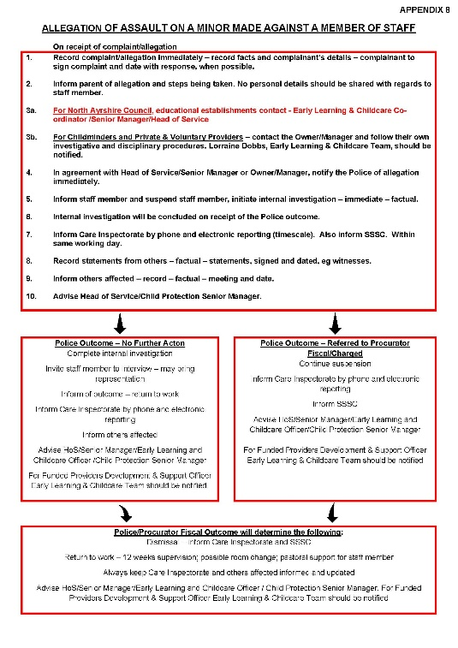
Responding to Allegation - Early Years Processes
Within Early Years establishments/classes, the Early Learning & Childcare Co-ordinator/Senior Manager/HoS must be notified of the allegation immediately. Childminders and Private & Voluntary Providers should contact the owner/manager and follow their own investigative and disciplinary procedures. Lorraine Dobbs, Early Learning & Childcare Team should be notified and will pass on information to the appropriate Senior Manager and HoS. Following discussion, notification of the allegation should be made to the Police and the Care Inspectorate must be informed by phone and electronic reporting. Policy and procedures then must be followed, for example Staff Discipline Policy and Procedures – Disciplinary Code Policy and Procedure – Teachers and Associated Professionals
*Please refer to Standard Circular L3 (August 2021) and Appendix 8 for further guidance (CP Noticeboard). This appendix has been agreed by the Care Inspectorate (May 2019).
Please ensure the dignity and respect of all staff is maintained throughout this whole process (refer to North Ayrshire’s Dignity and Respect Policy and Procedures HR Policy & Procedure: Dignity & Respect at Work and confidentiality rules are adhered to.
Notes:
A copy of the attached process map agreed by the Care Inspectorate (2019) should be discussed with all early years staff and SMT and displayed on the establishment noticeboard

Slide 40

Early Years Classes and Centres – Extension of Hours
Child Protection and Safeguarding Processes
Term-time/when in the building
Head Teacher of establishment/Child Protection Co-ordinator or in their absence, most Senior member of staff
Non term-time or outwith school hours (when Head Teacher/Child Protection Co-ordinator is not in building)
Early Years Manager/Senior will assume the role of CP Co-ordinator within the Early Years Class or Centre in Head of Establishment’s absence
Funded Provider Pre-School Centres – Manager/HOC will assume the role of CP Co-ordinator at all times. Contact arrangements should be shared with all staff and displayed within the establishment.
Agreed procedures should be followed for all Child Protection, or Safeguarding/Welfare matters, in line with Standard Circular L3 and process maps provided.
Advice can be sought from Education Officers/Senior Manager or Head of Service within or outwith normal working hours or call Education Headquarters (01294 324443). Please refer to Phone Tree on CP Noticeboard. Lorraine Dobbs, Early Learning & Childcare Team, should be notified of all CP concerns from Funded Providers. Proportionate information should be shared securely with the CP Co-ordinator for any siblings
The CP Co-ordinator should keep the Named Person (0-5) updated with regards to any concerns
Notes:
To ensure cover for Child Protection and Safeguarding takes account of the additional hours in the early years settings, agreement has been reached in relation to Child Protection and Safeguarding responsibilities as noted above.
Agreed procedures should be followed for all Child Protection, or Safeguarding/Welfare matters, in line with Standard Circular L3 and process maps provided.
Advice can be sought from Senior Manager or Head of Service within or outwith normal working hours or call Education Headquarters (01294 324443). Please refer to Phone Tree on CP Noticeboard. Lorraine Dobbs, Early Learning & Childcare Team, should be notified of all CP concerns from Funded Providers. Proportionate information should be shared securely with the CP Co-ordinator for any siblings

Slide 41
Abuse/Neglect
Physical
Emotional
Neglect
Sexual
Abuse and neglect are forms of maltreatment of a child. Somebody may abuse or neglect a child by inflicting, or by failing to act to prevent, significant harm to the child.
Children may be abused in a family or in an institutional setting, by those known to them or, more rarely, by a stranger.
Always take into consideration that:
Children’s circumstances are unique.
Neglect and abuse cuts across all sectors of society.
Statistically, neglect can be linked to parents who are experiencing or have experienced particular challenges.
Not all children of parents who experience additional issues will be neglected or abused
Notes:
A reminder that abuse/neglect can be in many forms – sometimes there is a tendency to think of abuse as being sexual abuse, possibly because of current media attention:
What is Child Abuse? – www.scotland.police.uk/advice-and-information/child-abuse/what-is-child-abuse/#:~:text=A%20child%20may%20be%20left,from%20physical%20or%20emotional%20harm.

Slide 42
What do you notice?
What should we be aware of?
Think of any changes in behaviour you might see in a child or young person which may concern you.
Try to think of changes under these headings:
Physical
Emotional/Verbal
Neglect
Sexual
Notes:
The suggestion for the next four slides is that, rather than provide staff with the “answers” it would be more effective to ask staff to think of changes that children and young people may display under each of the headings as part of a group discussion, before going on to look at the slides themselves.

Slide 43
Physical
Unexplained Injuries and Burns
Untreated Injuries
Changing Friends
Distracted
Chronic Running Away
Dressing to Impress
Symbols/Tattoos
Refusal to discuss injuries
Weight loss/gain
Change in appearance
Fear of returning home
Hair style/piercings, etc
Changing Names
Withdrawal from physical contact
Notes:
Getting It Right for Vulnerable Children and Young People in North Ayrshire –https://glowscotland.sharepoint.com/sites/NorthAyrshireCouncil/StaffArea/GIRFEC/News%20Alert%20NPS/Vulnerable%20Children%20and%20Young%20People%20in%20North%20Ayrshire%20Aug%202018.pdf
Children and young people who run away, or go missing (Page 17)

Slide 44
Emotional/Verbal
Change in behaviour
Crying/upset
Say a friend has a problem
References to “them” “these people” “they
Change in language – tone
Anger
Rocking
Distracted
Self harming
Drug/Alcohol Abuse
More Outgoing than before
Over reaction to mistakes
Sudden speech disorders
Low self-esteem
“scripted language”
Treatment of others
Compulsive stealing
Low level disruption
Becoming withdrawn
Topics of conversation
Refusal to discuss obvious injuries/behaviour
Notes:
Getting It Right for Vulnerable Children and Young People in North Ayrshire –
https://glowscotland.sharepoint.com/sites/NorthAyrshireCouncil/StaffArea/GIRFEC/News%20Alert%20NPS/Vulnerable%20Children%20and%20Young%20People%20in%20North%20Ayrshire%20Aug%202018.pdf
Eg Children and young people who may be vulnerable as a result of their own or others mental ill health (Page 51)

Slide 45
Poor personal hygiene
Emaciation
Inappropriate clothing for climate
No/limited social relationships
Constant tiredness
Ill-fitting/worn clothing
Hunger
Low self esteem
Lack of routine
Neglect
Notes:
Getting It Right for Vulnerable Children and Young People in North Ayrshire –
https://glowscotland.sharepoint.com/sites/NorthAyrshireCouncil/StaffArea/GIRFEC/News%20Alert%20NPS/Vulnerable%20Children%20and%20Young%20People%20in%20North%20Ayrshire%20Aug%202018.pdf
Eg Children and young people who may be vulnerable as a result of their own or others mental ill health (Page 51)

Slide 46
Sexual
Sexual activity that does not involve mutual consent by the individual involved or where their relationship includes an imbalance of power for example due to age, intellectual ability, race or physical strength
Where the behaviour has the potential to cause physical and or emotional harm
Have unexplained sources of money
Inappropriate clothing for climate
Say a friend has a problem
Have urinary infections, bleeding and soreness
Cry hysterically at ‘nappy changing’ time
Low self esteem
Behave in a sexually inappropriate way
Sexual Abuse
Child Sexual Exploitation
Notes:
Getting It Right for Vulnerable Children and Young People in North Ayrshire –https://glowscotland.sharepoint.com/sites/NorthAyrshireCouncil/StaffArea/GIRFEC/News%20Alert%20NPS/Vulnerable%20Children%20and%20Young%20People%20in%20North%20Ayrshire%20Aug%202018.pdf
Children and young people who are at risk of being exposed to sexual exploitation, including online risk (Page 64)

Slide 47
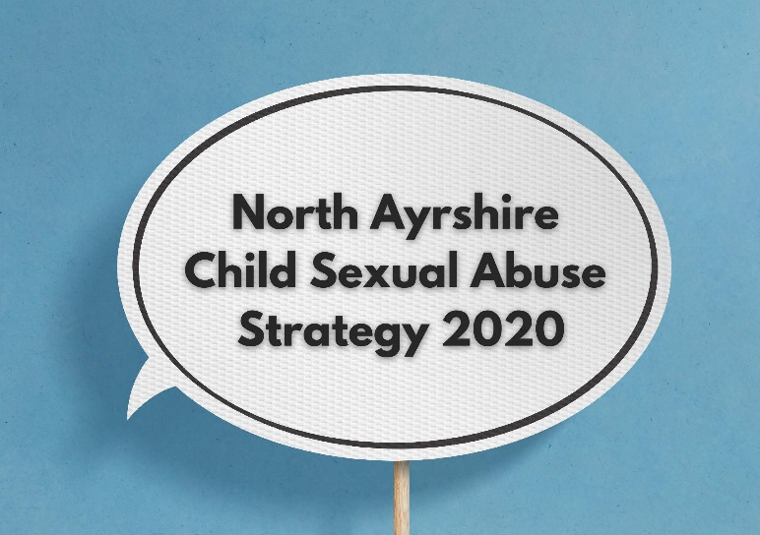
Child Sexual Abuse
Child Sexual Abuse is everyone’s business, North Ayrshire Council has developed a Child Sexual Abuse Strategy and all members of staff should complete CSA Strategy Awareness module accessed via the link below: Child Sexual Abuse Strategy Overview – Module - https://rise.articulate.com/share/Nf89g6Ony5KoxAmN-cEt9wD5QlWIk-fl#/
The full North Ayrshire Child Sexual Abuse Strategy is available on the CPC Website and an easy read version here - http://childprotectionnorthayrshire.info/cpc/media/2014/04/North-Ayrshire-Child-Sexual-Abuse-Strategy-Plain-English.pdf
Notes:
Further guidance is available via Upstream – https://www.theupstreamproject.org.uk/help/help-now

Slide 48
Child Sexual Exploitation - What is CSE?
North Ayrshire’s Child Sexual Abuse Strategy raises awareness of Child Sexual Abuse as an overarching concern. CSE is a part of this and can be recognised as a form of child sexual abuse in which a person(s), of any age takes advantage of a power imbalance to force or entice a child into engaging in sexual activity in return for something received by the child, this could be money, gifts or personal attention.
Also like other forms of sexual abuse, CSE:
Is typified by some form of power imbalance in favour of those perpetrating the abuse;
Can involve coerced and/or enticement based methods of compliance;
Can still be abuse even if it is claimed the child consented or assented – where the age of the child means they cannot legally give consent or the circumstances mean that agreement is not freely given.
If CSE is disclosed or suspected Child Protection processes should be followed immediately
Notes:
CSE is a form of Sexual Abuse and Child Protection processes should be followed immediately
Getting It Right for Vulnerable Children and Young People in North Ayrshire – https://glowscotland.sharepoint.com/sites/NorthAyrshireCouncil/StaffArea/GIRFEC/News%20Alert%20NPS/Vulnerable%20Children%20and%20Young%20People%20in%20North%20Ayrshire%20Aug%202018.pdf
Children and young people who are at risk of being exposed to sexual exploitation, including online risk (Page 64)

Slide 49
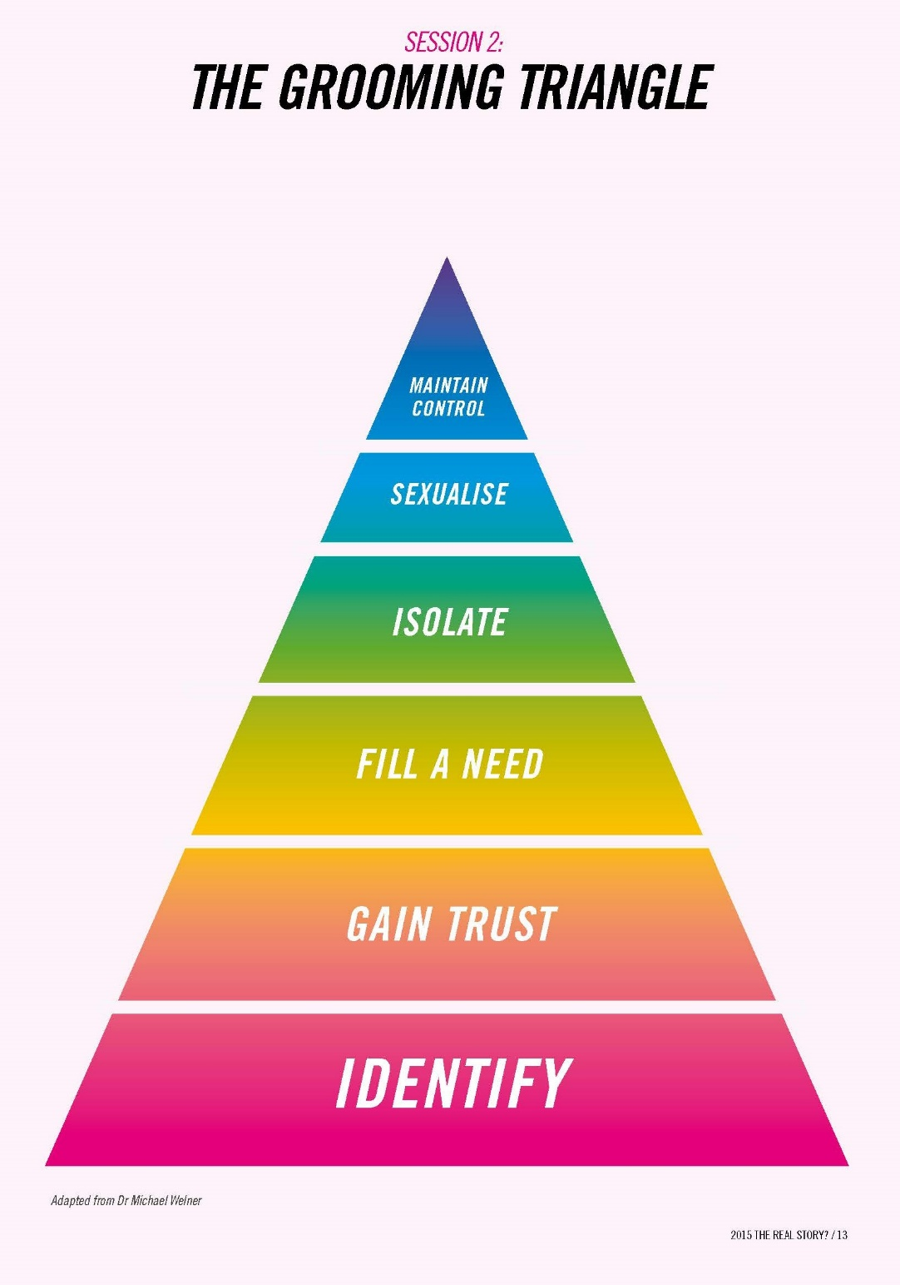
Stages of Grooming
Targeting
Friendship
Special Friendship
Abuse
Notes:
https://www.nspcc.org.uk/what-is-child-abuse/types-of-abuse/grooming/

Slide 50

Vulnerability Factors
Having older boyfriends/girlfriends
Poor health and well-being
Problematic parenting, lack of or no adult guidance/
supervision
History of abuse and disadvantage
Experience of bullying
Disengagement from Education
Looked after and accommodated
Substance, drug, alcohol misuse
Hanging out in areas know to be risky
History of missing episodes
Disrupted family life and violence
Associating with other young people involved in exploitation
Notes:
Vulnerability factors for discussion within groups as outlined in Barnardos support materials

Slide 51
Risk Indicators – Know the Signs
Staying out late/missing episodes
Multiple callers
High number of sexual partners
Unexplained amounts of money/gifts
Use of mobile phones
Expressions of despair
Disclosure followed by withdrawal allegation
Living independently at a young age
Peers involved in CSE
Substance, drug, alcohol misuse
Use of the internet that causes concern
Lack of positive relationship with nurturing adult
STIs
Truancy/exclusion
Notes:
Risk indicators for discussion within groups as outlined in Barnardos support materials

Slide 52
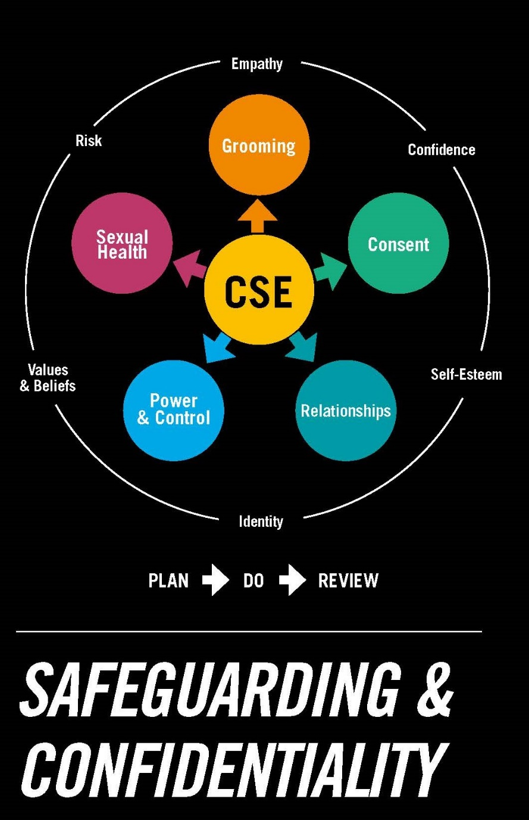
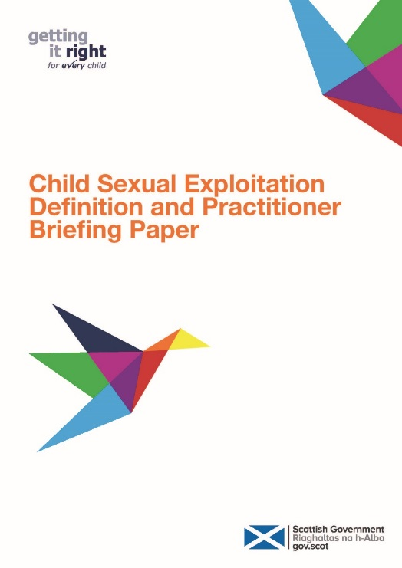
Child Sexual Exploitation
Notes:
Additional resources for display on CP/Safeguarding noticeboard or to assist in curricular planning
Supporting Children and Young People - Child Sexual Exploitation – http://www.scotland.police.uk/keep-safe/young-people/supporting-children-and-young-people/child-sexual-exploitation
Child Sexual Exploitation Definition and Summary – http://www.gov.scot/Resource/0050/00508567.pdf
Child Sexual Exploitation Definition and Practitioner Briefing Paper – http://www.gov.scot/Resource/0050/00508563.pdf
Offence of meeting a child following certain preliminary contact (any child under 16):
Essentially an offence of “grooming”. Covers an individual travelling (in UK or abroad) to engage in unlawful sexual activity with, or in the presence, of a child; following prior contact or communication.25
Barnardos CSE – https://www.barnardos.org.uk/what_we_do/our_work/sexual_exploitation.htm

Slide 53

Children Who Display Sexually
Harmful Behaviours
Harmful sexual behaviour (HSB) is defined as ‘sexual behaviour(s) expressed by children and young people under the age of 18 years that are developmentally inappropriate, may be harmful towards self or others and/or may be abusive towards another child or young person or adult’ (Hackett, 2014).
Children’s sexual behaviour may be described on a continuum ranging from normal to uncommon behaviours, including serious sexual violence.
The Brook Traffic Light Toolkit is a useful tool which can help differentiate any behaviours witnessed.
A half hour free training session can be organised by contacting Eilidh James.

Slide 54
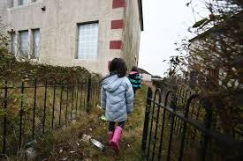
Poverty
Most families experiencing Poverty provide safe and loving homes. However, research shows that there is a "strong association between families’ socio-economic circumstances and the chances that their children will experience child abuse and neglect" (JRF 2016)
Practitioners should be careful not to stigmatise families through highlighting the impact of Poverty in families.
Poverty intersects with other stressors upon families, including disability, ill health, poor housing, barriers to employment and racial discrimination
Poverty must never be a reason for removal of children from the care of their family.
Migrant families face a high risk of poverty and destitution
The My World Triangle prompts practical consideration of material barriers to wellbeing for each child
Some instances of material affluence can also mask emotional neglect and abuse
Actions to prevent and mitigate Child Poverty at local level are likely to have a direct and indirect impact on child wellbeing, safety and protection
Therefore there must be significant, on-going and persistent commitment to ending Poverty and mitigating its impacts for Scotland’s children, families and communities
Notes:
Child Poverty Analysis - https://www.gov.scot/collections/child-poverty-statistics/
North Ayrshire Local Child Poverty Action Plan and Report 2020/21 – http://northayrshire.community/wp-content/uploads/2021/06/NAC_Child_Poverty_2020-21-accessible.pdf

Slide 55
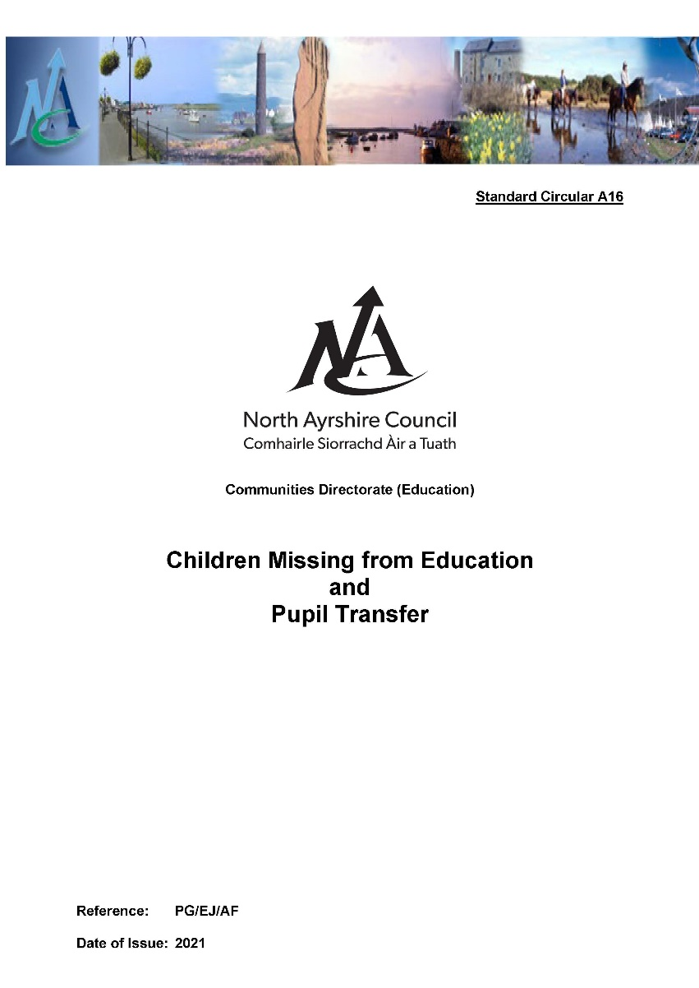
Children Missing from Education
CME processes should be followed by the Head of Establishment or CP Co-ordinator.
If a child is absent and there are no CP/Safeguarding concerns, standard Attendance processes should be followed for up to 4 weeks.
If there are any CP/Safeguarding concerns in relation to the child and/or family these processes should be followed immediately.
Staff should ensure that they share any CME concerns with the CP Co-ordinator.
The welfare of the child and young person is paramount
Notes:
CP Co-ordinators will follow the Guidance in Standard Circular A16 and accompanying process maps and complete standard templates/appendices. These templates will then be emailed securely to the CME mailbox. The Senior Manager with responsibility for CME will acknowledge receipt and follow up with the referrer.
During holiday periods, CME notifications from other authorities will be directed to nominated person covering (or Philip Gosnay/Cluster Senior Manager during October/Easter breaks). If agreed with Head Teacher, nominated staff member can make decisions on outcome. For any CMEs relating to pupils within North Ayrshire schools, normal CME processes should be followed.
Getting It Right for Vulnerable Children and Young People in North Ayrshire –https://glowscotland.sharepoint.com/sites/NorthAyrshireCouncil/StaffArea/GIRFEC/News%20Alert%20NPS/Vulnerable%20Children%20and%20Young%20People%20in%20North%20Ayrshire%20Aug%202018.pdf
Children and young people who run away or go missing (Page 17)

Slide 56
Adult Support & Protection
The Adult Support and Protection (Scotland) Act 2007 introduced legislation for adults (over the age of 16 years) to prevent them from being harmed.
All staff have a legal responsibility to make an Adult Support and Protection referral for any adult they come across in the course of their work, for whom they have concerns.
The legislation enables organisations to work together to support and protect an adult at risk of harm. The harm can come from another person or can be self-harm or self-neglect. The adult's wishes are central to the ASP Process. All types of harm are covered by the Act; physical harm, psychological harm, sexual harm, financial harm etc.
If you have a concern about an adult, don't ignore it – you have a legal duty to take action – speak to the establishment CP Co-ordinator without delay. The CP Co-ordinator will complete and submit Appendix 13 – Multi-Agency Adult Protection/Adult Concern Referral Form or access the form (AP1) via the North Ayrshire Council website –www.north-ayrshire.gov.uk/health-and-social-care/adults-and-older-people/adult-support-and-protection.aspx
The person who is being harmed or neglected may not be able to report it themselves. Everyone has the right to be safe and free from harm. Additional information is available on the North Ayrshire Council website.
Notes:
Getting It Right for Vulnerable Children and Young People in North Ayrshire – https://glowscotland.sharepoint.com/sites/NorthAyrshireCouncil/StaffArea/GIRFEC/News%20Alert%20NPS/Vulnerable%20Children%20and%20Young%20People%20in%20North%20Ayrshire%20Aug%202018.pdf
Adult Support and Protection (Page 16)

Slide 57
Trauma Informed Contact and Care (TICC) and MAASH/MADART Notifications
A Police and Education Early Intervention partnership which supports children and young people exposed to domestic abuse
Information will be passed to the CP Co-ordinator via the Named Person Service detailing information relating to a domestic violence incident that a young person has been exposed to in the last *24 hours – the CP Co-ordinator should share with the NP.
The information given to schools allows the provision of immediate early support depending on the wellbeing needs and wishes of the child.
*MADART Notifications may not be sent within 24 hours
Notes:
The National requirements of a CP Coordinator:
https://www.gov.scot/publications/national-guidance-child-protection-scotland-2021/documents/ - Page 45-47

Slide 58
Trauma Informed Contact and Care (TICC) and MAASH/MADART Notifications
What happens after this email is received?
Named Person/Child Protection Co-ordinator should:
Follow the GIRFEC Child’s Pathway
Consider your knowledge of the family and any additional information you have
Take account of the child's views, and if appropriate talk to the child and/or parent/carer and offer support
Record information in Pastoral Notes and in the AYRshare chronology, if appropriate
If required carry out a wellbeing assessment and follow Team Around the Child Processes
Information regarding the incident will continue to be shared
with Social Work by the Police
If significant concerns arise, then follow Child Protection Procedures
Notes:
The National requirements of a CP Co-ordinator:
https://www.gov.scot/publications/national-guidance-child-protection-scotland-2021/documents/ - Page 45-47

Slide 59

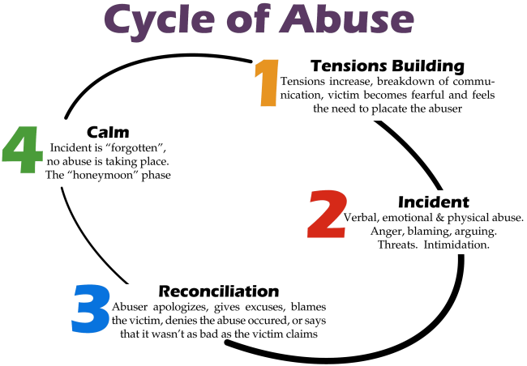

Domestic Abuse Scotland Act 2018
The Domestic Abuse Scotland Act makes any abuse towards a partner, whether, psychological or physical a criminal offence. It redefines Domestic Abuse as a course of behaviour towards a partner intended to cause them harm, or which is reckless as to whether it causes it harm.

Slide 60
Domestic Abuse – Impact on Children
Domestic Abuse is any form of physical, verbal, sexual, psychological or financial abuse which might amount to criminal conduct and which takes place within the context of a relationship:
Offences cover behaviour likely to cause a partner or ex-partner to suffer physical or psychological harm (including fear, alarm and distress)
Children are harmed by experiencing behaviour that is:
Intimidating and degrading
Threatening
Exposing of intimate information
Accusing and blaming coercive and controlling behaviour is also harmful
Chronic trauma can disrupt attachment, achievement, concentration and wider relationships
The traumatic impact of domestic abuse is often masked and emerges indirectly in anxious or troubled behaviours – a trauma-informed approach is required by practitioners
Young people may experience abuse and coercive control in their own relationships outside of the family home
This is often unrecognised and not disclosed
Social media and digital technology may also be used to perpetrate abuse
Notes:
Getting It Right for Vulnerable Children and Young People in North Ayrshire – https://glowscotland.sharepoint.com/sites/NorthAyrshireCouncil/StaffArea/GIRFEC/News%20Alert%20NPS/Vulnerable%20Children%20and%20Young%20People%20in%20North%20Ayrshire%20Aug%202018.pdf
Children and young people who are affected by domestic abuse (Page 43)

Slide 61
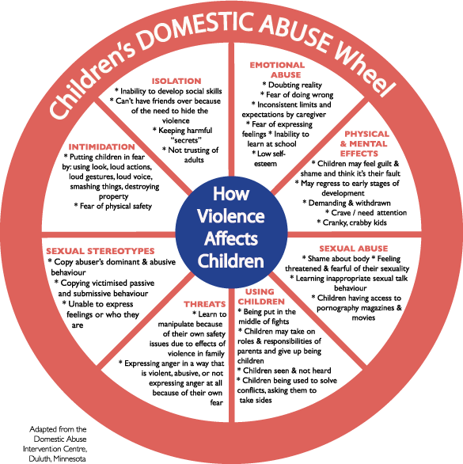
Domestic Abuse – Impact on Children
Notes:
Click on Domestic Abuse Wheel picture and print for discussion
Getting It Right for Vulnerable Children and Young People in North Ayrshire – https://glowscotland.sharepoint.com/sites/NorthAyrshireCouncil/StaffArea/GIRFEC/News%20Alert%20NPS/Vulnerable%20Children%20and%20Young%20People%20in%20North%20Ayrshire%20Aug%202018.pdf
Children and young people who are affected by domestic abuse (Page 43)

Slide 62
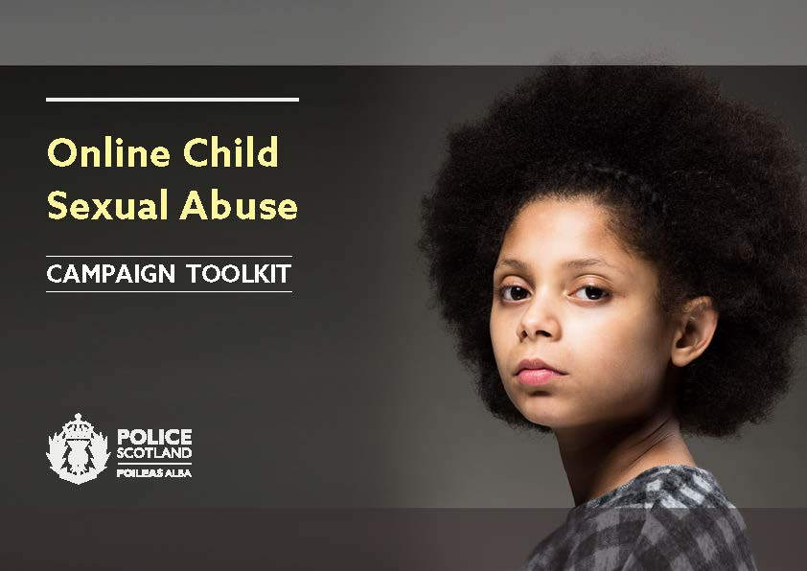


Online Safety
The National Action Plan on Internet Safety for Children and Young People (April 2017) provides guidance around appropriate training, support and information to ensure children and young people are protected, safe and supported in the online world. In addition, the aim of the plan is to assist children and young people to be able to enjoy the internet, show resilience and take advantage of the opportunities it has to offer.
Notes:
National Action Plan on Internet Safety for Children and Young People – http://www.gov.scot/Resource/0051/00516921.pdf

Slide 63
Online Safety
Experiences and Outcomes which have a stronger focus on Digital Literacy and incorporate internet safety and cyber resilience were published for the Technologies area of Curriculum for Excellence in March 2017 and are promoted by Digital Literacy Co-ordinators and CP Co-ordinators in all establishments
How you can be involved and contribute to the safety of children and young people online within North Ayrshire?
CEOP Training – Ambassadors
CPC Training Calendar
CEOP Curricular Links
Online Safety Events
The Pledge
Teaching staff – Links
Communication Strategy
Notes:
Following a request from Parents and Community Groups for a list of resources and websites to help them support children and young people to remain safe online a North Ayrshire Online Safety Directory was created. A copy of the Directory can be found on the North Ayrshire CPP and CPC websites, in addition to the CP & Safeguarding Glow tile. If you would like a copy, please contact Angela Feeney, afeeney@north-ayrshire.gov.uk

Slide 64
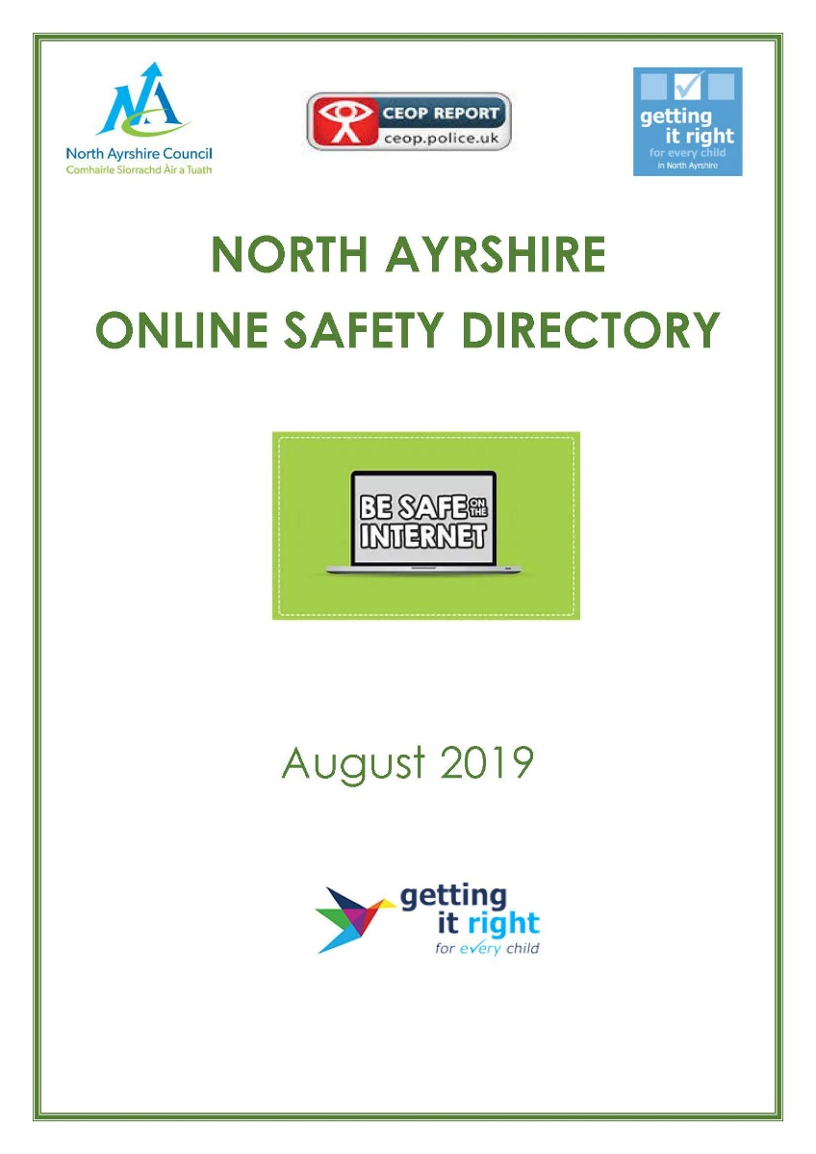
Online Safety
Professionals involved in assessment and planning should develop a knowledge of online risks, the impact of technology on the lives of children and young people and the use of technology by parents and carers which may impact on children. They should consider the place of technology within the child’s world, with a view to working together on plans relevant to the situation.
Notes:
Following a request from Parents and Community Groups for a list of resources and websites to help them support children and young people to remain safe online a North Ayrshire Online Safety Directory was created. A copy of the Directory can be found on the North Ayrshire CPP and CPC websites, in addition to the CP & Safeguarding Glow tile. If you would like a copy, please contact Angela Feeney, afeeney@north-ayrshire.gov.uk

Slide 65
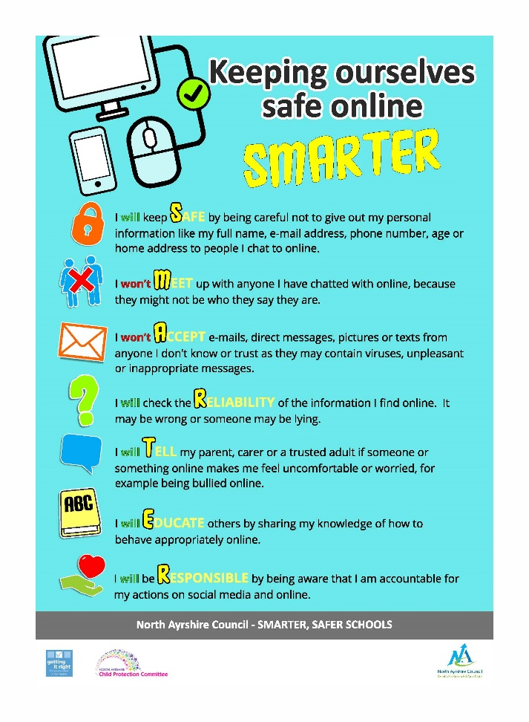
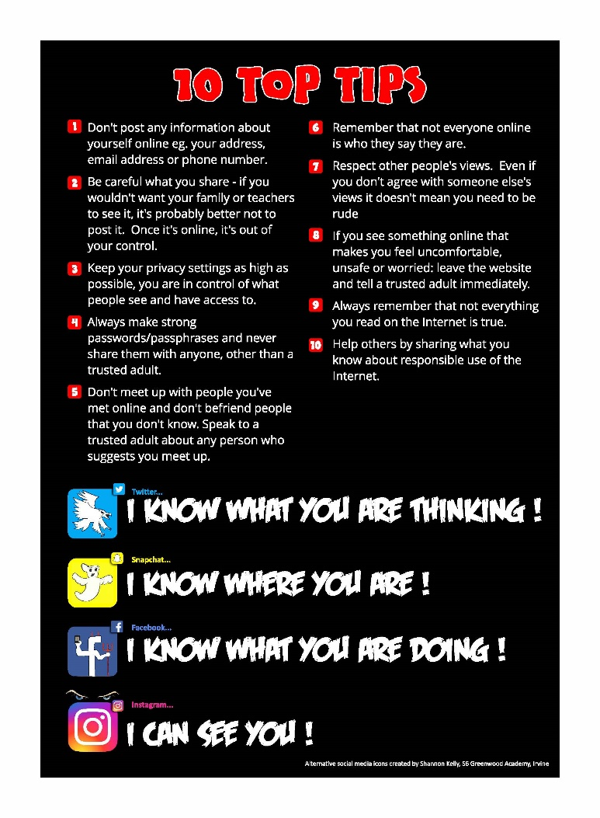
Online Safety
Children and young people in North Ayrshire have created a Pledge which all pupils have signed up to:
North Ayrshire Pupil Definition:
Being switched on when using websites and social media and being able to use them confidently, happily and safely.
Draft National Guidance for Child Protection in Scotland 2020 definition:
Online child abuse is any type of abuse that occurs in the digital environment and the internet, facilitated through technology and devices such as computers, tablets, mobile phones, gaming devices and other online-enabled devices.
Notes:
Please ensure the signed Pledge is displayed within the school entrance and copies of the double-sided flyer are displayed in all classrooms.

Slide 66
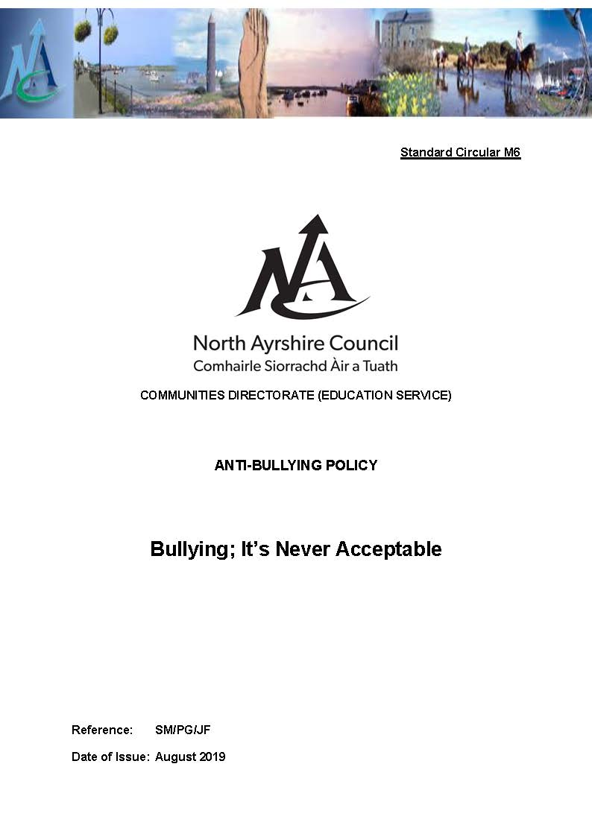
Anti-Bullying
A culture that encourages respect, values opinions, celebrates differences and promotes positive relationships will make it all the more difficult for bullying behaviour to flourish or be tolerated.
It is the on-going aim to reduce and eradicate bullying behaviour by:
Raising awareness of bullying behaviour
Creating and supporting a culture of respect, care and consideration of others
Ensuring that all staff, pupils, parents and carers are aware of school procedures and strategies on dealing with instances of bullying
Having built in monitoring and evaluation mechanisms to ensure that procedures are being consistently applied.
Standard Circular M6 – Bullying: It’s Never Acceptable
Notes:
Please refer to Respect Me guidance - http://respectme.org.uk/

Slide 67

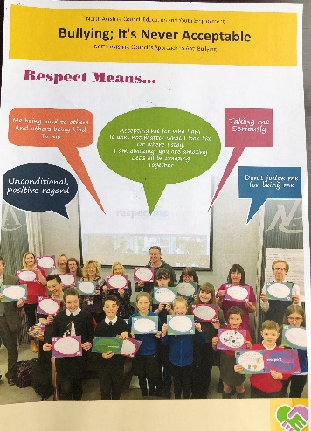
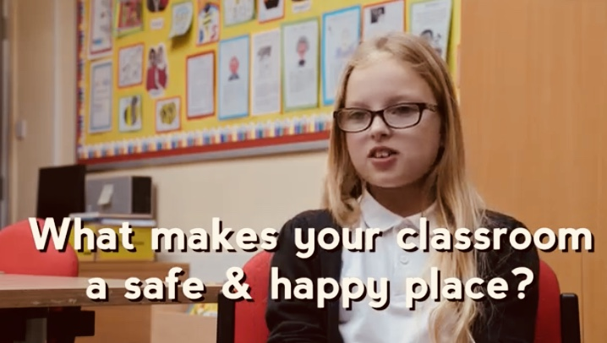
Respect for All and North Ayrshire’s response policy Bullying: It’s Never Acceptable (in partnership with respectme – Scotland’s anti bullying service) provides an overarching framework and context for all anti-bullying work to be undertaken in all our schools and establishments. The policy aims to build capacity, resilience and skills in children and young people, and all those who play a role in their lives, to prevent and deal with bullying. It utilises the skills built in nurture and restorative practice and the associated appendices provide comprehensive strategies for responding to bullying behaviours.
Notes:
Respect Me guidance - http://respectme.org.uk/
APPENDIX 24
1.0 Introduction
Recording and Monitoring of Bullying Incidents in Schools (RAMBUS)
1.1 This guidance to be read in conjunction with “Respect for All (2017)” and North Ayrshire Council’s Anti-bullying Policy; “Bullying. It’s Never Acceptable (2018)
1.2 There is an expectation that all schools adopt the approach outlined within this guidance (in the case of North Ayrshire this is from June 2019)
1.3 North Ayrshire recognises that bullying behaviour may be a result of prejudice that relates to perceived or actual differences. This can lead to behaviour and language that manifests as racism, sexism, homophobia, biphobia or transphobia or prejudice and discrimination towards disability or faith. It can also be based on characteristics unique to a child or young person’s identity or circumstance. There is therefore a need to address the root cause of prejudice as well as respond to incidents as they arise.
1.4 The existence of bullying and harassment in schools impacts upon a wide range of children and young people’s human rights
1.5 Environments that promote respect, celebrate difference and promote positive relationships and behaviour are less likely to see bullying as acceptable behaviour. Implementing preventative strategies should result in an overall reduction in bullying incidents.(see NAC Promoting Positive Relationships Policy)
1.6 Information gathered at a local level may be used by the Scottish Government, working in partnership with Convention of Scottish Local Authorities (COSLA), Association of Directors of Education in Scotland (ADES), teaching unions and other stakeholder bodies to support self-evaluation and improvement and inform future policy and practice.
1.7 The Bullying and Equalities Module within the SEEMiS system has been updated and is identified as the process in NAC to record and monitor bullying incidents.
1.8 ‘How Good is Our School 4’ includes a safeguarding quality indicator and specific quality indicator on ensuring wellbeing, equality and inclusion. Together with “How Good Is OUR School Part 2” these support schools to effectively evaluate their own practice and support through self- evaluation and improvement in child protection and anti bullying approaches.

Slide 68
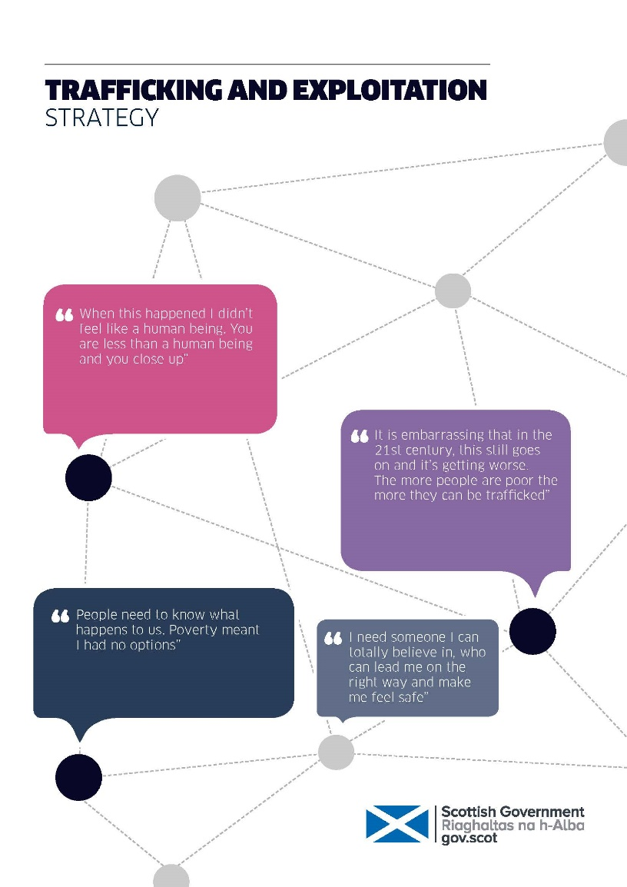
Child Trafficking
“The recruitment, transportation, transfer, harbouring or receipt of a child for the purposes of exploitation”. Palermo Protocol
Trafficking is where children and young people tricked, forced or persuaded to leave their homes and are moved or transported and then exploited, forced to work or sold. Children are trafficked for:
Sexual exploitation
Benefit fraud
Forced marriage
Domestic slavery like cleaning, cooking and childcare
Coerced labour in factories or agriculture
Committing crimes, like begging, theft, working on cannabis farms or moving drugs
Trafficked children experience many types of abuse and neglect. Traffickers use physical, sexual and emotional abuse as a form of control. Children and young people are also likely to be physically and emotionally neglected and may be sexually exploited
Always take timely and decisive action due to the risk of the child being moved.
Getting It Right For Vulnerable Children and Young People in North Ayrshire 2018
New Legislation in Scotland published 2017 – link with photo
Notes:
Getting It Right for Vulnerable Children and Young People in North Ayrshire –https://glowscotland.sharepoint.com/sites/NorthAyrshireCouncil/StaffArea/GIRFEC/News%20Alert%20NPS/Vulnerable%20Children%20and%20Young%20People%20in%20North%20Ayrshire%20Aug%202018.pdf
Children and young people who are trafficked in the UK (Page 21)

Slide 69

Female Genital Mutilation
The World Health Organisation defines FGM as all procedures that involves partial or total removal of the female genitalia, or other injury to the female genital organs.
FGM is a violation of human rights
The Prohibition of Female Genital Mutilation (Scotland) made it a criminal offence to have FGM carried out in Scotland and abroad. (The Scottish National Action Plan to Prevent and Eradicate FGM; Equally Safe – Scotland's for Preventing Violence Against Women and Girls)
Women and young girls may be trafficked outwith the UK to have the procedure.
There is growing evidence that female genital mutilation is being arranged in Scotland/the UK.
School summer holidays emerge as a particular time of risk as it is thought that the girls and young women will heal and recover for the procedure in time to return to education.
Notes:
https://www.gov.scot/publications/scotlands-national-action-plan-prevent-eradicate-fgm/
In the UK, it is estimated that:
around 137,000 women have undergone FGM
some 60,000 girls under 15 years old are at risk
*source - www.gov.uk/guidance/female-genital-mutilation-fgm-migrant-health-guide

Slide 70

Female Genital Mutilation
All staff should be particularly vigilant in relation to parents informing the establishment of planned absences over a number of weeks. Any information should be passed to the Head of Establishment or CP Co-ordinator immediately.
FGM is a violation of the rights of the child. The practice is illegal in the UK and will cause severe physical and psychological trauma to victims both in the short and long term.
FGM is a CHILD PROTECTION issue – follow Child Protection processes immediately.
Office staff in school who deal with attendance should be aware of the necessity to report any concerns to the CP Co-ordinator immediately.
www.shaktiedinburgh.co.uk

Slide 71
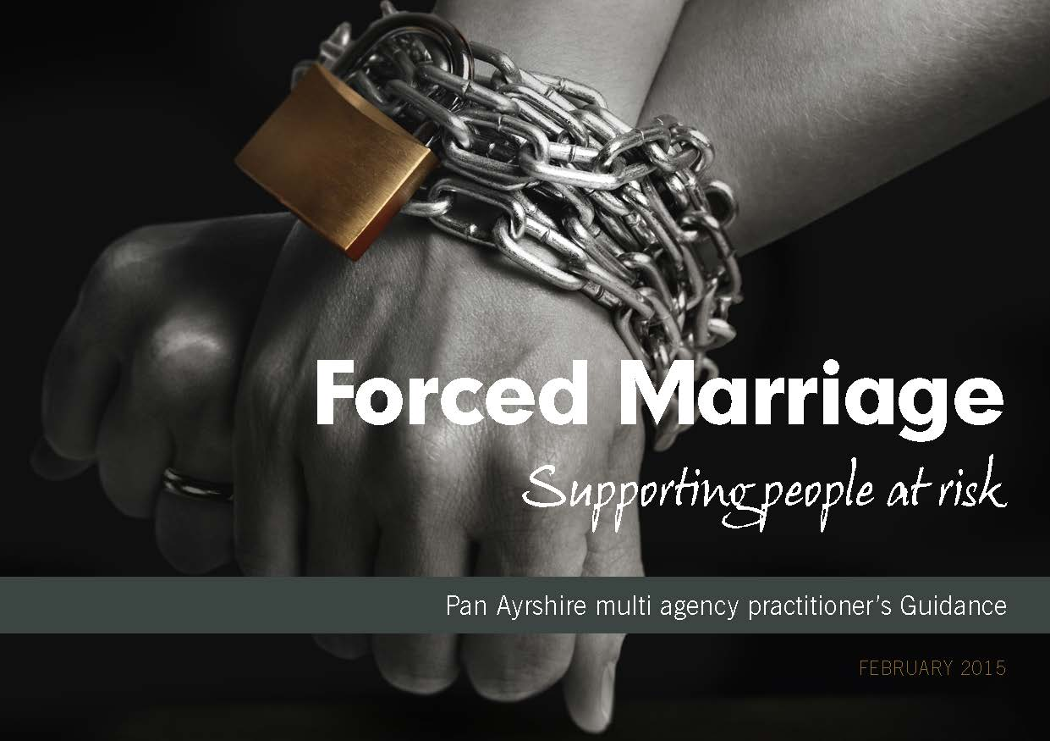
Honour Based Abuse and Forced Marriage
Honour Based Abuse includes practices used to control behaviour within families, communities, or other social groups, to protect perceived cultural and religious beliefs and/or ‘honour’. Such abuse can occur, for example, when perpetrators perceive that a relative has shamed or may potentially shame the family and/or community by breaking their honour code. This abuse can take many forms, including threatening behaviour, emotional blackmail, assault, rape, abduction, forced marriage, confinement and ‘honour killing’.
A Forced Marriage is a marriage conducted without the full and free consent of both parties, and where duress is a factor. Duress can include physical, psychological, financial, sexual and emotional abuse. A forced marriage is different from an ‘arranged marriage’.
Notes:
https://www.gov.scot/publications/national-guidance-child-protection-scotland-2021/documents/
Page 203-204
Children at Risk
Those who might identify as LGBT and disabled children may be at increased risk of forced marriage. For LGBT people this is seen as a way of ensuring that their LGBT identity is not made public. Forced marriages are also seen as a way of ensuring that someone who needs care has a spouse who can provide this care. Furthermore, immigration can be an aggravating factor towards forced marriage: by arranging a marriage of a UK citizen with someone from overseas, the overseas spouse is guaranteed an easier entry into the UK. An estimated 80% of forced marriage victims are girls and women. HBA support work is mainly conducted by women’s organisations. However, boys, especially those who might identify as gay, bi-sexual or transgender are also affected by forced marriage, domestic abuse, coercive control and other forms of HBA. Practitioners should be aware that forced marriage is not restricted to any particular ethnic or religious community.

Slide 72
Honour Based Abuse and Forced Marriage
Most Forced Marriage or HBA victims are female, although boys who identify as gay, bi-sexual or transgender are also affected.
Forced Marriage and HBA is both a child and adult protection matter. Child Protection processes should be followed up to the age of 18.
The consequences of Forced Marriage can be devastating for the whole family, but especially to the young people affected. They may become estranged from their families and wider communities, lose out on educational opportunities, or become victims of domestic abuse. Rates of suicide and self-harm within forced marriages are high.
Potential indicators of honour-based abuse and forced marriages include:
concerns voiced by child or person in child’s network about going overseas ‘to visit relatives’ or attend a wedding
concerns expressed about a dowry being collected (usually jewellery, clothing, other material possessions)
a girl undergoing or at risk of undergoing FGM as part of her ‘preparation’ for the marriage
Child Protection procedures should be followed
Notes:
https://www.gov.scot/publications/national-guidance-child-protection-scotland-2021/documents/
Page 203-204
Education concerns:
absence, or persistent absence, from education
request for extended leave of absence and failure to return from visits of country of origin
decline in behaviour, engagement, performance or punctuality
being withdrawn from school by those with parental responsibility
being prevented from attending extra-curricular activities
being prevented from going onto further/higher education
sudden changes in appearance or behaviour (especially young girls changing their dress code dramatically to adopt culturally/religiously appropriate clothing)
Health concerns:
self-harm
attempted suicide
depression
eating disorders accompanied to doctors or clinics and prevented from speaking to health practitioners in confidence
experience of female genital mutilation (FGM)
Police concerns:
reports of domestic abuse, harassment or breaches of the peace at the family home •
threats to kill and attempts to kill or harm the potential victim or another family member (emotional blackmail)
truancy or persistent absence from school
Approach. Direct engagement with the family is not advised, as it may aggravate and expedite the risk of a child being taken abroad for a marriage. It is always advisable to contact a specialist organisation or community advisor for support.

Slide 73
Radicalisation and Extremism
PREVENT is part of CONTEST, the government counter-terrorism strategy, it is designed to tackle the problem of terrorism at its roots, preventing people from supporting terrorism or becoming involved in terrorism themselves.
PREVENT is essentially about recognising when individuals, particularly those who are vulnerable, are being exploited, and responding effectively in partnership with other statutory agencies when concerns arise.
There is no single profile of a person who is likely to become involved in extremism or radicalisation. Also, there is no universally accepted view of why vulnerable individuals might become involved in such activities.
Radicalisation and Extremism refers to a number of areas. For example:
Sectarianism
Terrorism
The Far Right
Animal Rights
All staff are required to complete the i-Learn module
(WRAP) Workshop to Raise Awareness of PREVENT training is available via the council’s e-learning platform (i-Learn) -
Notes:
Extreme Dialogue for PREVENT Scotland – https://education.gov.scot/improvement/Documents/ExtremeDialogue.pdf
Raising a concern – Notice, Check, Share
Don’t rely on others. You must report any concerns you have. This is a safeguarding issue and CP procedures should be followed except in the case of an emergency when the Police should be contacted immediately.
http://naconnects.north-ayrshire.gov.uk/news/documents/32808-6pp-x-3rd-A4-NAC-Safety-Leaflet-24-May-2017.pdf
Ayrshire Council - Prevent Strategy – Stop Press – 9 June 2017
http://naconnects.north-ayrshire.gov.uk/news/documents/Stop-press-Prevent-strategy-briefing-v2-9-June-17.pdf
Preventing vulnerable people being drawn into terrorism
The purpose of this stop press is to let you know what you can do to prevent vulnerable people being drawn into terrorism.
The Counter Terrorism and Security Act came into force in July 2015, placing a duty on a number of specified authorities to have “due regard to the need to prevent people from being drawn into terrorism”.
The authorities identified as having a role in protecting vulnerable people include the NHS, the local authorities, further and higher education establishments, prisons and the police. It is important to recognise that for most of these authorities, work to stop individuals from being drawn into terrorism forms part of their normal work to protect vulnerable children and adults, and existing procedures are applied.
So, in the same way that we might raise concerns about children who may be vulnerable to neglect, or someone who could be vulnerable to abuse in the home, we need to know how to identify concerns that people
might be vulnerable to being drawn into terrorism. We need to know who to tell, so that the appropriate care, advice and support can be considered. In doing this, we can help prevent people from being exploited by those who would seek to harm us through terrorism and violent extremism.
This briefing introduces the Prevent strategy and answers any questions about what it means for you.
What is the Prevent strategy?
The Prevent strategy aims to reduce the threat to the UK from terrorism by stopping people becoming terrorists or supporting terrorism. It is about preventative action, and is very much focused on the early stages where a crime has not yet been committed.
Working together to achieve the healthiest
life possible for everyone in Ayrshire and Arran
What is the threat?
Prevent involves all kinds of terrorist threat to the UK, including organisations originating in Syria, Iraq and Northern Ireland, and also
right wing extremist organisations who pose a threat to our safety and security.
Motivations are varied and many usually relate to particular ideologies, some further examples include:
• political movements;
• religious beliefs;
• animal rights groups;
• environmental issues; and
• economic issues.
Why do people get involved in terrorism or violent extremism?
There is no single profile for a person who is likely to become radicalised or move to support extremism. However, here are some
signs that may indicate vulnerability to terrorist ideologies – for example:
• a lack of identity or belonging/identify crisis;
• insecurity;
• defending a culture, way of life or beliefs; and
• being pressured or bullied.
Those who radicalise others into believing terrorist or violent extremist ideologies often target vulnerable people who are led into believing that violence or criminality can earn respect, right a wrong or glorify a cause.
Spotting the signs
There is no checklist that we can give you to help you make decisions about whether a staff member, patient, client, student or visitor has been or is being radicalised.
There is no single profile to determine who is likely to become involved in terrorism
or violent extremism and the process of radicalisation. The process of radicalisation is different for every individual and situation.
However, signs that an individual may be being radicalised could be:
• becoming focussed on extremist activities;
• becoming withdrawn and stopping participating in their usual activities;
• expressing feelings of anger, grievance or injustice;
• going missing from their home, school or care setting;
• a new group of friends who you have concerns about using language that supports ‘us and them’ thinking;
• possessing or searching for extremist literature online; or
• changes in an individual’s appearance or behaviour.
As a member of staff, you are required to use your existing skills and professional judgement in determining the significance of any changes. However, we recognise that in large organisations, staff have different levels and types of interaction with others.
In some areas, staff will have professional duties in relation to safeguarding members of the public – in other areas, much less so. If you work in an area where you are already skilled in safeguarding, you will receive additional training to help you spot the signs of vulnerability to being drawn into terrorism. For others, the focus is on being aware that if you see something that is of concern, you know who you can contact in your organisation for advice and guidance. This is so that you can pass on your concern if this is necessary and be confident that you have done the right thing. It also ensures that others in the organisation, who are suitably trained, can exercise professional judgement so that cases that need to be taken forward are dealt with appropriately. Concerns could relate to people in your community, members of the public you have some dealings with as part of your work, or members of staff.
Raising a concern – Notice, Check, Share
Don’t rely on others. You must report any concerns you have.
http://naconnects.north-ayrshire.gov.uk/news/documents/32808-6pp-x-3rd-A4-NAC-Safety-Leaflet-24-May-2017.pdf

Slide 74
Radicalisation and Extremism
Scottish Government National Guidance for Child Protection in Scotland 2021 uses terminology Vulnerability to being drawn into terrorism.
This places an obligation on local authorities to ensure that a panel of persons is in place for its area to assess the extent to which identified individuals are vulnerable to being drawn into terrorism and, where appropriate, arrange for support to be provided.
Revised HM Government Guidance (2021) is available for Scotland - Prevent Multi-Agency Panel Duty Guidance: Protecting people vulnerable to being drawn into terrorism.
Public sector frontline staff identified as a key group in the identification and referral of individuals who may be vulnerable to being drawn into terrorism as a consequence of radicalisation.
All should have undertaken the relevant training to ensure they understand Prevent, the Prevent Multiple Agency Panel (PMAP) process, the radicalisation process and how to intervene to prevent someone from being drawn into terrorism.
Notes:
Revised HM Government Guidance (2021) is available for Scotland (Prevent Multi-Agency Panel Duty Guidance: Protecting people vulnerable to being drawn into terrorism(publishing.service.gov.uk). https://assets.publishing.service.gov.uk/government/uploads/system/uploads/attachment_data/file/964230/6.6467_HO_PMAP-Duty-Guidance-Scotland.pdf (new)
Extreme Dialogue for PREVENT Scotland – https://education.gov.scot/improvement/Documents/ExtremeDialogue.pdf
Revised Prevent duty guidance: for Scotland - GOV.UK (www.gov.uk) (new)
Raising a concern – Notice, Check, Share
Don’t rely on others. You must report any concerns you have. This is a safeguarding issue and CP procedures should be followed except in the case of an emergency when the Police should be contacted immediately.
Preventing vulnerable people being drawn into terrorism
The purpose of this stop press is to let you know what you can do to prevent vulnerable people being drawn into terrorism.
The Counter Terrorism and Security Act came into force in July 2015, placing a duty on a number of specified authorities to have “due regard to the need to prevent people from being drawn into terrorism”.
The authorities identified as having a role in protecting vulnerable people include the NHS, the local authorities, further and higher education establishments, prisons and the police. It is important to recognise that for most of these authorities, work to stop individuals from being drawn into terrorism forms part of their normal work to protect vulnerable children and adults, and existing procedures are applied.
So, in the same way that we might raise concerns about children who may be vulnerable to neglect, or someone who could be vulnerable to abuse in the home, we need to know how to identify concerns that people might be vulnerable to being drawn into terrorism. We need to know who to tell, so that the appropriate care, advice and support can be considered. In doing this, we can help prevent people from being exploited by those who would seek to harm us through terrorism and violent extremism.
This briefing introduces the Prevent strategy and answers any questions about what it means for you.
What is the Prevent strategy?
The Prevent strategy aims to reduce the threat to the UK from terrorism by stopping people becoming terrorists or supporting terrorism. It is about preventative action, and is very much focused on the early stages where a crime has not yet been committed.
Working together to achieve the healthiest life possible for everyone in Ayrshire and Arran
What is the threat?
Prevent involves all kinds of terrorist threat to the UK, including organisations originating in Syria, Iraq and Northern Ireland, and also right wing extremist organisations who pose a threat to our safety and security. Motivations are varied and many usually relate to particular ideologies, some further examples include:
• political movements;
• religious beliefs;
• animal rights groups;
• environmental issues; and
• economic issues.
Why do people get involved in terrorism or violent extremism?
There is no single profile for a person who is likely to become radicalised or move to support extremism. However, here are some signs that may indicate vulnerability to terrorist ideologies – for example:
• a lack of identity or belonging/identify crisis;
• insecurity;
• defending a culture, way of life or beliefs; and
• being pressured or bullied.
Those who radicalise others into believing terrorist or violent extremist ideologies often target vulnerable people who are led into believing that violence or criminality can earn respect, right a wrong or glorify a cause.
Spotting the signs
There is no checklist that we can give you to help you make decisions about whether a staff member, patient, client, student or visitor has been or is being radicalised. There is no single profile to determine who is likely to become involved in terrorism or violent extremism and the process of radicalisation. The process of radicalisation is different for every individual and situation.
However, signs that an individual may be being radicalised could be:
• becoming focussed on extremist activities;
• becoming withdrawn and stopping participating in their usual activities;
• expressing feelings of anger, grievance or injustice;
• going missing from their home, school or care setting;
• a new group of friends who you have concerns about using language that supports ‘us and them’ thinking;
• possessing or searching for extremist literature online; or
• changes in an individual’s appearance or behaviour.
As a member of staff, you are required to use your existing skills and professional judgement in determining the significance of any changes. However, we recognise that in large organisations, staff have different levels and types of interaction with others.
In some areas, staff will have professional duties in relation to safeguarding members of the public – in other areas, much less so. If you work in an area where you are already skilled in safeguarding, you will receive additional training to help you spot the signs of vulnerability to being drawn into terrorism. For others, the focus is on being aware that if you see something that is of concern, you know who you can contact in your organisation for advice and guidance. This is so that you can pass on your concern if this is necessary and be confident that you have done the right thing. It also ensures that others in the organisation, who are suitably trained, can exercise professional judgement so that cases that need to be taken forward are dealt with appropriately. Concerns could relate to people in your community, members of the public you have some dealings with as part of your work, or members of staff.
Raising a concern – Notice, Check, Share
Don’t rely on others. You must report any concerns you have.
Safeguarding - Prevent Radicalisation and Extremism – https://education.gov.scot/improvement/learning-resources/safeguarding-prevent-in-education/#:~:text=Simply%20put%2C%20Prevent%20is%20about,form%20of%20safeguarding%20from%20harm.

Slide 75

Radicalisation and Extremism
The Vulnerability Assessment Framework involves three dimensions:
Engagement with a group, cause or ideology.
Intent to cause harm.
3. Capability to cause harm
The Prevent strategy, published by the UK Government in 2011, is part of our overall counter-terrorism strategy, CONTEST. The Prevent strategy has 3 specific strategic objectives:
Respond to the ideological challenge of terrorism and the threat we face from those who promote it.
Prevent people from being drawn into terrorism and ensure that they are given appropriate advice and support.
Work with sectors and institutions where there are risks of radicalisation that we need to address.

Slide 76

Summary – Responding to Child Protection & Safeguarding Concerns
Where there is concern about child protection or safeguarding (child abuse, neglect or exploitation) you should:
Discuss your concerns with the Child Protection Co-ordinator (or member of Senior Management Team) immediately. The CP Co-ordinator will decide on an appropriate course of action.
Establish with the CP Co-ordinator when and how concerns should be recorded/shared, including, if and when, following consultation with Social Work, if this information can be shared with parents/carers.
Ensure you are clear with regards to the establishment policy and procedures.
Formalise with the Child Protection Co-ordinator what further support the child is likely to need and how best this can be met.
Notes:
With regards to significant events, the CP Co-ordinator/Head of Establishment should ensure these are recorded in chronologies within SEEMiS Pastoral Notes/AYRshare Multiagency record as appropriate and within CP 7 Part files.
Each establishment should create a sign/poster indicating who their Head Teacher, Child Protection Co-ordinator, EY Child Protection Co-ordinator (if applicable), and ASIST trained staff member (if applicable) are and display on their Parent and CP Noticeboard and within the entrance area of their school/establishment.

Slide 77
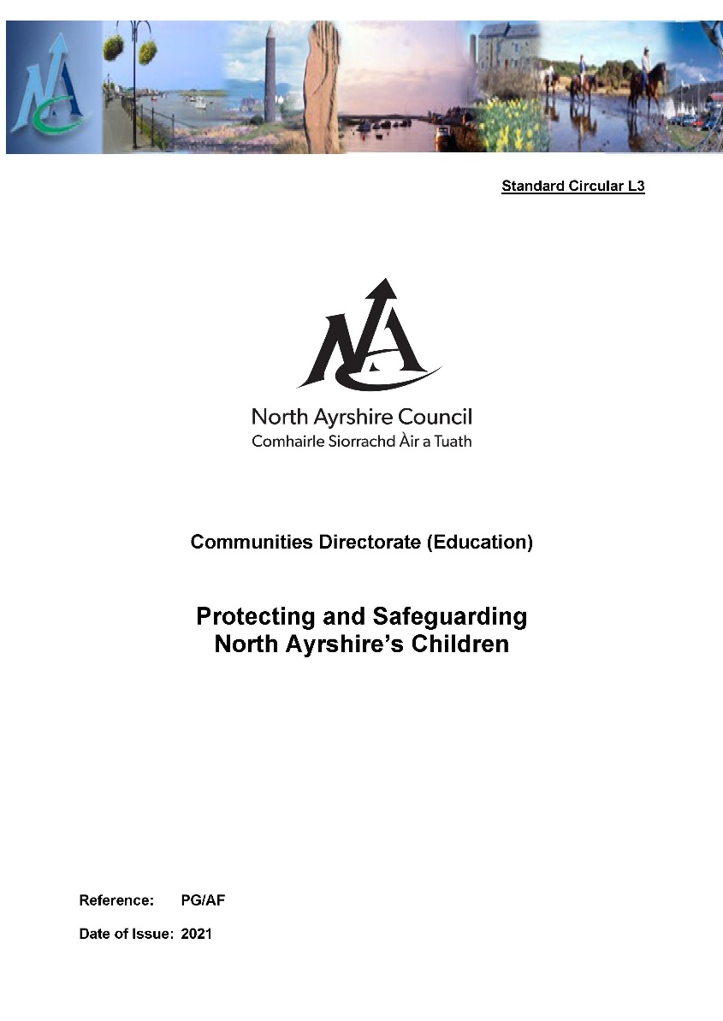
Protecting and Safeguarding North Ayrshire’s Children
Standard Circular L3: Protecting and Safeguarding North Ayrshire’s Children provides guidance for policy and practice within all Education establishments to secure the care and wellbeing of all children and young people and to ensure an appropriate response when concerns are identified.
All staff are required to be familiar with SC L3 and to follow the procedures and guidelines it contains. (A copy of this policy can be found on Connects, Glow and the Staff CP Notice Board within all establishments).

Slide 78
Key Agency Contacts
SERVICE ACCESS TEAMS If you are concerned about a child it is important that this information gets to the right people as soon as possible. The best people to contact are the social services team for the area in which the child lives. If you are not sure which area the child lives, then contact Irvine Social Services. If you are trying to contact Social Services out of office hours, then telephone: 0800 328 7758
Arran Area Office | For Arran | 01770 600742 | RSArran@north-ayrshire.gov.uk
Irvine Area Office | For Irvine and Kilwinning | 01294 310300 | RSIrvine@north-ayrshire.gov.uk
Kilbirnie Area Office | For Garnock Valley | 01505 684551 | RSKilbirnie@north-ayrshire.gov.uk
Largs Area Office | For North Coast | 01475 687592 | serviceaccess@north-ayrshire.gov.uk
Three Towns Area Office | For Stevenson, Saltcoats and Ardrossan | 01294 310005 | RS3Towns@north-ayrshire.gov.uk
Police Scotland at any police office or
by calling 101 or 999 in case of emergency
Notes:
Display on CP Staff Noticeboard

Slide 79

Education Contacts (5-18)
During Office Hours and Outwith
* Key Contacts for Child Protection
Name |  | Telephone | Email
Caroline Amos * | Mobile | 07398 991597
Head of Service | Office | 01294 324416 (Cunninghame House) | carolineamos@north-ayrshire.gov.uk
Philip Gosnay * | Mobile | 07798 577355
Senior Manager (Inclusion) | Office | 01294 324740 (Cunninghame House) | philipgosnay@north-ayrshire.gov.uk
Gail Nowek | Mobile
Principal Psychologist | Office | 01294 324589 (Cunninghame House) | gailnowek@north-ayrshire.gov.uk
Notes:
Display on CP Staff Noticeboard

Slide 80
Education Contacts (Early Years)
During Office Hours and Outwith
* Key Contacts for Child Protection
Name |  | Telephone | Email
Calum Maxwell | Mobile | 07866 504826
Senior Manager (Early Years) | Office | 01294 324467 (Cunninghame House) | calummaxwell@north-ayrshire.gov.uk
Lorraine Dobbs * | Mobile | 07712 288893
Early Learning and Childcare Co-ordinator | Office | 01294 317261 (Cunninghame House) | lorrainedobbs@north-ayrshire.gov.uk
Notes:
Display on CP Staff Noticeboard

Slide 81
Useful Documents and Websites
North Ayrshire Child Protection Committee www.childprotectionnorthayrshire.info
Barnardos – www.barnardos.org.uk
CEOP – www.ceop.police.uk/safety-centre/
Female Genital Mutilation – www.forwarduk.org.uk/key-issues/fgm
National Child Protection Guidance 2021– here
National Risk Framework – www.gov.scot/Resource/0040/00408604.pdf
Pan Ayrshire GIRFEC – www.girfec-ayrshire.co.uk/
Shakti Women’s Aid – www.shaktiedinburgh.co.uk
UNICEF – UN Rights of the Child – www.unicef.org/crc/

Slide 82
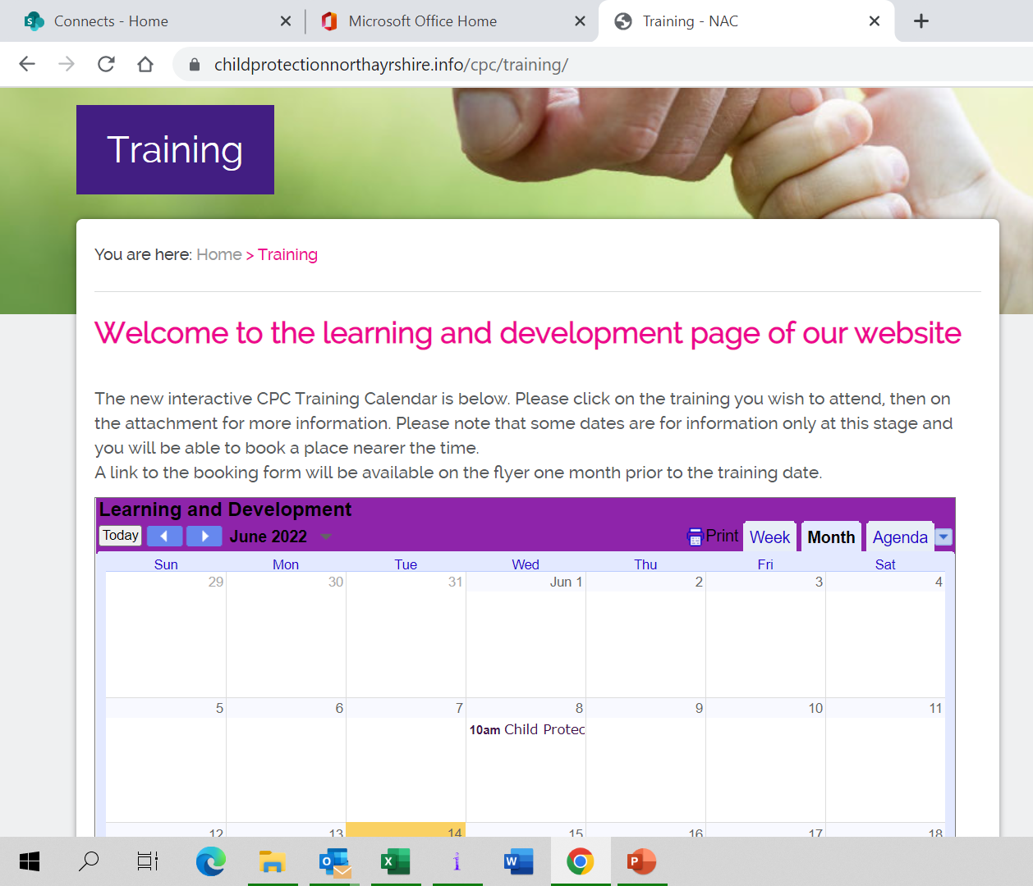
CPC Training
Additional Training is available to all staff via the CPC training calendar that can be accessed via the CPC website. Staff should seek permission from their line manager when applying for courses http://childprotectionnorthayrshire.info/cpc/training/

Slide 83

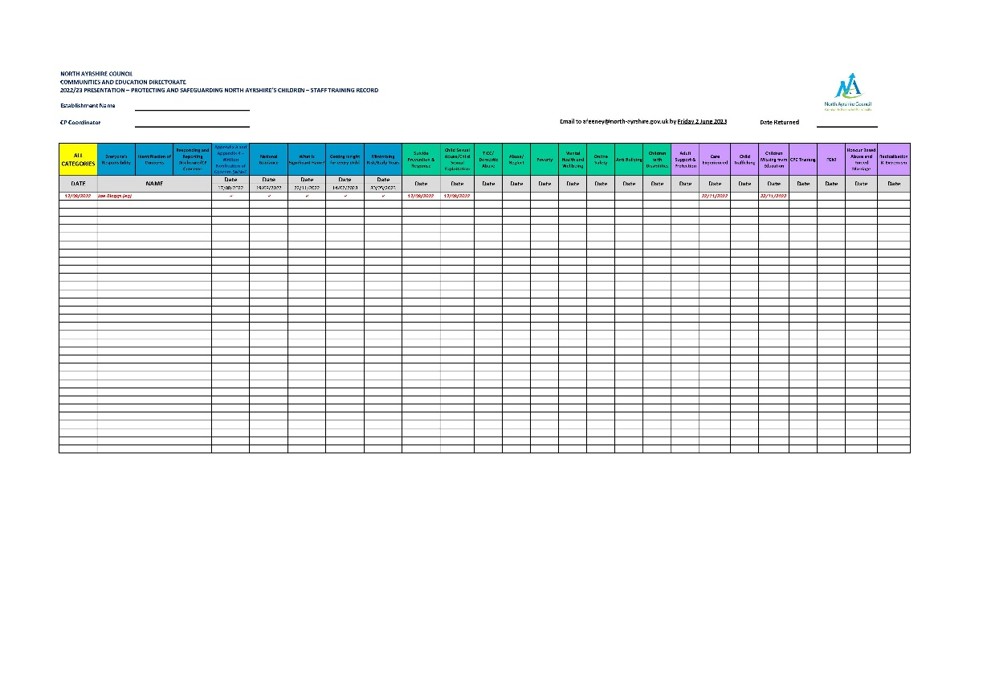

Child Protection Annual Presentation
TO COMPLETE AND RETURN THE TRAINING RECORD

